Slide 1
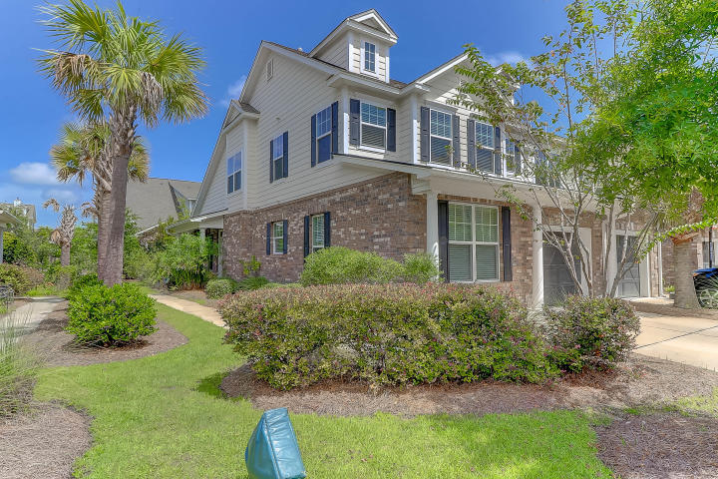
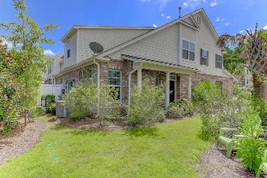
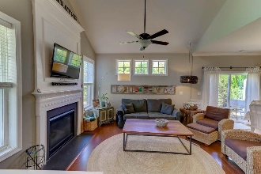
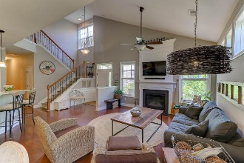
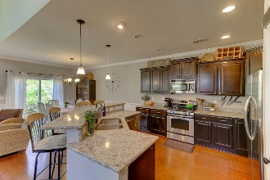
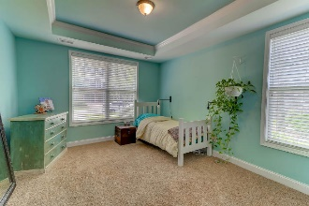
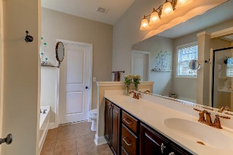
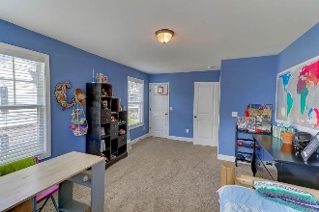
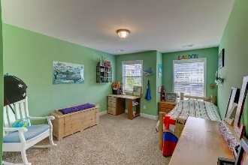


3647 Bagley Drive Preston at Park West · Mt Pleasant MLS# 17022259 · $365,000
New Price!!
Move in Ready
Beautiful Townhome
Master Downstairs
3 bedrooms upstairs with a Office nook
Open Floor Plan with an Island in the Kitchen
Great For Entertaining and Family Gatherings
Walking distance to Great Schools, Pool and Neighborhood Crabbing Dock
$550,000
Nick Collins Office - (843) 266-5000
Mobile - (843) 224-8771
ncollins@carolinaone.com
www.nickacollins.com
Carolina One Real Estate | 2713 Highway 17 North | Mt. Pleasant, SC 29466

