Slide 1
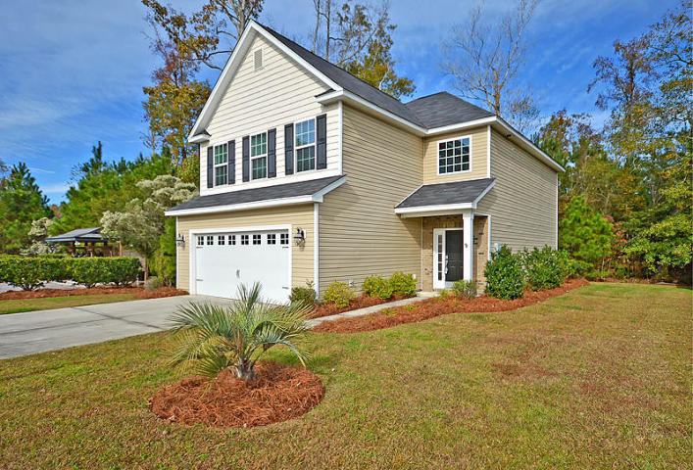
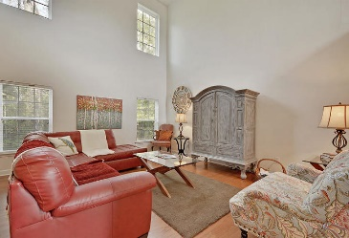
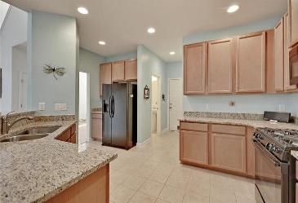
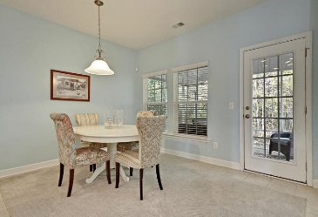
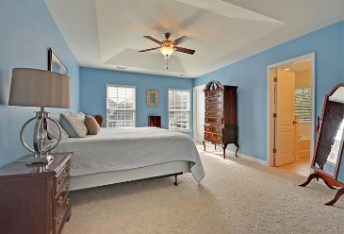
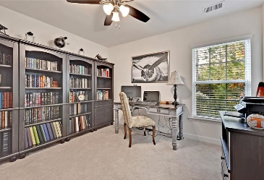
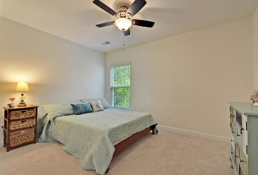
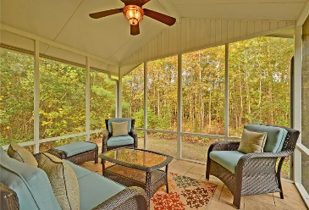
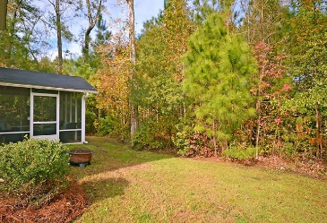

3649 Pimmit Place
Spencer Creek Woods · Ladson, SC 29456
MLS# 18031834 · $235,000
New To The Market
New To The Market
GORGEOUS 3 bedroom 2.5 bath home on AWSOME PRIVATE LOT with great curb appeal! Only one neighbor to your right - woods to the back and left of you! This beautiful home has a wonderful OPEN FLOOR PLAN and features fantastic details, like the two story foyer and family room, with the wall of windows in the family room to allow for an abundance of natural light and view of the woodlands behind you. Handsome hardwood floors from the foyer into the family room and plenty of space for entertaining family and friends. The GOURMET kitchen features beautiful upgraded staggered maple cabinets, lots of granite counter space, a spacious pantry, recessed lighting, a large breakfast bar to accommodate those casual meals and a gas range to make the home chef happy!
The dining room is incredibly spacious and can easily accommodate a large formal dining set. The kitchen and dining room feature tile floors. The dining room opens to the backyard through the screen porch and all that privacy... it feels like you are a million miles away from any neighbors! This home isn't just a pretty face . . . it's incredibly functional as well, with multiple storage closets downstairs, an OVERSIZED LAUNDRY ROOM, a large 2 car garage, and a powder room. Upstairs there are three bedrooms. You will LOVE the SPACIOUS master bedroom-features include a trey ceiling, a HUGE walk-in closet and a spa-like master bathroom with a separate shower with cultured marble surround and glass door, a relaxing soaking tub, and a large dual sink vanity with cultured marble counters. The secondary bedrooms are a generous size and share a second full bathroom. Spencer Creek Woods neighborhood is located right next to Palmetto Commerce Parkway for an easy morning commute, and is near great shops, dining restaurants and local county parks!
Stan Huff
843-670-2835
stan.huff@agentowned.com
Jill Marcacci
843-297-5590
jill@agentowned.com
www.agentownedrealty.com
AgentOwned Realty Co. Preferred Group, Inc. | 824 Johnnie Dodds Blvd | Mt Pleasant, SC 29464

