Slide 1
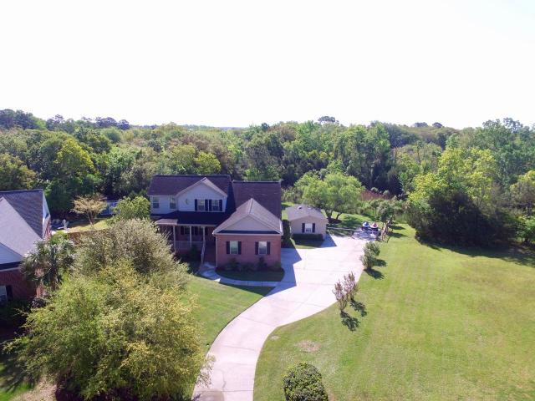
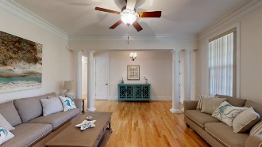
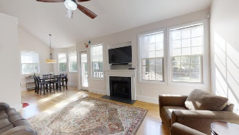
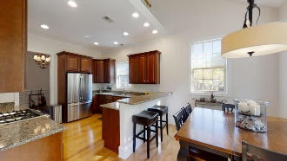
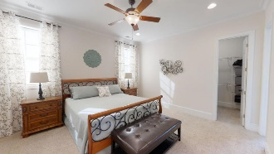
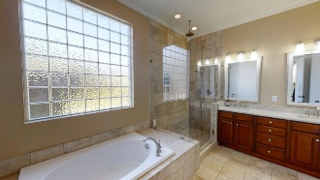
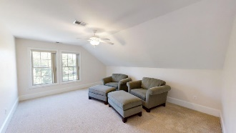
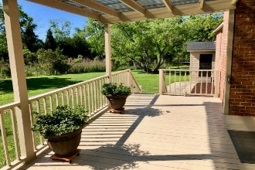
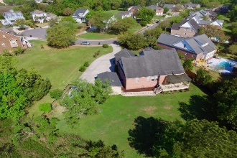
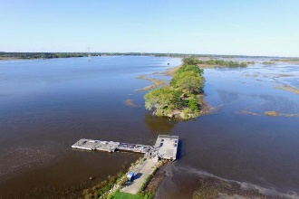


364 Meadow Breeze Lane Sylvan Shores Charleston, SC 29414 MLS# 20009557 $625,000
This beautiful, meticulously maintained home is located on a cul-de-sac in the highly desirable Sylvan Shores neighborhood of West Ashley. Set back on a .6 acre lot & bordered with marsh in the back, you'll enjoy plenty of quiet privacy. You're welcomed by a full brick porch and once inside, you 'll be met with 10' ceilings. beautiful crown molding & lots of natural sunlight. This home has a very comfortable flow. The kitchen & all bathrooms have been remodeled to include beautiful quartz countertops, glass enclosures and travertine tile. Master bedroom is down with a huge walk-in closet and spa-like bathroom. 3 bedrooms or 2+FROG share a Jack-n-Jill bath upstairs. The extended covered deck is perfect for entertaining & enjoying the beautiful back yard, AKA "The Park". An oversized 2 car garage and 16'x24' shed provide ample storage. The neighborhood sports a beautiful bird sanctuary and private boat launch + dock to access the Stono River and Intracoastal waters. Thank you for showing this beautiful home.
Virtual Tour:
https://my.matterport.com/show/?m=tVyyNmvLGhR
Just Listed To $425,000
Meticulously Maintained Home
Cathy Rosenblum
843-817-7869
crosenblum@comcast.net

