Slide 1

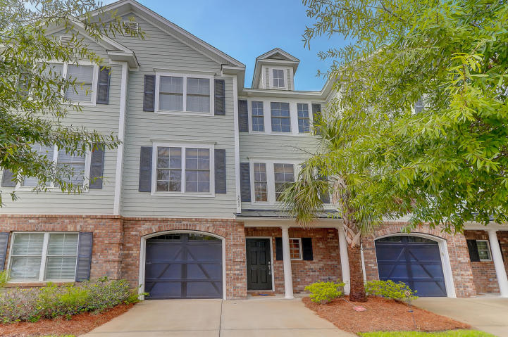
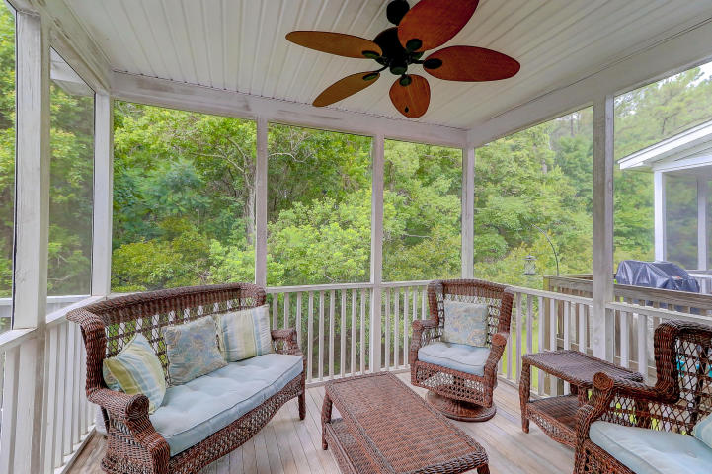
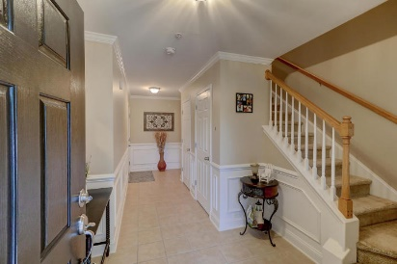
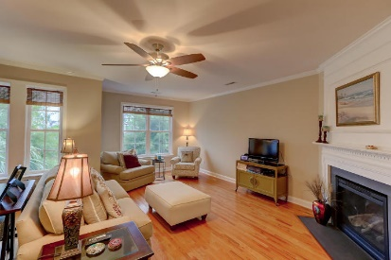
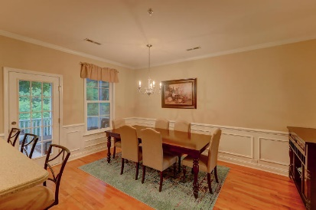
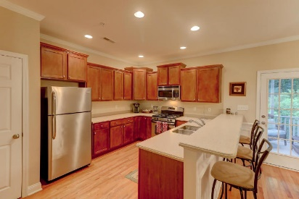
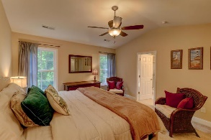
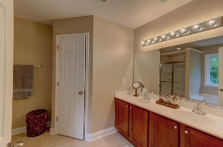
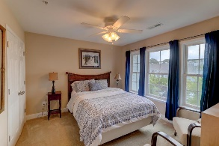
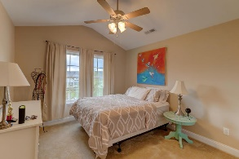
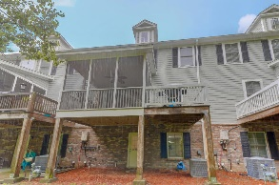
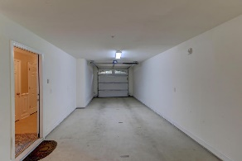
Just Reduced In Park West!!
Low Monthly Regime!
Ken Earnhardt
(843) 343-3872
ken.earnhardt@exprealty.com
www.kensellscharleston.com
3652 Bagley Drive | Park West | Mount Pleasant | MLS# 18019061 | $349,900
Well maintained 3 bedroom, 2.5 full bath townhome in Preston at Park West.
Hardwood floors through out the main family area. The well designed gourmet kitchen features beautiful counter tops, ss appliances and raised bar top.
Off the kitchen is a dining area with access to a deck and screened in porch that overlooks the natural woodlands.
Preston at Park West is next to the amenity pools and tennis courts. Short drive to grocery stores, Oakland shopping center and Laurel Hill Charleston County Park with miles of biking and walking trails.
eXp Realty Charleston · 711 Fairview St · Fountain Inn, SC 29644

