Slide 1

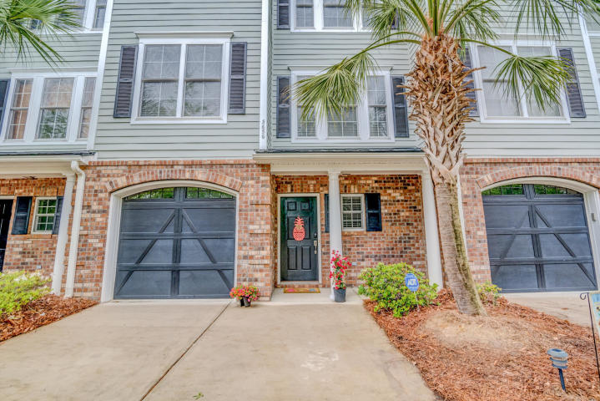
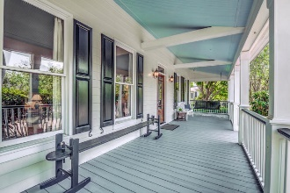
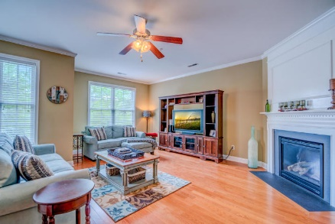
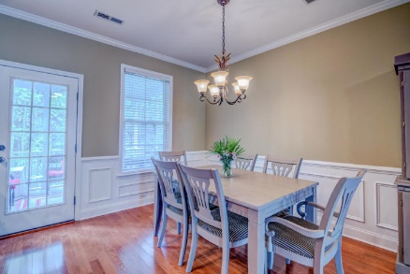
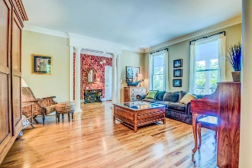
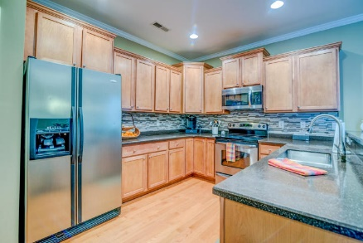
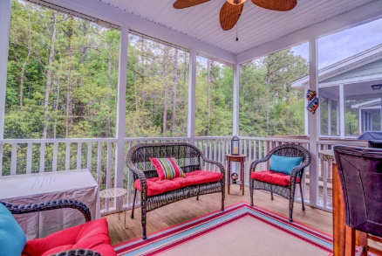
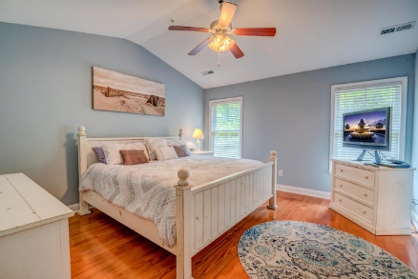
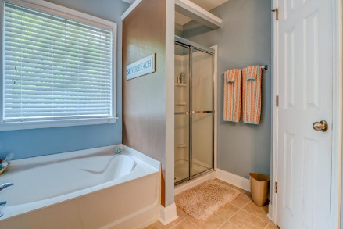
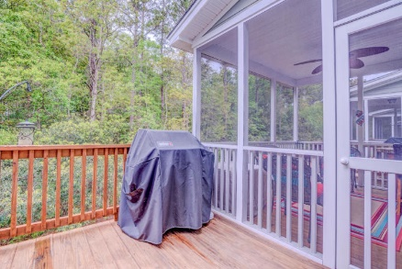
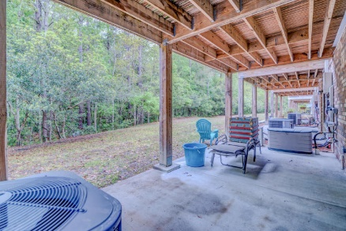
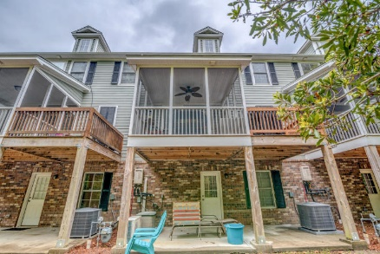
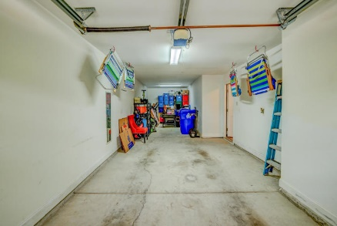


3656 Bagley Drive Park West Mount Pleasant, SC 29466 MLS# 19010895 $354,900
Beautiful Town Home With Desirable 1st Floor Flex-space
In this cozy townhome community, the builder designed plans that are unique, roomy, and offer a bit of a surprise while maintaining classic architectural low country elements. Preston at Park West offers all the comforts of modern living yet nostalgically reminds us of an era where family and community means everything! Set in the heart of the thriving Park West master plan, this Preston townhome offers low maintenance lock and leave living. The landscapers typically show up on Fridays to groom your grounds and all common spaces – press your EASY button! And now for the surprise – LOTS OF STORAGE (THE CLOSETS ARE AMAZING) AND A TWO CAR GARAGE!
Asking $1,200,000
MLS# 17023051
3,692 SqFt
4 Bed/3½ Baths
Short Drive to Historic Downtown Charleston & Beaches
Don Dawson 843-514-0452 ddawson@carolinaone.com Carolina One Real Estate • 2713 Highway 17 North • Mount Pleasant, SC 29466
www.TeamDawsonSC.com

