Slide 1
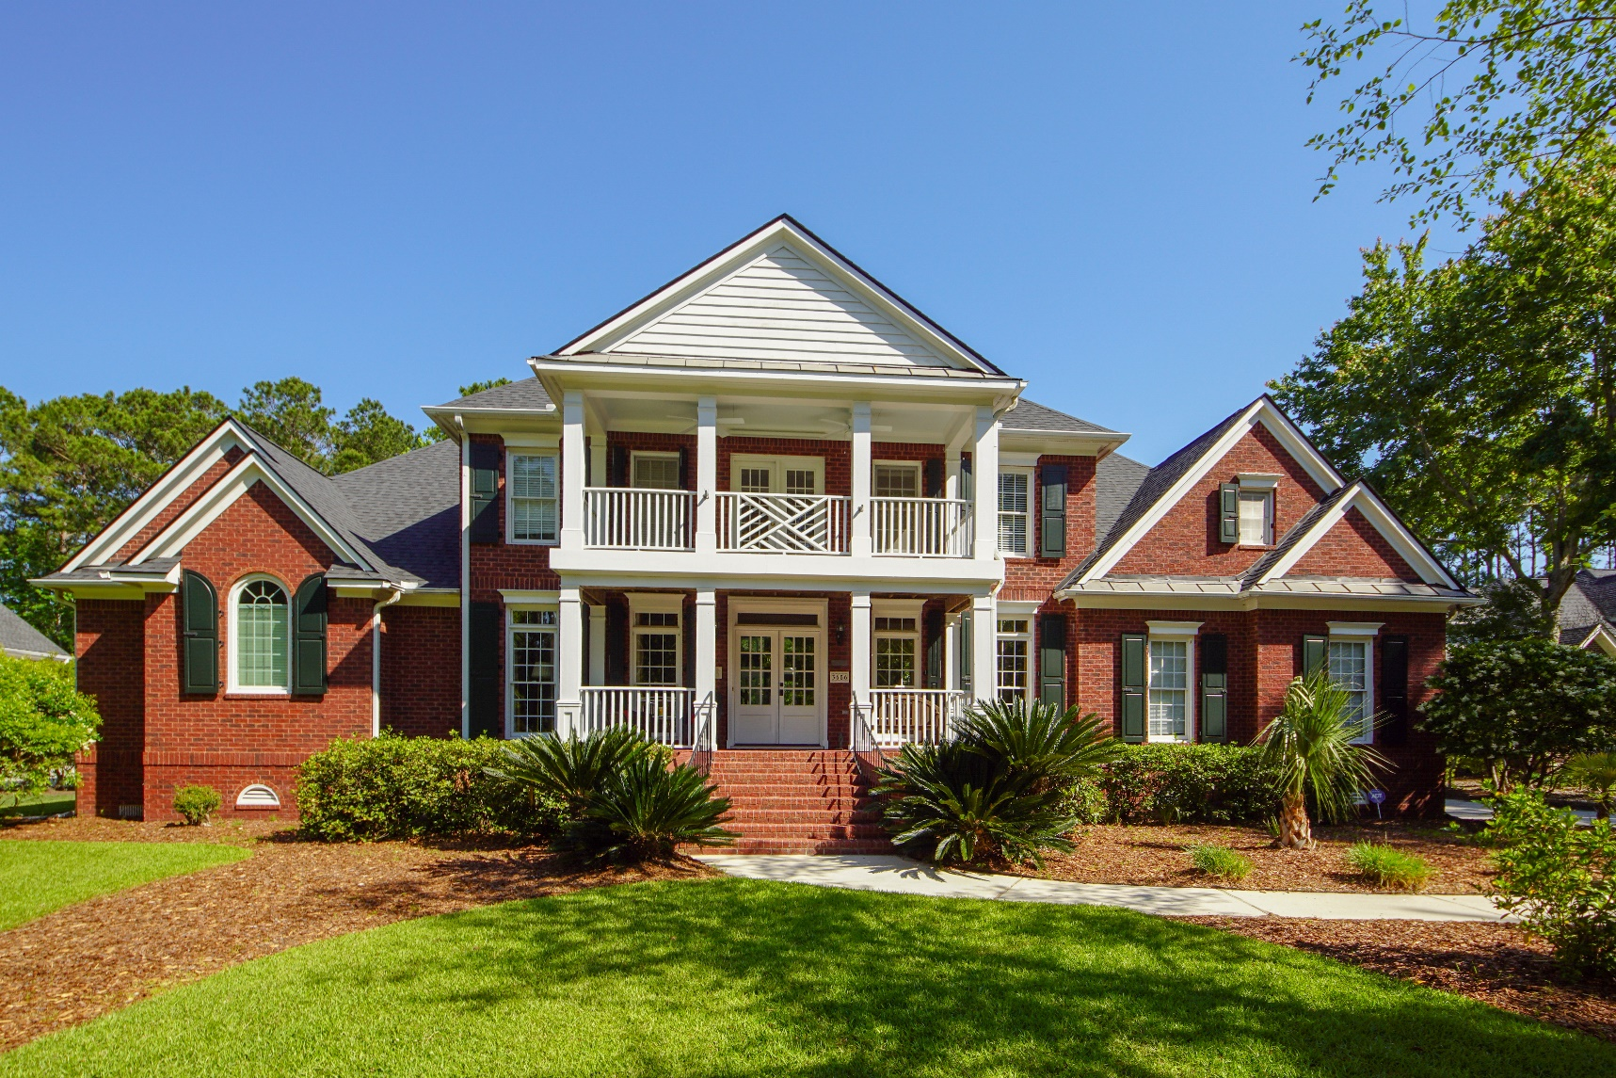
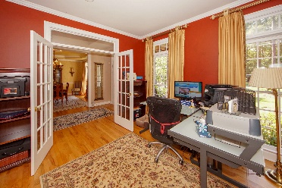
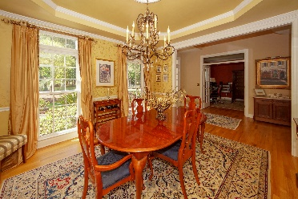
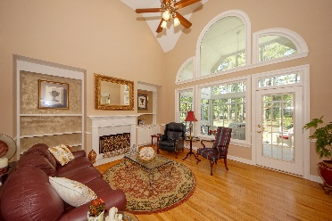
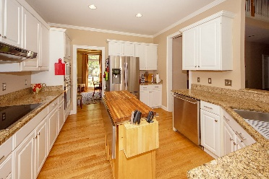
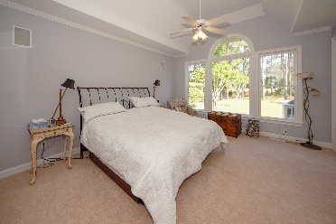
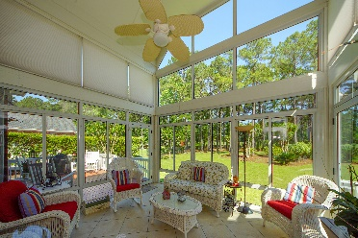
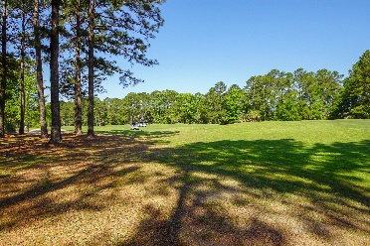


$10,000 Agent Bonus Offered
3656 Colonel Vanderhorst Circle
Dunes West ~ Mount Pleasant
MLS# 19013196 ~ $775,000
$450,000
Beautiful home on the golf course. New roof, updated kitchen with granite counters and stainless appliances, new master bath with dual vanities, 2 walk in closets, encapsulated crawl space with dehumidifier, yard well and irrigation system. Hurricane shutters for all windows. Open design with large kitchen and great room. Eat in kitchen with bay window overlooking back yard. Separate dining room and office/den. Master bedroom on first floor with sitting area, gas fireplace and tray ceiling. Fireplace in great room. Large FROG with walk in storage attic. Large sun porch with decks off each side. 2 car garage and beautifully landscaped lawn. Gated community. Perfect home for entertaining and lots of natural light. Enjoy all that Dunes West has to offer.
Peggy Reese
E-PRO, GRI
phreese@bellsouth.net Mobile (843) 693-2050
Real Estate ● Mortgage ● Insurance ● Business Brokerage

