Slide 1
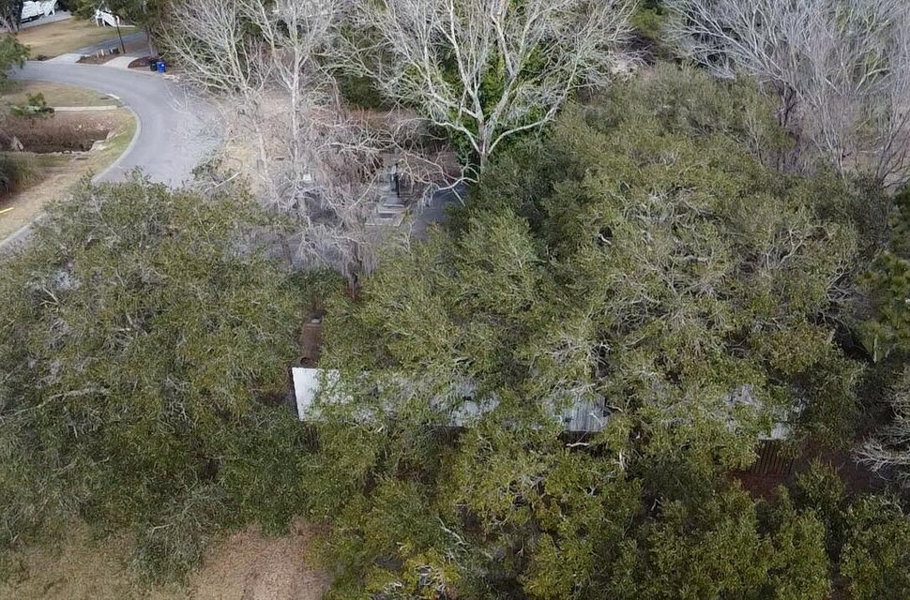
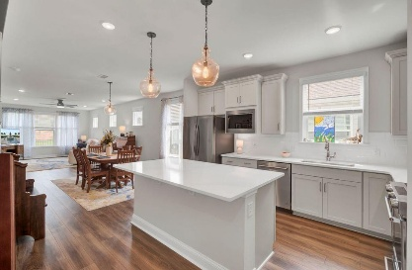
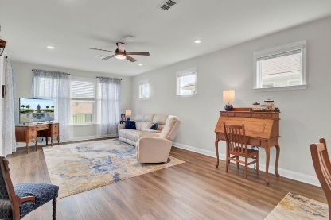
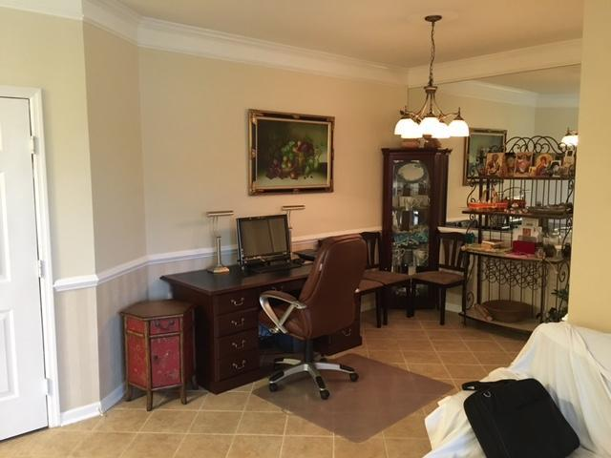
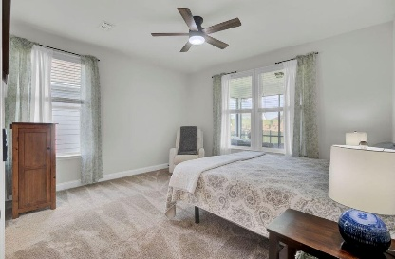
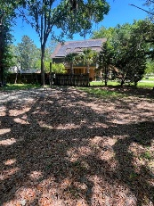
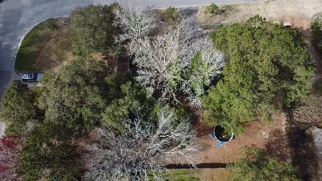
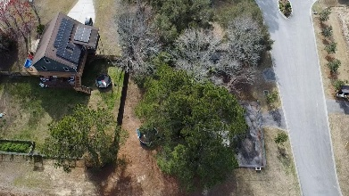
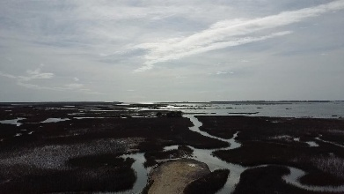
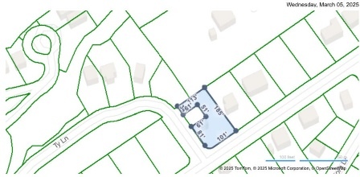
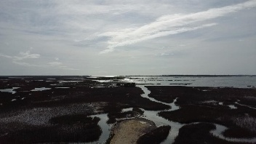



Vacant Lot In Mt. Pleasant | Utilities Already Run No HOA - Voluntary Fee To Use Boat Ramp
3658 Zacoma Drive
Copahee View | Mount Pleasant, SC 29466 | MLS# 25005736 | $299,000
Opportunity to build in the last frontier of Mount Pleasant, decidedly not "cookie cutter" where you can still park your boat, RV, build a modular home, drop a modular home or erect a custom million dollar plus property of which there are many. A neighborhood without mandatory HOA but for a modest annual fee of $60 you may have access to neighborhood boat landing to launch your watercraft of just golf cart down to marvel at the sunset. Trailer has been removed and lot cleared of debris. There is a partial driveway. Perfect spot cleared for a Charleston Single style home. Lot has public water/sewer and electric run to lot.
Jenn Gallagher
843-327-2053
jenn.gallagher@cbrealty.com
Visit My Website
Coldwell Banker Realty
55 Broad St
Charleston, SC 29401

