Slide 1
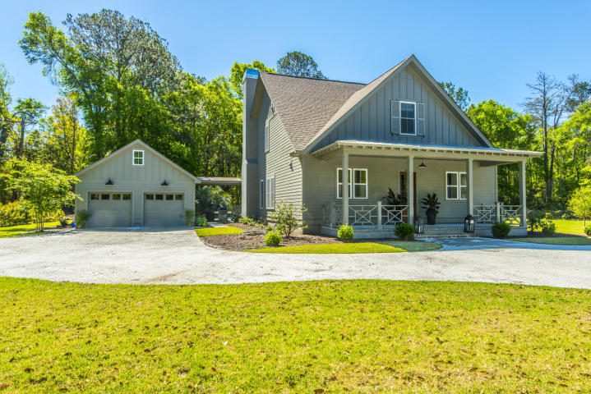
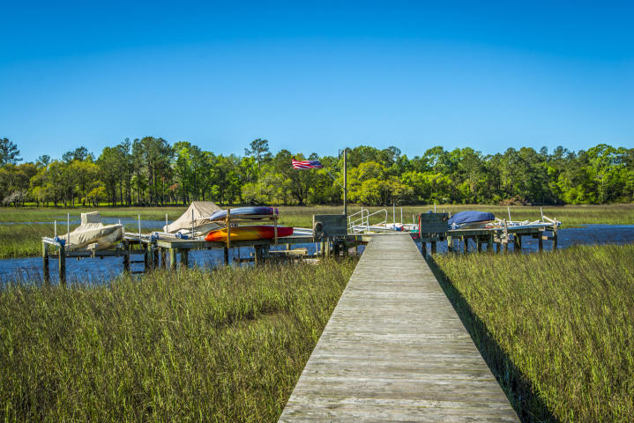
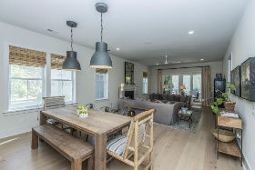
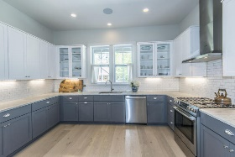
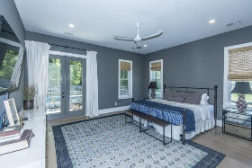
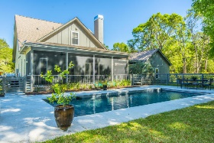
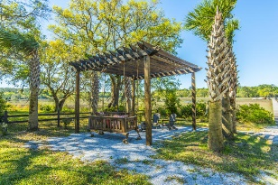


4 bed, 3.5 bath
Private Boatlift
Broker Open House
Friday May 26 10:00 am - 12:00 pm
Refreshments and Cash Drawing
3659 Edings Court
Bohicket Oaks | Johns Island, SC 29455 | MLS# 17010106 | $675,000
4 bedrooms
3 ½ baths
2,877 sqft
1.05 acre lot
Built in 2015
Private and gated, "Bohicket Oaks" features only 6 property owners.
Each property includes a private boat lift & shared dock with floater.
Only 5 minutes to Maybank off Bohicket Road.
Truly something special, nothing else like this home on the market!
Crissy Rowell
Mobile - (843) 377-5177
crissy.rowell@carolinaone.com
www.crissyrowell.com
Carolina One Real Estate | 195 W Coleman Blvd | Mt Pleasant, SC 29464

