Slide 1
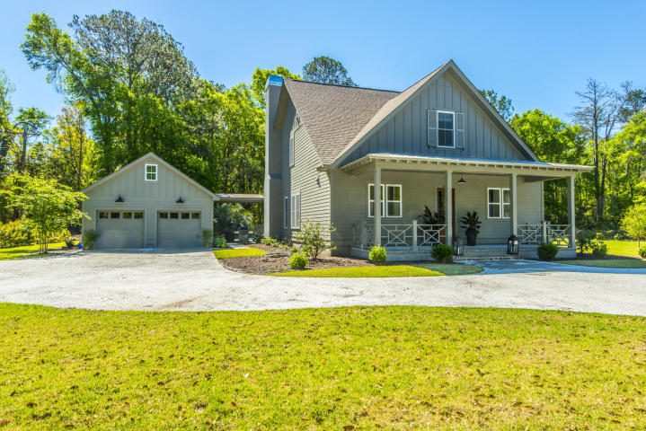
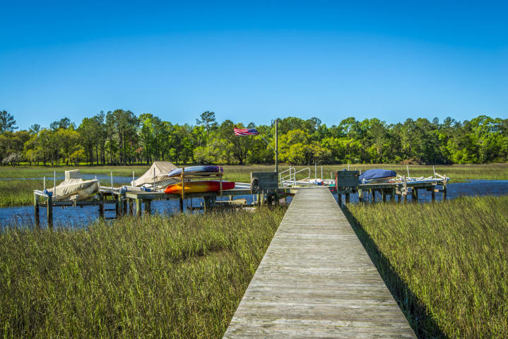
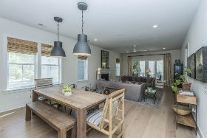
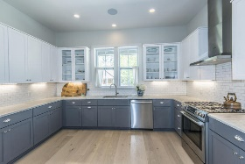
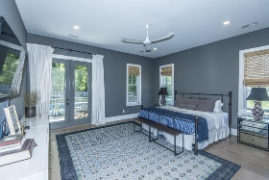
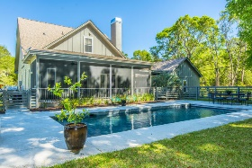
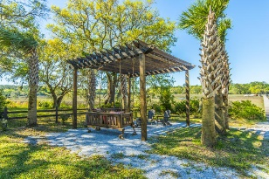


4 bed, 3.5 bath
Private Boatlift
3659 Edings Court
Bohicket Oaks | Johns Island, SC 29455 | MLS# 17010106 | $675,000
Lowcountry living at it’s finest; you have finally found your “some place special” on John’s Island. This “like new” 4 bedroom, 3.5 bath home was built in 2015, featuring nearly 2700sqft and located on a gorgeous 1 .05 acre lot inside the private gated community of Bohicket Oaks. Just minutes from Maybank Hwy, the neighborhood boasts a shared 500 ft community dock with a floater and each of the 6 property owners has their own private boat lift. For your growing family or a relaxing retirement, enjoy Hoopstick Creek for stunning views, boating, SUP, fishing and crabbing. No detail was missed on the construction of this home. An oversized driveway and huge front porch welcome you. Enter the home into beautiful foyer, and notice the private office on your right, this space would also make for a lovely sitting room or library. Continue past the office and you will immediately be impressed with the wide open floor plan. A huge chefs kitchen boasts stainless steel appliances eStar including gas range and vent hood, Carrera marble counter-tops, custom cabinets and classic white subway tiles. The kitchen opens up to spacious dining and living rooms, notice special features like custom light fixtures, 5" hard scraped floors, custom contrast paint colors on walls, cabinets and doors. The oversized living room features a gas log fireplace and stunning view of your extra large screened back porch, 1 acre lot and gorgeous pool. The master bedroom, master bath, powder room, walk in closets and laundry room are all also located on the first floor. Downstairs master bedroom features private access to the fully screened back porch and pool. Master bathroom features stunning black granite counter-tops, dual vanities, large glass front shower with floor to ceiling tiles, incredible master closet. The second floor includes a large family room in the upstairs landing which makes for an awesome getaway for the kids, three more excellent sized bedrooms and 2 full baths. Notice hardwood flooring throughout both stories in every bedroom/living space. Special highlights: custom pool cover operated by electronic keypad, Rinnai tankless water heater, 2 car detached garage with easy access via breezeway, cement drive with parking for multiple vehicles and custom cement pathways, fully fenced back yard for privacy and security, fiber cement siding, 30 year architectural shingles, gated community with private code for entry, ceramic tiled floors in bathrooms and laundry, the list goes on. All just minutes from Maybank Highway for your convenience and quick access to downtown Charleston. Don't miss this unique opportunity to have it all on John's Island!
Crissy Rowell
Mobile - (843) 377-5177
crissy.rowell@carolinaone.com
www.crissyrowell.com
Carolina One Real Estate | 195 W Coleman Blvd | Mt Pleasant, SC 29464

