Slide 1
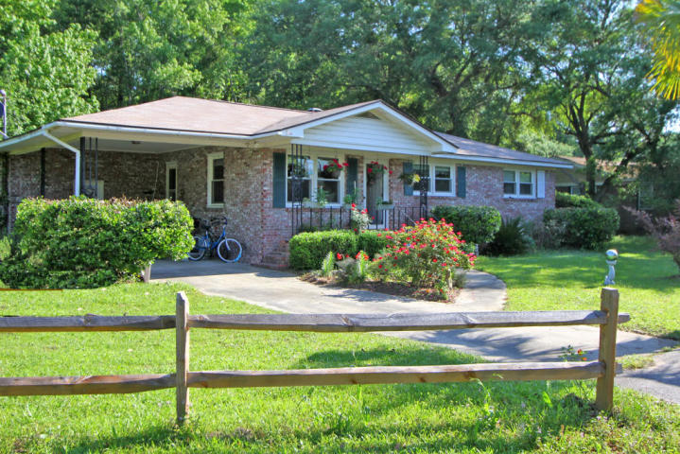
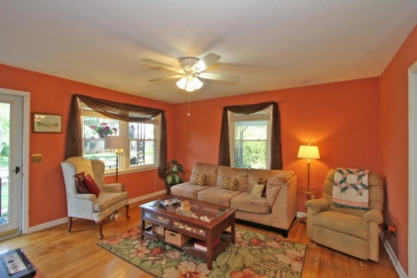
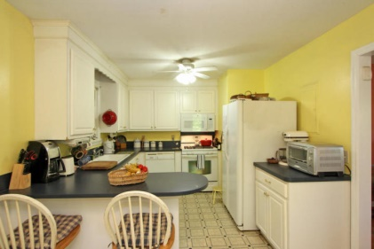
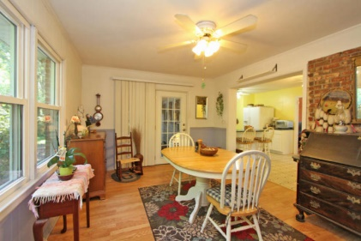
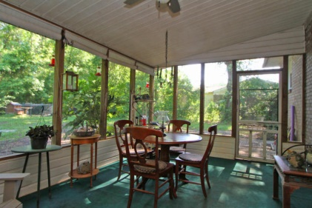
OPEN HOUSE 3662 Moonglow Dr. John's Island (Near Limehouse Bridge) 12:00 - 2:00pm Thursday 6/ 11/15
Serving: Norm's Hickory Smoked Vinegar Ham Sandwiches
Mac & Cheese
Cold Fresh Fruit
Chilled water
3/2 with wood floors and an open floor plan. Nice, private wooded lot. Please come tour, offered at $225,000.
Norm Cooper
Dunes Properties
843-460-0319
ncooper@dunesproperties.com

