Slide 1
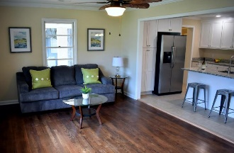
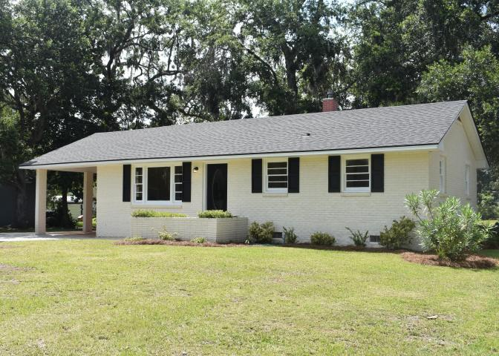
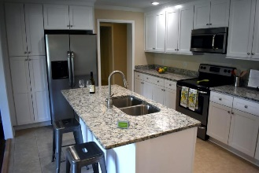
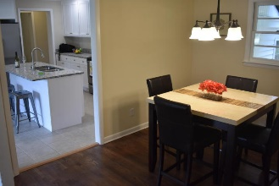
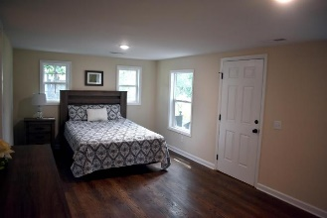
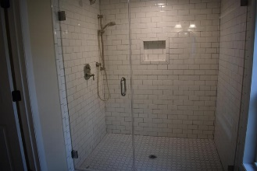
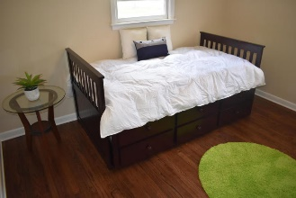
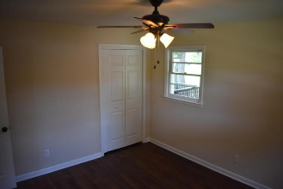
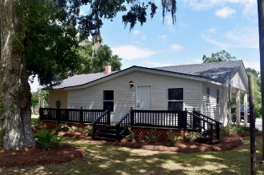

3666 Tower Drive
Whitehall Terrace | Mount Pleasant, SC 29466
MLS# 17018794 | $305,000
The Only Deep Water Home On Daniel Island
Huge Price Reduction!
Won't last long!!
Can't beat this price!!
Completely updated ranch in N Mt Pleasant! This lovely 3bedroom/2bath home is move in ready! Roof was replaced this year. Master suite with private bath. New hardwoods throughout. Bathrooms have granite vanities and tile floors. Kitchen has a nice island, granite countertops and brand new stainless steel appliances. Smooth ceilings.
Huge back yard for entertaining! Outdoor shed for additional storage. Carport and side street parking. Lockbox. If square footage is important to you, please verify and measure.
Kimberly Imbus
(843) 494-7977
kimberly.imbus@carolinaone.com
Carolina One Real Estate
628 Long Point Rd.
Mt Pleasant, SC 29464-3032
www.summervillesouthcarolinahomes.com

