Slide 1
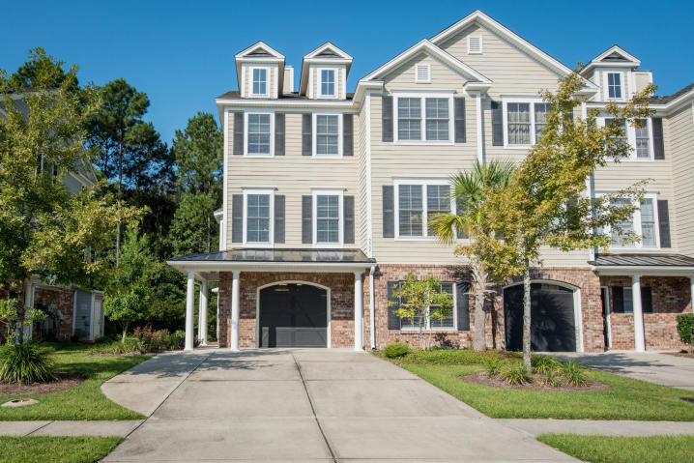

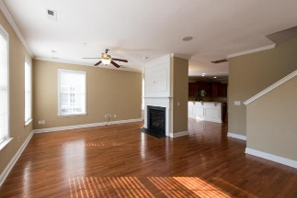
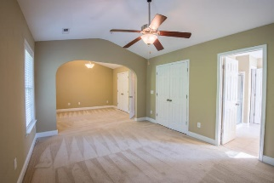
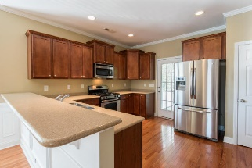
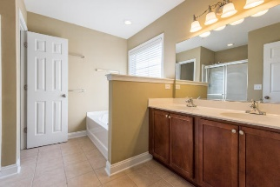
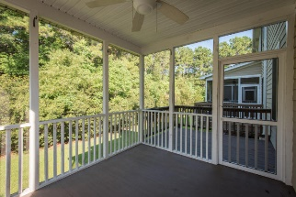
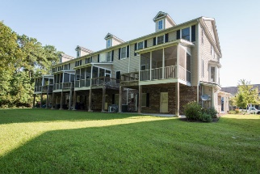


Just Reduced to $365,000!
Virtual Tour Available at
https://www.youtube.com/watch?v=B-ZMWzHEJu0&feature=youtu.be
3668 Bagley Drive
Park West ~ Mount Pleasant ~ MLS# 16023834 ~ $365,000
Beautiful, luxury end unit townhome with many upgrades. Located in the desirable Preston section of Park West, this large 4 bed / 3 bath home boasts over 2600 square ft and lots of storage. Large ceramic tile foyer on the first level with wainscoting and two storage closets. This level also offers a finished flex room with recessed lighting, ceiling fan and its own heating & air unit. This can be a great study, workout room or playroom for the kids. The second floor has an open living area with hardwood floors, a large family room that includes a gas fireplace, a spacious dining area with a bay window and wainscoting, and a beautiful kitchen with stainless appliances (that includes the refrigerator) and gas cooking. There is also a nice size pantry. Conveniently located off the kitchen is the screened porch and deck overlooking the wooded area out back. Also on the second floor is a bedroom with access to a full bath. The large master suite is located on the third floor. It not only has two spacious closets but also a sitting room. The master bath has a soaking tub along with a separate shower. There are also two additional large bedrooms on this floor that share a hall bath. The laundry area is also on this level. Other features are wood blinds throughout and a tankless water heater. Out back off the garage is a nice covered patio area as well.This home shows great and can close quickly. There are also many conveniences nearby to include pools, tennis courts, clubhouse, shopping, dining , schools, ballfields and track (Town of Mount Pleasant), and a short drive to the beaches or Charleston.
Bill Barnhill
843-364-6903
bill@billbarnhill.com
496 Bramson Ct., Suite 200
Mount Pleasant, SC 29464

