Slide 1
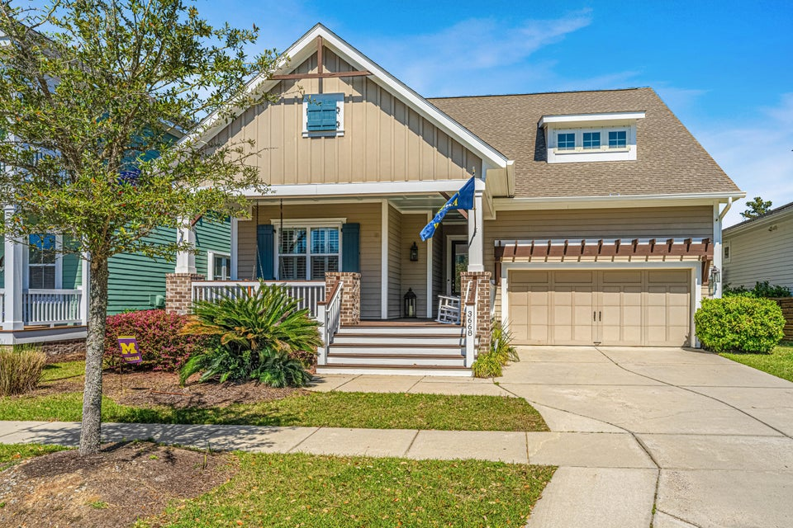
Move-In Ready Immaculate One Owner Home
3668 Maidstone Drive
Carolina Park | Mount Pleasant, SC 29466 | MLS# 25007199 | $975,000
Total privacy looking out back of house with pond setting and protected wetlands beyond. Easy to install hurricane shutters for all windows. Whole house generator conveys as does Family Room and Office televisions.
Easy to show with only 1 hour notice through Showing Time.
Bob & Shari Alford
843-442-9215
bob@bobalford.com
www.bobalford.com
Carolina One Real Estate
195 W Coleman Blvd
Mt Pleasant, SC 29464-3495

