Slide 1
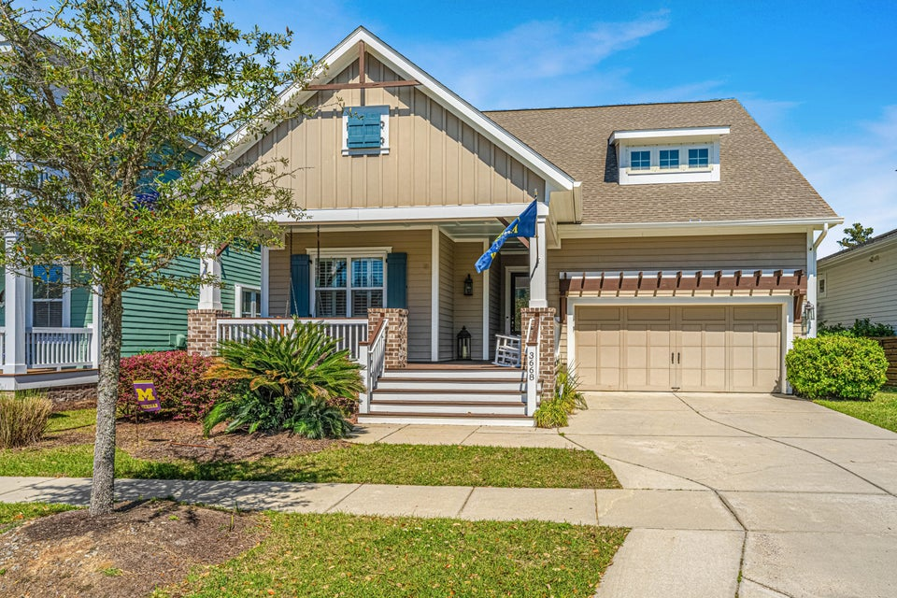
Price Just Improved
3668 Maidstone Drive
Carolina Park | Mount Pleasant, SC 29466 | MLS# 25007199 | $960,000
This beautiful home offers total privacy looking out back of house. No other structure can be seen when viewing scenic pond and protected wetlands beyond. Move in ready with spacious open kitchen, dining area and family room with gas log fireplace. Fully equipped kitchen features stainless steel refrigerator; gas cook top and large center island. Primary bedroom is downstairs with large walk-in closet and primary bath features a large walk-in shower. Screen porch overlooks fenced back yard, pond and protected wetlands beyond. Two secondary bedrooms, an office and second full bath complete downstairs. Upstairs is a huge bonus/4th bedroom with third full bath. Whole house generator conveys as do family room and office televisions. Easy to install hurricane shutters for all windows.
Bob & Shari Alford
843-442-9215
bob@bobalford.com
www.bobalford.com
Carolina One Real Estate
492 Rice Hope Drive
Mt. Pleasant, SC 29464

