Slide 1
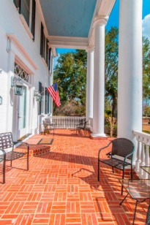
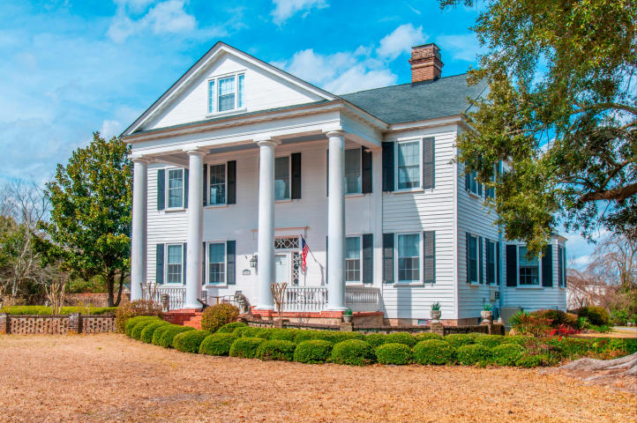
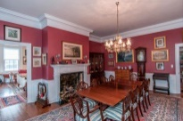
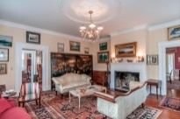
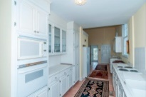
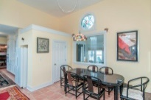
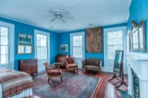
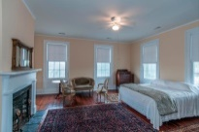
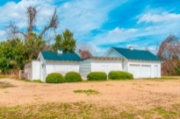
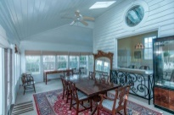
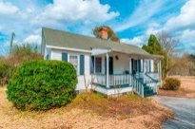
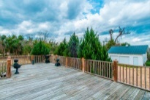
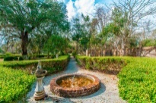
Open House Sunday August 23 from 3-5
366 Avenue Of Oaks
Gippy Plantation
Moncks Corner
MLS# 15005548
$1,400,000
The Gippy Plantation home built in 1852 has a fabulous history to tell. This Antebellum home is in the process of being put on the National Historic Registry. It has bedrooms measuring 25' x 25'. the ''Lords of the Discipline'' had parts of the movie filmed here. It has been beautifully restored. The guest cottage in the rear is restored and 861 SF. It's a great place for guests or your mother-in-law.
BJ Rodgers 843-697-1409 bj.rodgers@carolinaone.com Carolina One Real Estate

