Slide 1
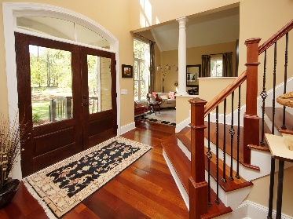
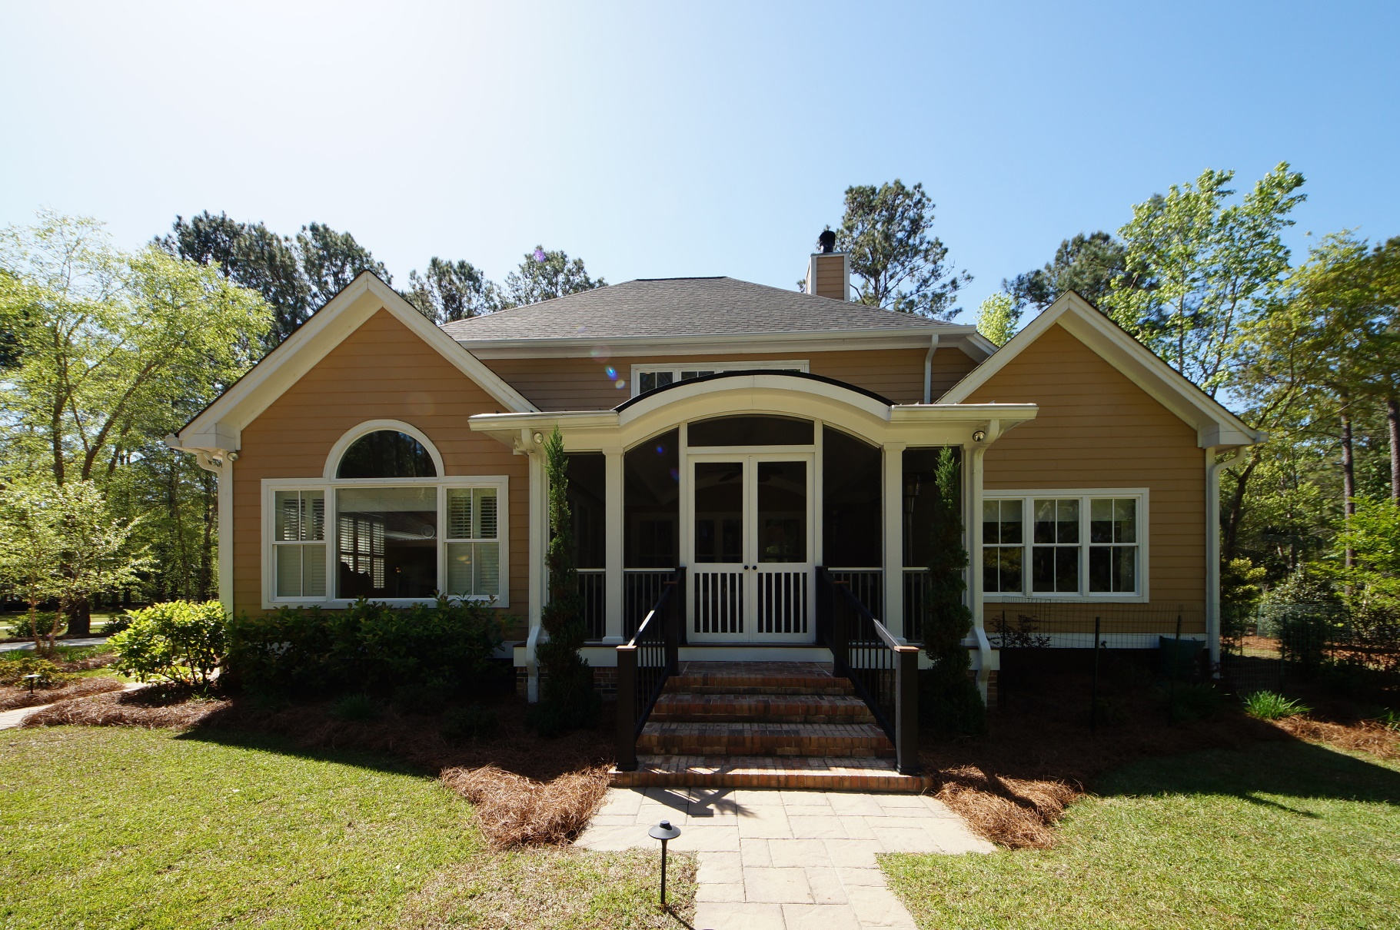
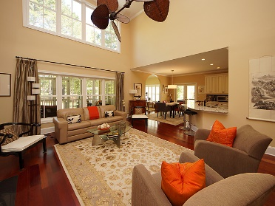
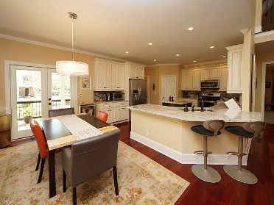
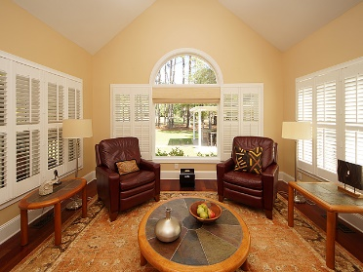
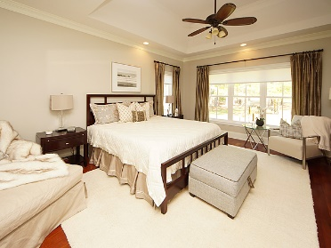
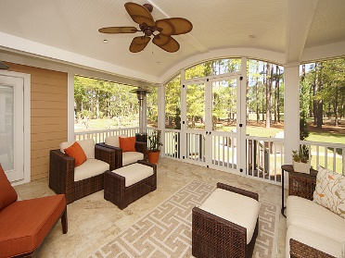
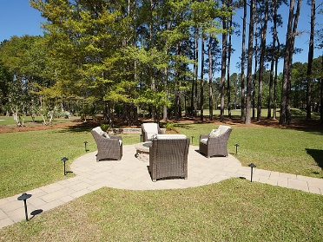


Dunes West Executive Home Reduced $100,00
3672 Colonel Vanderhorst Circle
Dunes West ~ Mount Pleasant
MLS# 18010624 ~ $779,000
$450,000
Gated community Complete renovation. Master down. Other bdrms upstairs w/ large media room. Open kitchen, attached 3 car garage with 2 bays and lots of storage. Detached 800 sq.ft. bldg with plumbing, heat/air. Could be used as art studio, shop, garage., mother-in-law suite. Following items all NEW--siding,roof,3 HVAC units, tankless water heater, windows, Brazilian cherry floors, appliances. Tiled screen porch, covered front porch with new composite decking & railing, new poured concrete driveway, new pavers. Yard irrigation system with well, outdoor lighting on timer. Great flow for entertaining. On golf course so no house behind. Outdoor kitchen, Firepit, Immaculate.
Easy to show. Move in ready with no work needed. The perfect place to call home. Enjoy all Dunes West offers. This beautiful home overlooks the golf course designed by Arthur Hill. The community has walking and biking paths throughout. The amenities include clubhouse, golf course, exercise room, water park, tennis courts and beautiful landscaping. The acre lots provide one of the most distinguished neighborhoods in the area with excellent schools. Memberships can be purchased for activities of interest to the owners. The neighborhood is a very private enclave with lots of activities and shopping areas nearby. Just 18 miles to downtown Charleston and minutes to the beaches.
Peggy Reese
E-PRO, GRI
phreese@bellsouth.net Mobile (843) 693-2050
Real Estate ● Mortgage ● Insurance ● Business Brokerage

