Slide 1
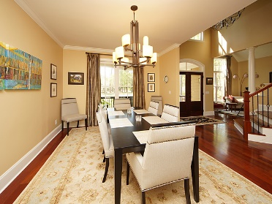
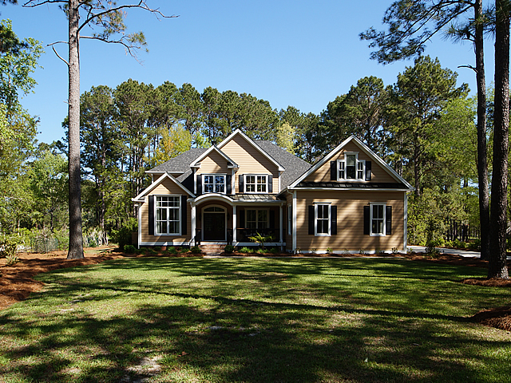
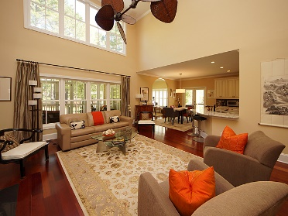
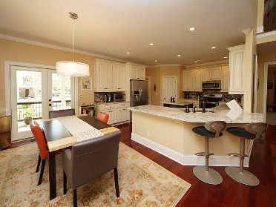
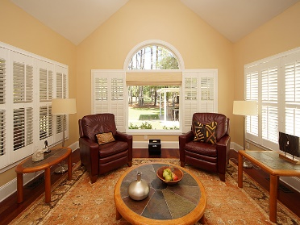
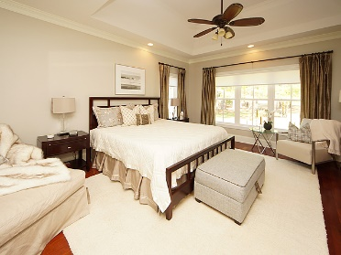
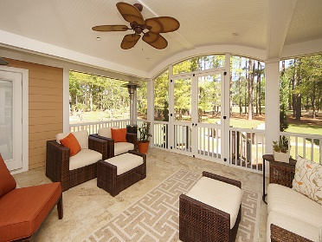
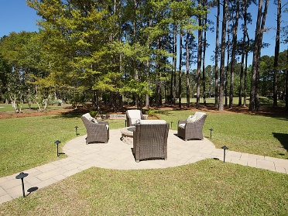


Executive Home in Gated Golf Course Community
3672 Colonel Vanderhorst Circle
Dunes West ~ Mount Pleasant
MLS# 18010624 ~ $925,000
$450,000
Immaculate home in gated community was completely rebuilt/redesigned in 2013. Everything is new and in perfect shape. Master down. Open gourmet kitchen, 3 car garage with 2 bays and lots of storage, media room with wet bar, detached 800 sq. ft. heated building with half bath, used as a shop could be mother-in-law suite, pool house. Outdoor kitchen with pergola w/motorized louvers, fire pit. Following items all NEW--siding, roof, 3 HVAC units, tankless water heater, windows, drywall, Brazilian cherry floors, all appliances, bathrooms. Tiled screen porch, covered front porch with new composite decking & railing, new poured concrete driveway, new paver walkways, Yard irrigation system with well and outdoor lighting on timer. This house is better than new. The new owners have nothing to do, but move in and enjoy!
Peggy Reese
E-PRO, GRI
phreese@bellsouth.net Mobile (843) 693-2050
Real Estate ● Mortgage ● Insurance ● Business Brokerage

