Slide 1
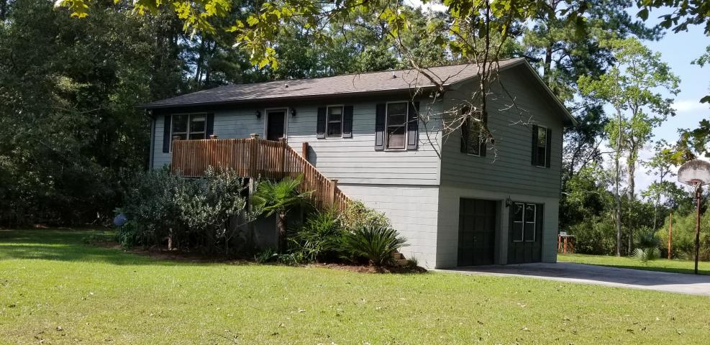
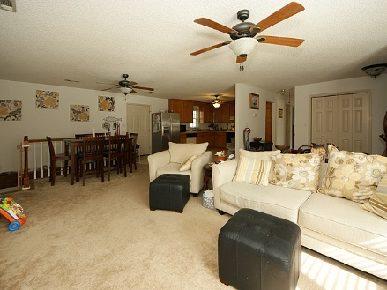
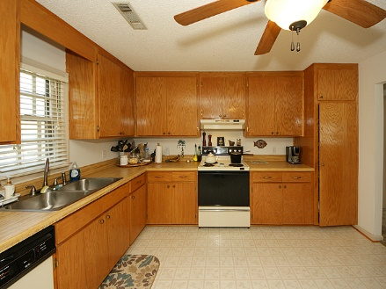
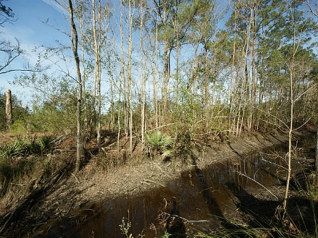


367 Backfield Road Backfield :: Walterboro, SC 29488 MLS# 18025728 :: $205,000 4 Bed / 2 Bath
2.67 Acres!
Prettiest home in Walterboro!
This two story home features open floor plan with 4 bedrooms and 2 bathrooms. Sellers have created two living spaces by remodeling first floor. First floor has laundry room, full bathroom, bedroom and living room/bedroom option with closet. Second main floor has kitchen, dining, large family room, 2 bedrooms and a full bathroom. This floor plan is perfect for blended families, mother in law suite, office or man cave. Front and back deck/stairs have been replaced within the past year. This home sits on a private lot with access to Chessy Creek and Chessy Creek runs into the Ashepoo River. Rice fields are located behind the house to maintain privacy. Sellers are motivated!
Connie White, Broker
843-532-3356
connie@chrepros.com · conniewhiterealestate.com
Charleston Homes · 597 Old Mt. Holly Road · Suite 301 · Goose Creek, SC 29445

