Slide 1
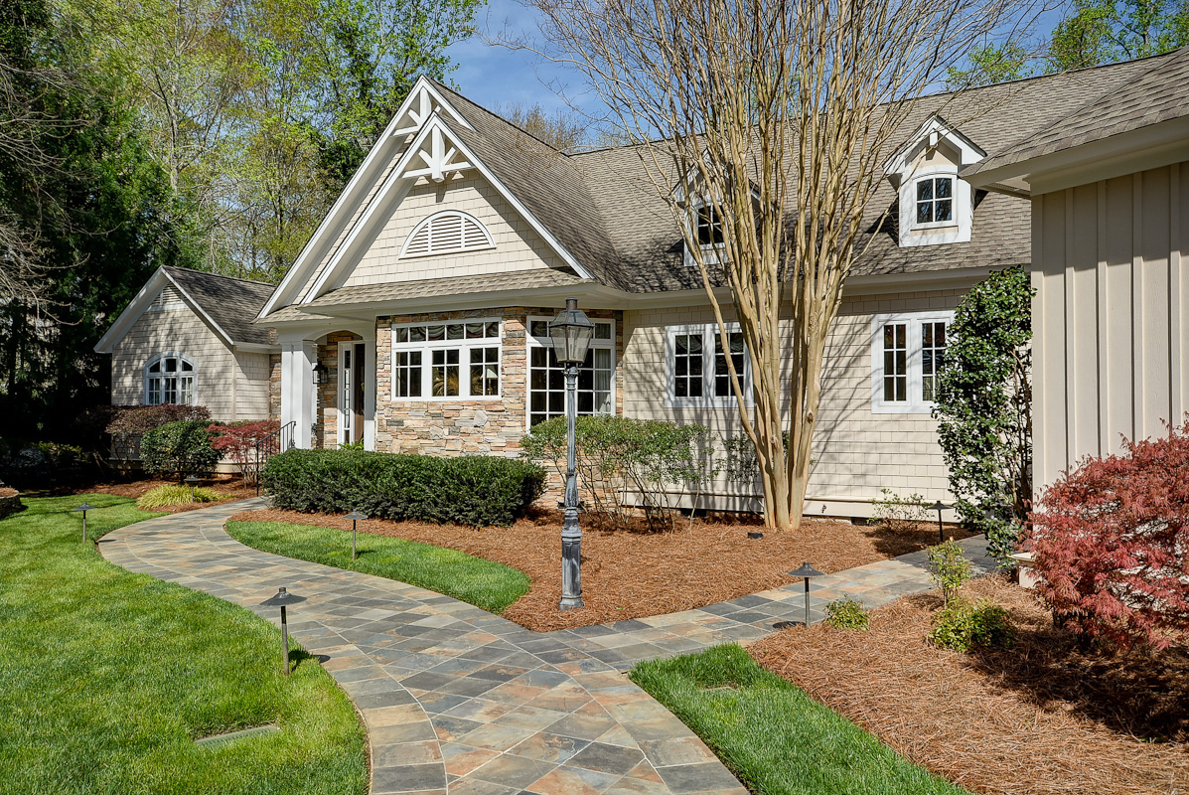
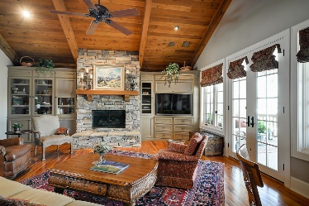
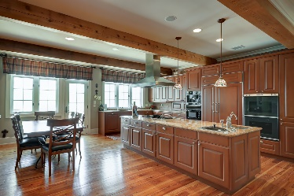
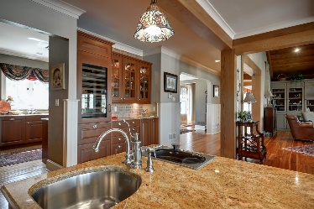
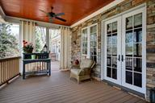
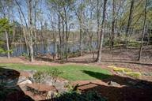
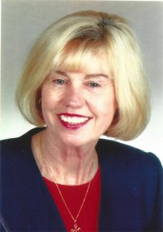

Carolina Country Club, 367 Twin Oaks Drive, Spartanburg, SC
Open House
April 16th ~ 1-5pm
Carolina Country Club, 367 Twin Oaks Drive, Spartanburg, SC
If these walls could talk! They would tell you of this truly spectacular showplace with unsurpassed quality and detail. The house was built for gatherings and fundraisers alike, and is located in a private gated golf course community. The main floor which is completely handicap accessible includes a mother-in-law suite. I-26 is only 5 miles away which means easy access for the commuter. Older children will appreciate having their own space in the downstairs living and recreation area. Enjoy evenings sitting outside on the porch while feeling like you are up in a tree house. You will be surrounded by the beautiful natural setting with fabulous sunsets streaming over the lake. Go to realtysc.com MLS 234060 to view pictures and more detail.
MLS# 234060
$949,000
Peggy Wilson
Realtor, Broker, GRI, ABR
864-415-3958
peggy@realtysc.com
www.realtysc.com

