Slide 1
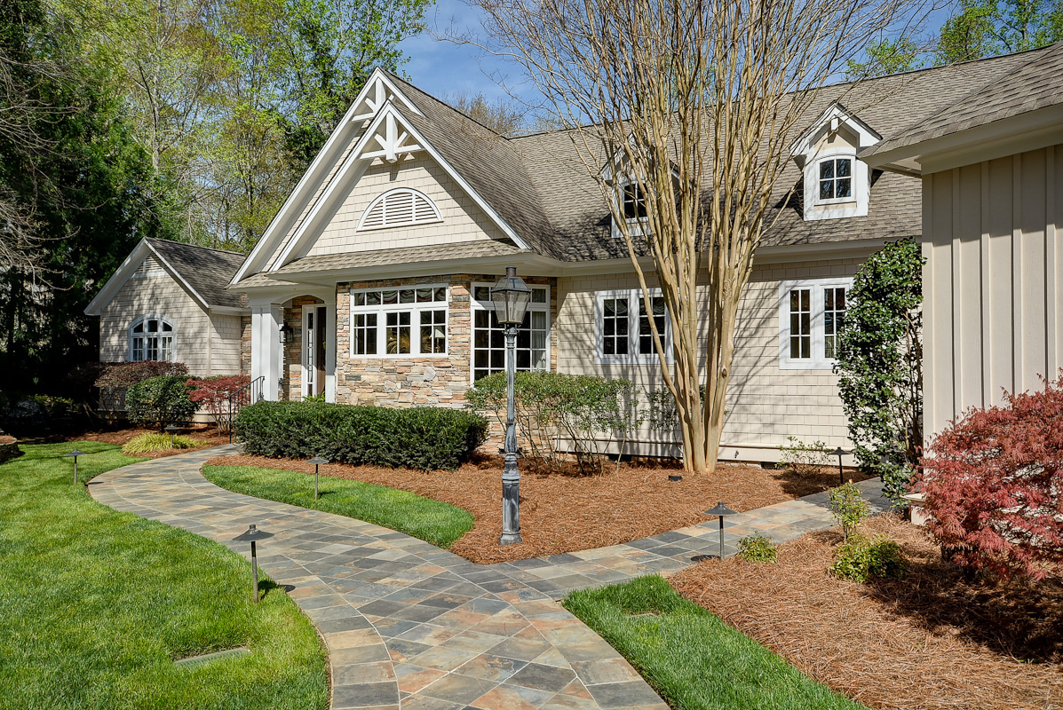
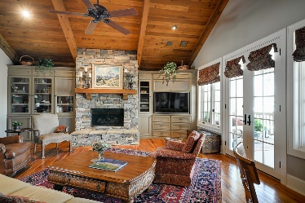
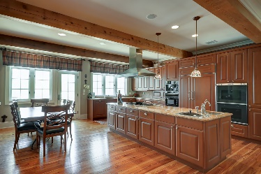
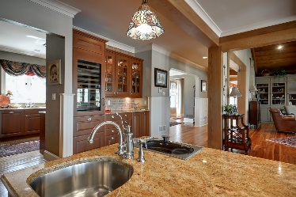
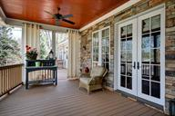
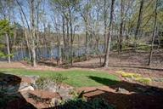


Carolina Country Club, 367 Twin Oaks Drive, Spartanburg, SC
Price
Reduced!
Carolina Country Club, 367 Twin Oaks Drive, Spartanburg, SC
This house was designed and built with unsurpassed quality and detail. A truly spectacular showplace for many gatherings and fund raisers alike, and is located in a private golf course community. The main floor which is completely handicap accessible includes a mother-in-law suite. I-26 is only 5 miles away which means easy access for the commuter. Older children will appreciate having their own space in the downstairs living and recreation area. Enjoy evenings sitting outside on the porch while feeling like you are up in a tree house. You will be surrounded by the beautiful natural setting with fabulous sunsets streaming over the lake. Go to realtysc.com MLS 234060 to view pictures and more detail.
MLS# 234060
$899,900
Peggy Wilson
Realtor, Broker, GRI, ABR
864-415-3958
peggy@realtysc.com
www.realtysc.com

