Slide 1
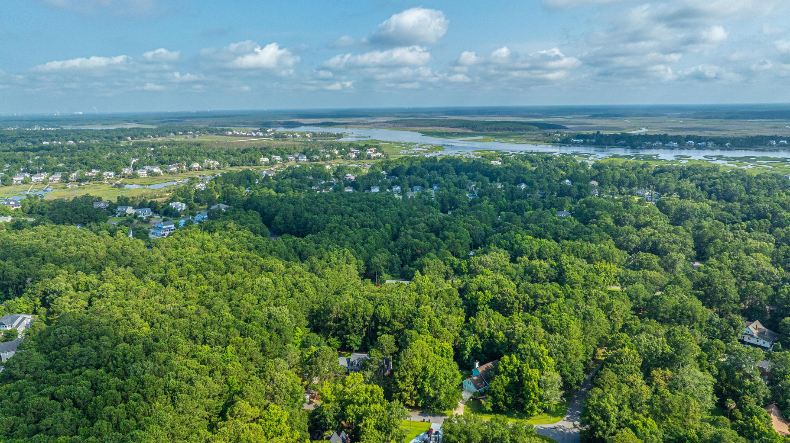
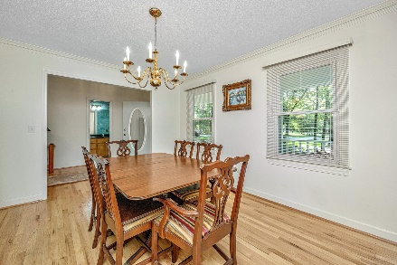
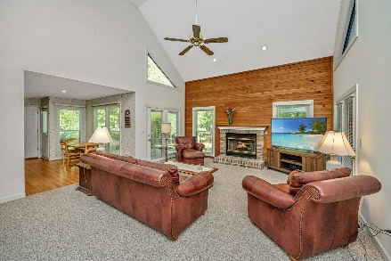
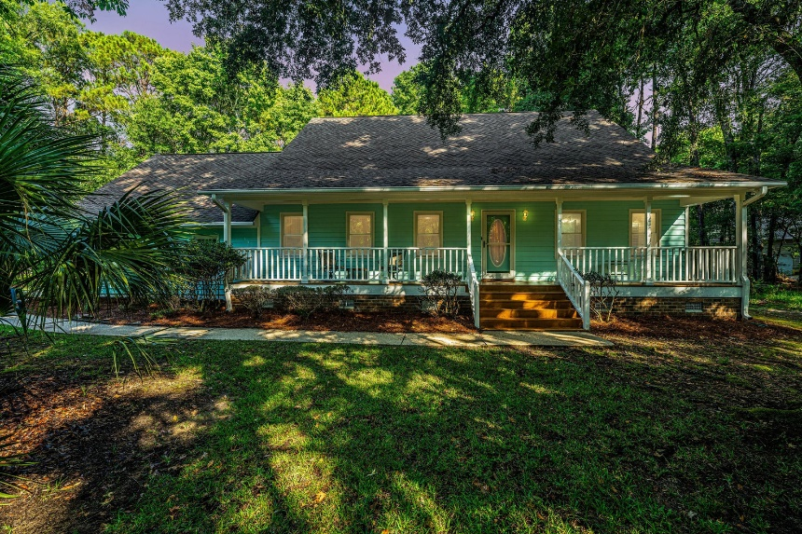
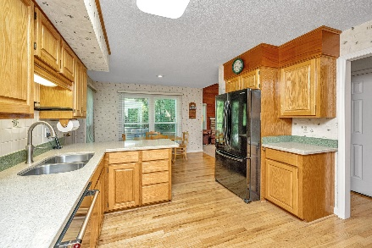
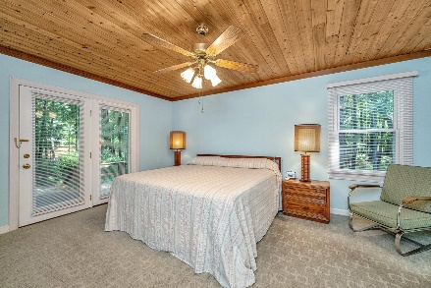
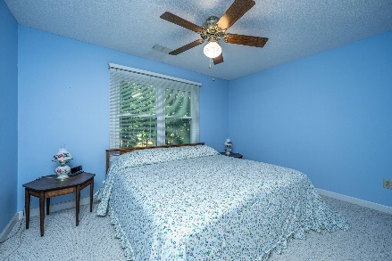
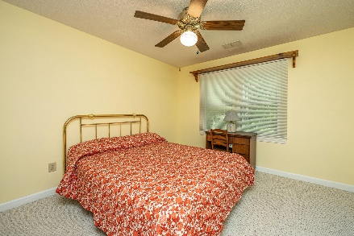
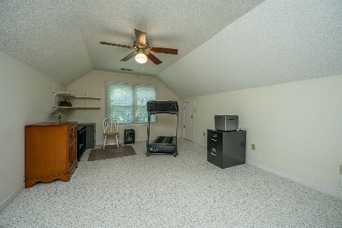
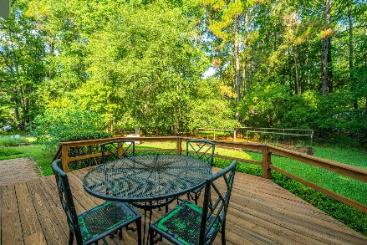
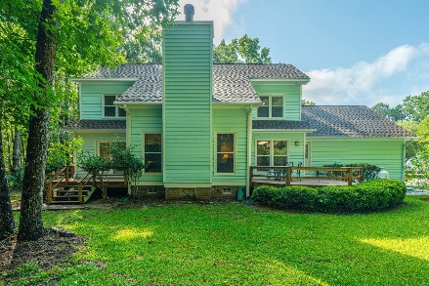
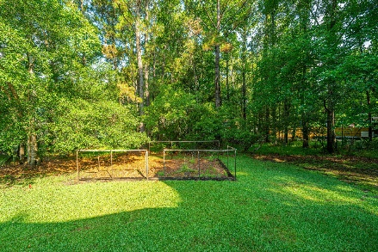
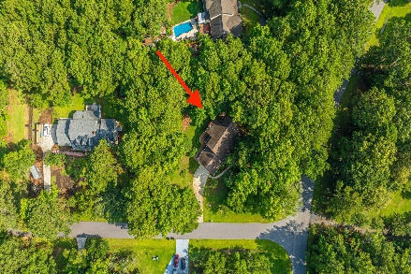

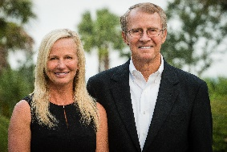

3686 Everhope Road
Commonwealth
Mount Pleasant, SC 29466
MLS# 24016659 | $800,000
Motivated Seller Best Value
Hidden gem of country living right in Mount Pleasant! Tucked into a peaceful setting of mature trees on a large lot, this charming coastal cottage has been lovingly maintained and is ready to welcome you home! A classic southern sitting porch extends the length of the home and leads to a large foyer where you'll step inside to details such as crown moulding and hardwood floors. Just beyond the foyer is a cozy living room boasting a vaulted two story ceiling and a gorgeous feature wall with knotty pine paneling and a brick surround fireplace. A large opening flows into the eat-in kitchen where a sunny breakfast nook, tons of countertop area, including a peninsula, plenty of cabinetry for storage and newer appliances make meal prep a breeze. Adjacent the kitchen is a formal dining room perfect for hosting dinners for family and friends. This home offers a much desired first floor owners suite featuring a beautifully finished wood ceiling, private access to the backyard, walk-in closet and en-suite bath. The bathroom boasts an extra long double vanity, new tile flooring, a tub shower combination with custom tile work. Additional first floor conveniences include a perfectly located guest powder room and a large laundry room with storage shelving and utility sink. Upstairs you'll find an open catwalk style hallway that overlooks the living area below, two nicely sized secondary bedrooms and a full bathroom as well as multiple storage closets. A large bonus room over the garage has a private staircase entrance and tons of storage access! This space is ideal as a teen retreat, playroom, secondary family room, home gym or office! Outside offers plenty to enjoy with two open air decks and a large, shaded yard. It's easy to imagine morning coffee on the deck or grilling dinner while the kids and pets play in the private yard! All of this and located in Commonwealth, situated on Alston Creek with access to the Wando River. A community boat ramp, dock, tennis courts, picnic area and play park are all private amenities for Commonwealth residents and their guests and conveniently located just minutes from Oakland Market, schools, area beaches, Costco, Roper Hospital and the world class dining and shopping of historic downtown Charleston.
Don Dawson
843-514-0452
ddawson@carolinaone.com
Carolina One Real Estate • 2713 Highway 17 North • Mount Pleasant, SC 29466
www.TeamDawsonSC.com

