Slide 1
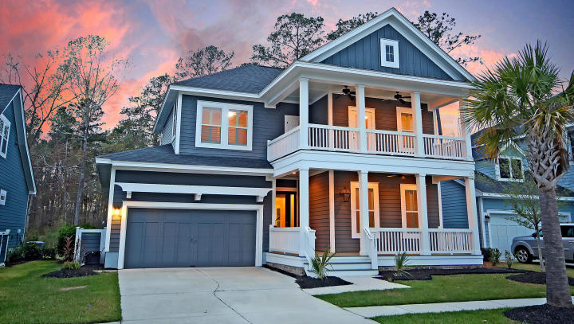



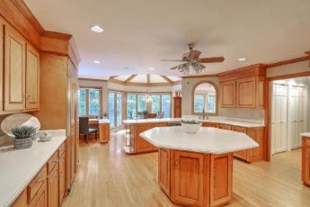
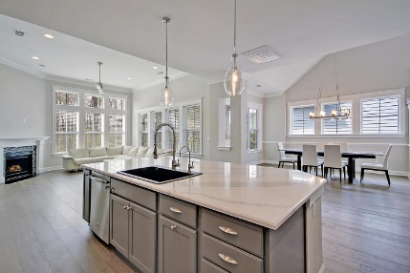





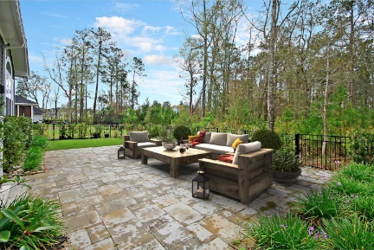
Parkshore Marshfront
Privacy Abounds!
3687 Spindrift Drive
Carolina Park ~ Mount Pleasant, SC 29466 ~ MLS# 20008026 ~ $684,000
Backing to wooded privacy in Carolina Park, this stunning like-new home is better than new construction and ready to go! This fantastic floorplan feature gleaming hardwood floors, volume ceilings, a fireplace in the spacious living room, gourmet kitchen with center island, and an expansive loft area upstairs. The master suite has wood beams along the cathedral ceiling, a massive walk-in closet and luxurious master bath with dual vanity and a tiled walk-in, rain fall shower. A bedroom and full bath downstairs offers a private guest suite. The double wrap-around front porches and back screened-in porch provide wonderful outdoor living spaces. The fenced-in backyard boasts a large paver patio as well as maintenance-free artificial turf for the lawn area! This home has it all!
Additional features include:
2 car garage
First level drop zone and laundry
First level master suite
Loft, two bedrooms, two full baths, an office, and a finished storage area make up the 2nd level
Kitchen has glass front cabinets, stainless steel appliances, Blanco carbon granite kitchen sink, tile backsplash and breakfast bar seating at the center island
AT&T fiber installed internet
Double dog doors
APEC reverse osmosis water filtration system under kitchen sink
Leafguard gutters on the back and partial side of the house
Custom garbage bin storage
Book your showing today!
Christopher Smith christopher@mattoneillteam.com 843-267-0735

