Slide 1
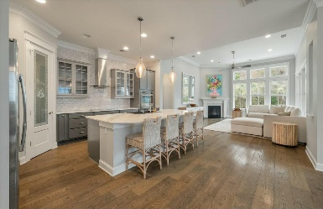
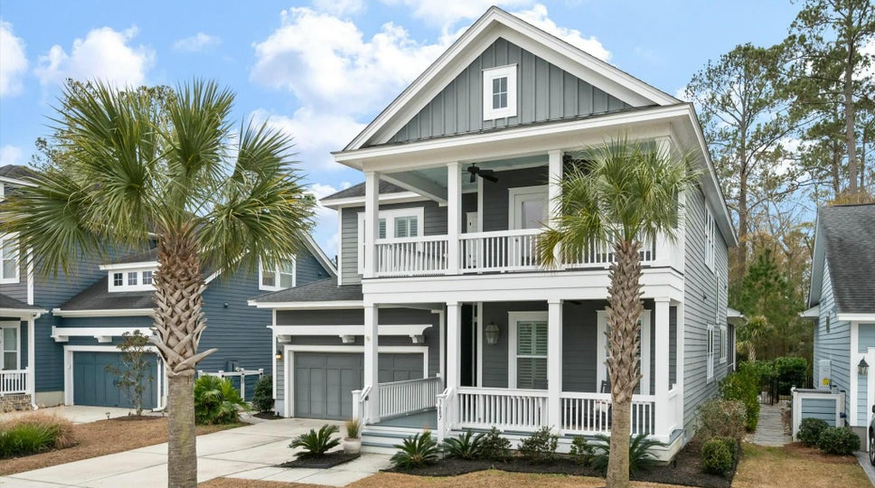
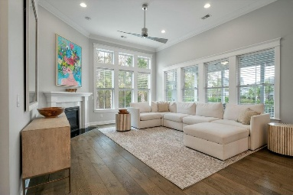
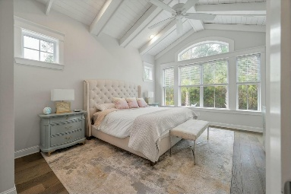
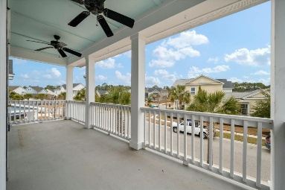
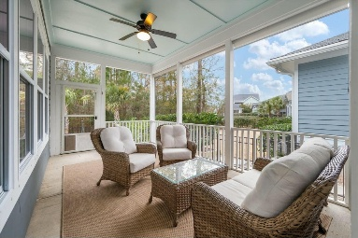
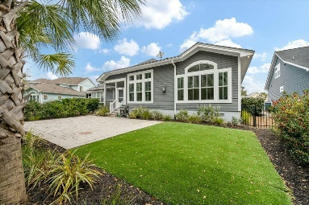


3687 Spindrift Drive
Carolina Park · Mount Pleasant, SC 29466 · MLS# 25001895 · $1,200,000
OPEN HOUSE SATURDAY 12-2
Welcome Home! This David Weekley home is situated in the heart of Carolina Park and backs up to protected wetlands. It has the coveted double porches which adds to this home's lowcountry charm! It boasts 4 bedrooms and 4 full baths. As you enter the home you are welcomed by a wide foyer/hall that has an architectural nook perfect to add that special decorating touch to welcome your guests. To the right of the front door is a full bedroom with an en suite bath that is a perfect escape for out of town guests. As you continue into the home on the left is the spacious laundry/mudroom that connects to the entrance to the two car garage. The laundry area also comes complete with custom cabinetry and a built in drop zone.
Across the hall from the laundry area is a private office with double glass doors for privacy. This space has multiple uses and could also be used as a den, library or downstairs playroom. The gourmet kitchen comes complete with all of the bells and whistles including a large walk in pantry and center island. It has an electric cooktop with a stainless steel vent and double wall ovens which is perfect if you are planning to entertain for the holidays or for any other occasion. There is a walk in pantry with wood shelving and it is quite spacious. Off of the kitchen is a large breakfast area that is truly large enough to double as a formal dining space. The family room is big enough for any size sofa and the extra windows to the back offer a lot of natural light. It also boasts a gas fireplace.
Off of the family room is the master bedroom that has a gorgeous vaulted ceiling with beautiful wooden detail. The en suite bath has double sinks and a huge walk in shower. It has a separate water closet (toilet room) and a gigantic walk in closet. Back through the home and to the side of the breakfast area is the stairs that lead to a huge loft area that is perfect for a playroom or man cave. There is also a large walk in storage area off of the loft. The two upstairs bedrooms are located just off of the loft and there is a hall bath and then one of the bedrooms has its own en suite bath. Also off of the loft area towards the front of the home is the second floor balcony which is a great space for a porch bed or hammock or for some old fashioned rocking chairs. Back downstairs and to the back is a screened in porch that leads out into the private fenced in back yard that has astro turf and thus it is very low maintenance! The current owners also added beautiful palmetto trees to add to this gorgeous Lowcountry landscape! Carolina Park is a master planned community that has a nicely laid out amenity area that has a community pool, tennis courts, play park and dog park as well. It is close to the schools and there are several restaurants and shopping options right in the neighborhood. The beach is a short 15-25 minute drive from Carolina Park as is downtown Charleston.
Carey Nikonchuk
843-276-1701
cnikonchuk@gmail.com
www.brennamangroup.com

