Slide 1
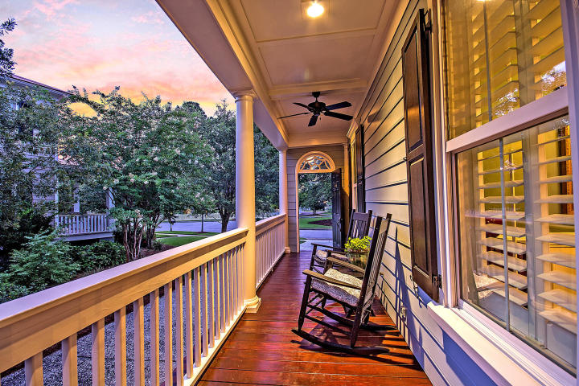
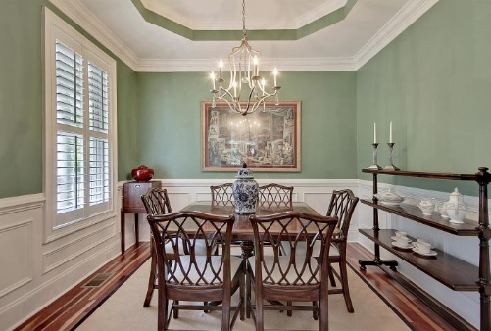
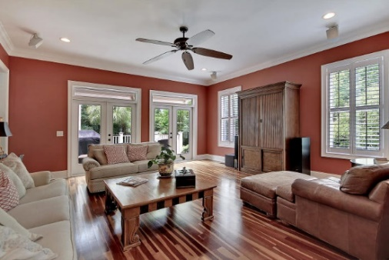


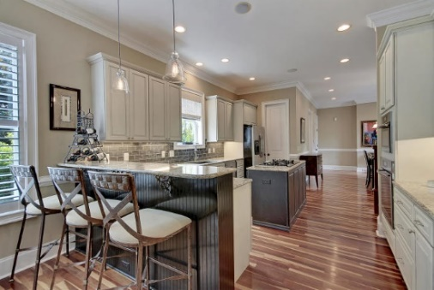

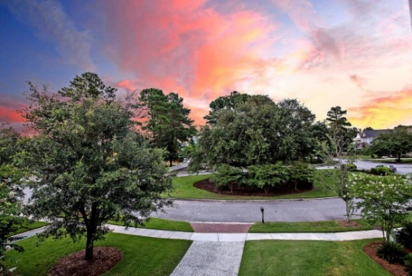
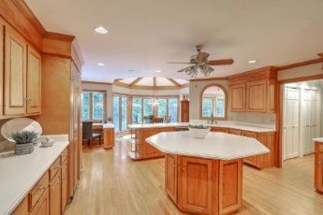

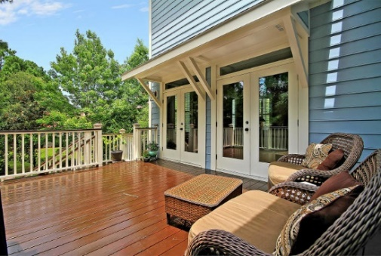


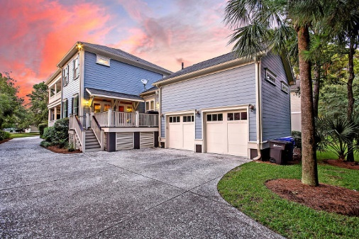

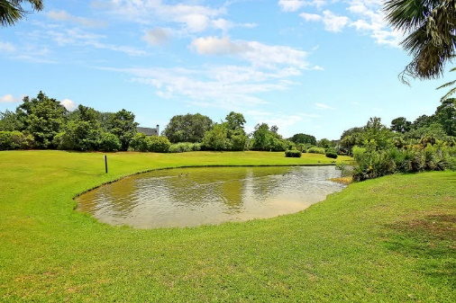
Parkshore Marshfront
Price Reduced!
Open House Sunday 12:30-3:00!
368 Evian Way
Belle Hall ~ Mount Pleasant, SC 29464 ~ MLS# 19022093 ~ $1,040,000
LOCATION, LOCATION, LOCATION! This home is 10 miles from downtown, 14 miles to the airport, and directly across the street from Belle Hall Shopping Center with Harris Teeter, South Coast Bank, CVS, and many restaurants. It is also 3 miles from the new Lucy Beckham High School. Located in the prestigious gated section of Belle Hall, this spacious Charleston Single is simply stunning and absolutely move-in ready. The home boasts high-end luxurious finishes like the Brazilian Cherry hardwood floors, columns in the formal dining room, tray ceilings, intricate trim work throughout, built-ins and gas buck stove in the sitting area off of the eat-in kitchen, double-sided porches and a spacious luxury owner's retreat of the first level. Upstairs are four spacious bedrooms, large Jack-n-Jill baths, and a large media / office area. The deck off of the living room offers another great outdoor living space. The two-car garage boasts close to 500 square footage of storage space.
Additional features include:
Chef's kitchen features breakfast bar seating, a center island with gas range, tile backsplash, SS appliances, an eat-in area, granite counters and maple cabinets
Master bath has a dual vanity, jetted tub, walk-in tile shower and huge walk-in closet
Built-in surround sound
Rinnai tankless water heater
Smart wiring with security system
Double French doors in the living room
Plantation shutters throughout the main floor
Community pool, parks, walking trails, dock and boat ramp
Book your showing today!
Jack Hall jack@mattoneillteam.com (847) 212-4613

