Slide 1
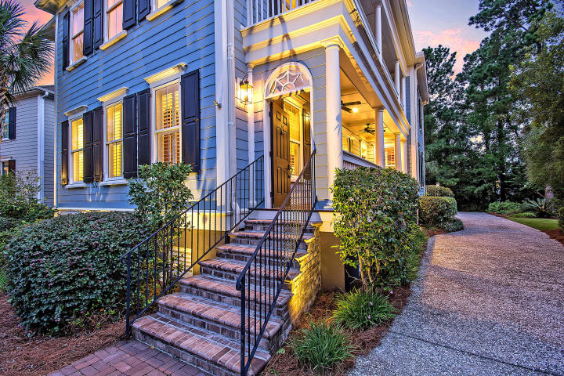
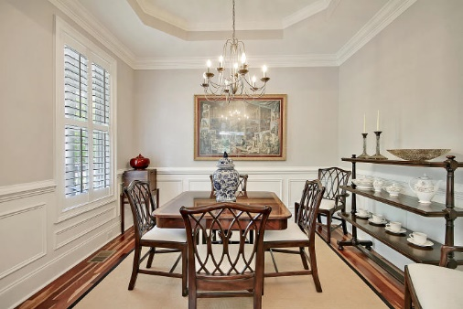
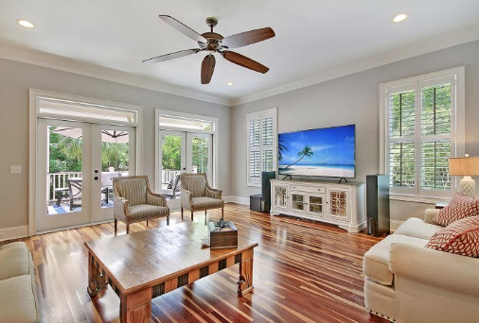

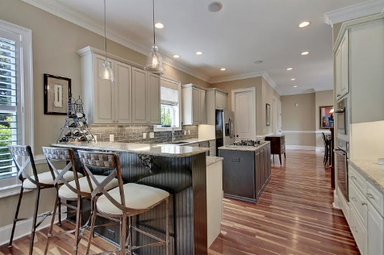

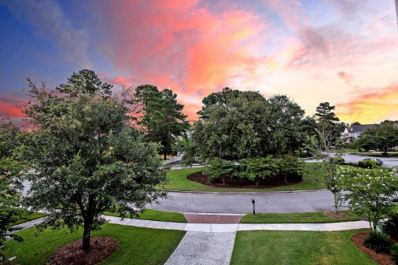
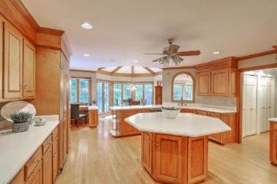

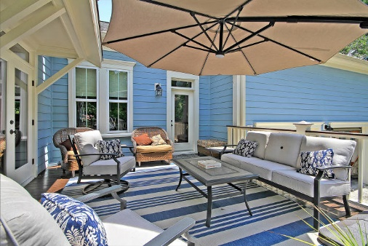

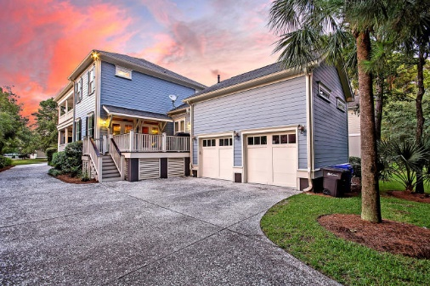

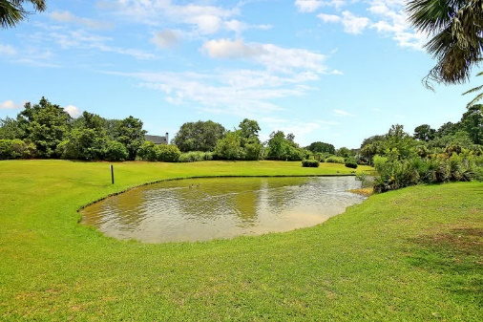
Parkshore Marshfront
Open House
Sunday 12-2
368 Evian Way
Belle Hall ~ Mount Pleasant, SC 29464 ~ MLS# 20013704 ~ $1,015,000
LOCATION, QUALITY AND STYLE ALL IN ONE HOME! Located in the prestigious gated section of Belle Hall Plantation, this spacious beautifully designed Charleston Row style home with Southern charm and comfort is simply stunning and absolutely move-in ready. The location is 10 minutes from downtown Charleston, 12 minutes from the airport, 6 minutes to the new Lucy Beckham High school and just across the street from the Belle Hall Shopping center. The home boasts high end luxurious finishes like the Brazilian Cherry hardwood floors, plantation shutters , California closets, custom pull-down shades and Miele gas range, convection oven, and dishwasher. The home is warm and inviting from the double side porches to the lovely keeping room with a unique gas Buck Stove as the focus, to the French Country style kitchen which is open to a large eat-in area which also allows access to the back deck. The living room has a double set of doors to the back deck, the formal dining room includes chair rail and trey ceiling. The owner's retreat is on the main floor and includes a spacious walk-in closet, oversized shower with double shower heads, and an extra deep jacuzzi tub. Upstairs are four large bedrooms, all with oversized walk-in closets, two Jack and Jill type large baths so that all bedrooms have access to a bathroom, and a media/playroom/office or kid's study room with additional storage closet and linen closet. Home includes a 2 car garage that also has an additional 500 sf of storage and a nice long side driveway so there is plenty of parking room for company. And the spacious deck is perfect for afternoon relaxing or entertaining. Owner is a licensed real estate agent.
Additional features include:
Chef's kitchen features breakfast bar seating, a center island with gas range, tile backsplash, SS appliances, an eat-in area, granite counters and maple cabinets
Master bath has a dual vanity, jetted tub, walk-in tile shower and huge walk-in closet
Built-in surround sound
Rinnai tankless water heater
Smart wiring with security system
Double French doors in the living room
Plantation shutters throughout the main floor
Community pool, parks, walking trails, dock and boat ramp
Listing agent is seller
Book your showing today!
Alana Hopkins sceliteproperties@gmail.com 843-619-8180

