Slide 1
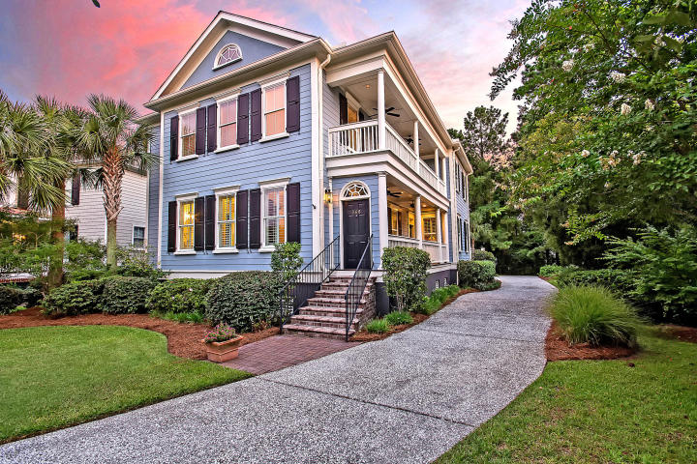



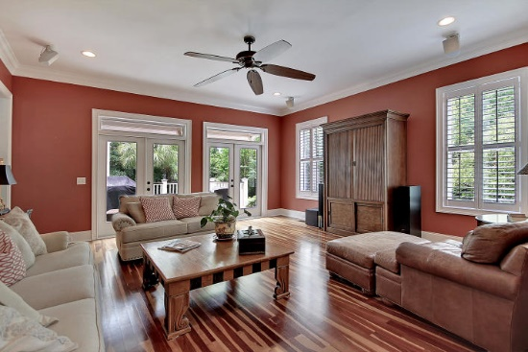
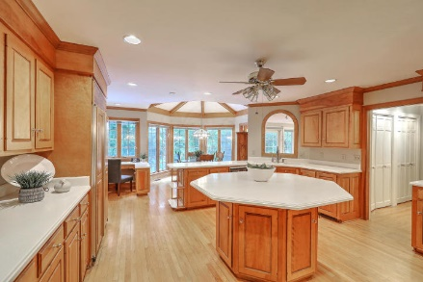
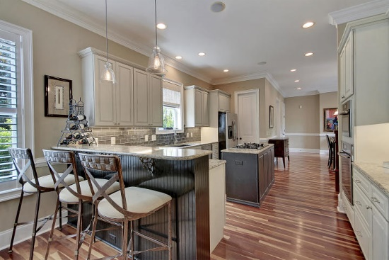



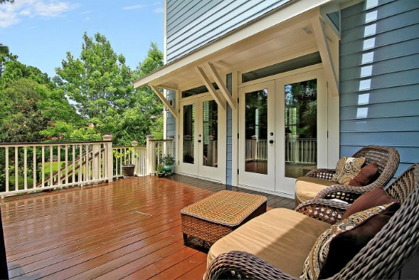

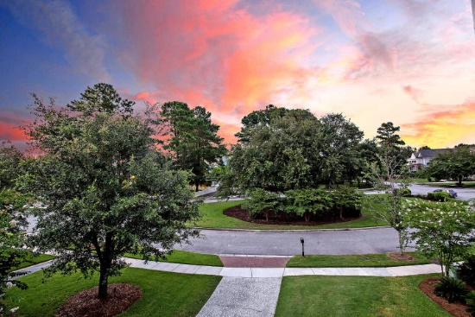
Parkshore Marshfront
Gated Living
East of the Cooper
368 Evian Way
Belle Hall ~ Mount Pleasant, SC 29464 ~ MLS# 19022093 ~ $1,049,900
Located in the prestigious gated section in Belle Hall, this spacious Charleston Single is simply stunning and absolutely move-in ready. The home boasts luxurious finishes like the Brazilian cherry hardwood floors, columns leading in the formal dining room, tray ceiling in the dining room, intricate trim work throughout, built-ins next to the gas buck stove in the sitting area off of the eat-in kitchen, the double side porches and a relaxing owner's retreat on the first level. Upstairs is a great loft area and four spacious bedrooms that all share jack-n-jill baths. The deck off of the living room offers another great outdoor living space. The two car garage boasts close to 500 square footage of storage space.
Additional features include:
Chef's kitchen features breakfast bar seating, a center island with gas range, tile backsplash, SS appliances, an eat-in area, granite counters and maple cabinets
Master bath has a dual vanity, jetted tub, walk-in tile shower and huge walk-in closet
Built-in surround sound
Rinnai tankless water heater
Smart wiring with security system
Double French doors in the living room
Plantation shutters throughout the main floor
Community pool, parks, walking trails, dock and boat ramp
Book your showing today!
Jack Hall jack@mattoneillteam.com (847) 212-4613

