Slide 1
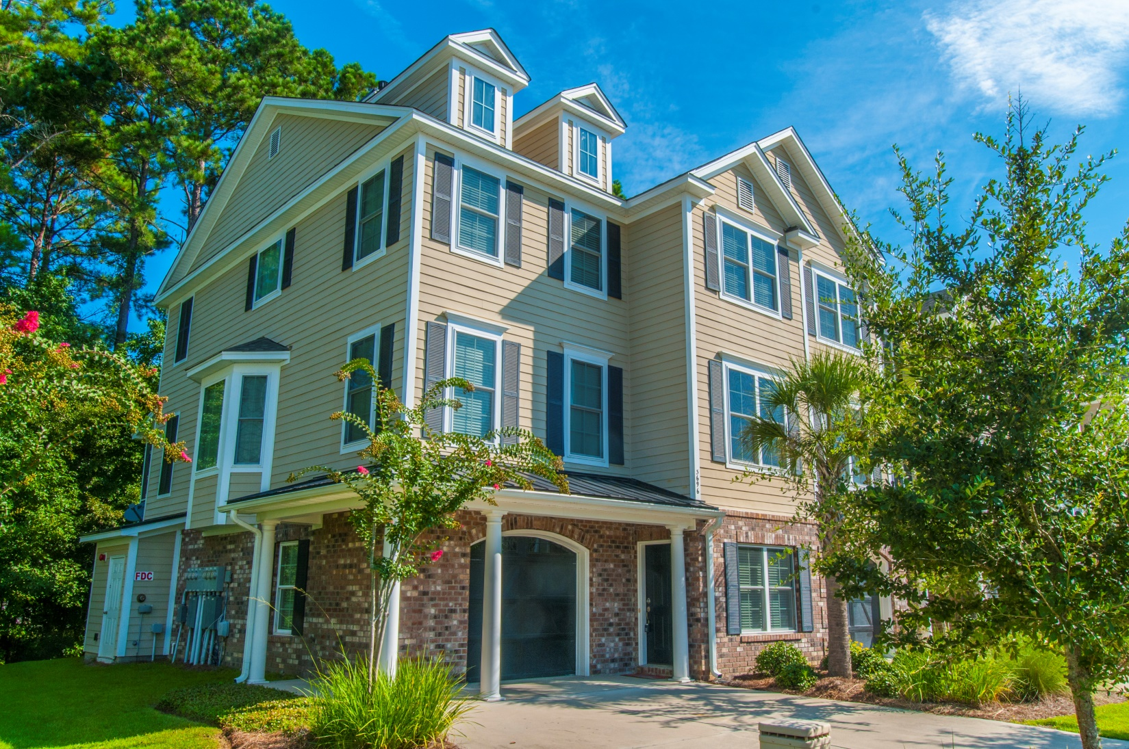
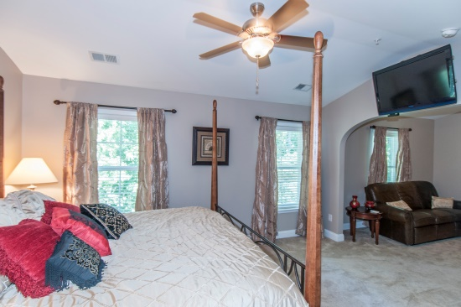
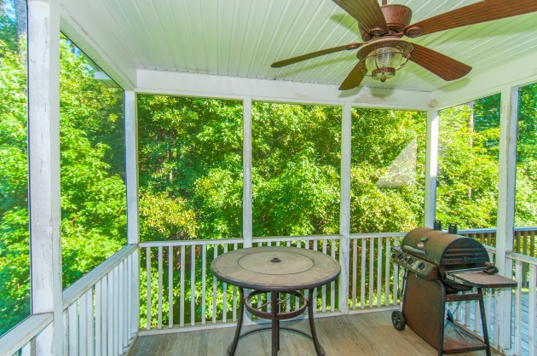
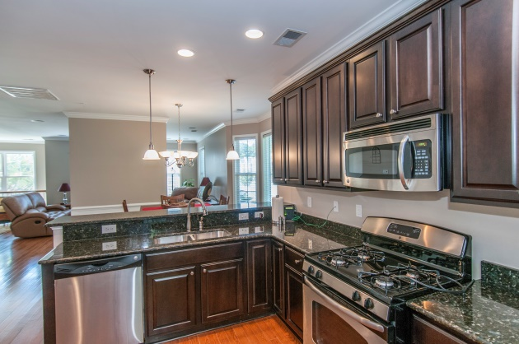
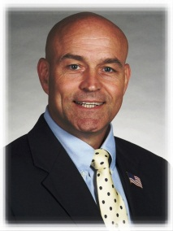

“Great location near all the amenities…”
3696 Bagley Dr
Mt Pleasant, SC 29466
$369,000
4 BR/3 BA
2375SF
Open House
Sunday
1-3 PM
Wonderful, spacious town home,
excellent condition, carefree living
One-Owner second home/”beach” home has been very gently and scarcely lived in
Park West amenities, trails, pools
Screened porch and separate grilling deck
Two+ car garage w/lots of extra storage
Not far from the beach at IOP
BR or flex space on main level
STEVE ROWE
,Realtor®
Retired Military. Active Agent.
(843) 303-7438
srowe@carolinaone.com
www.SteveRoweHomes.com

