Slide 1
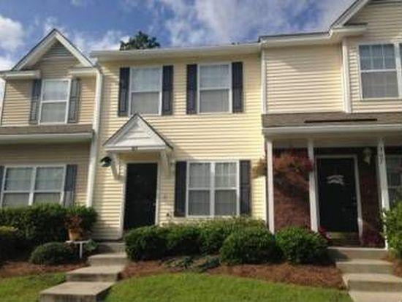
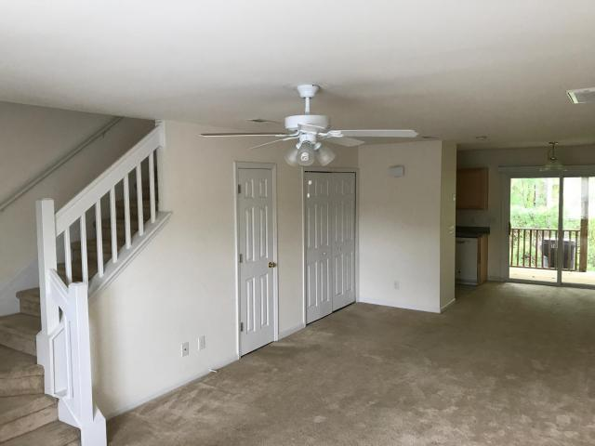
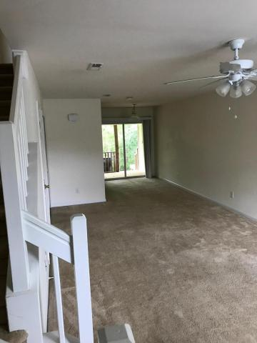
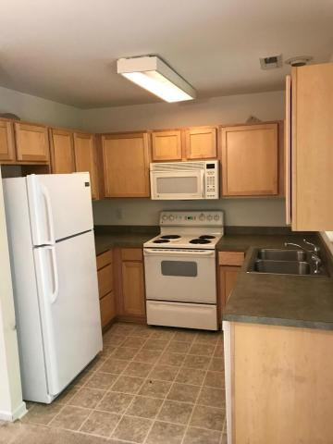
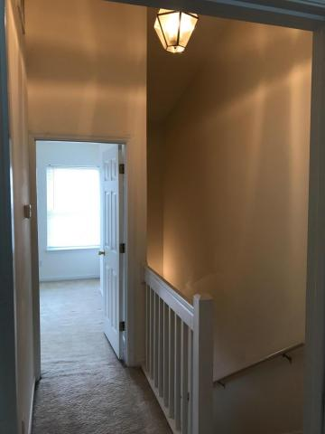
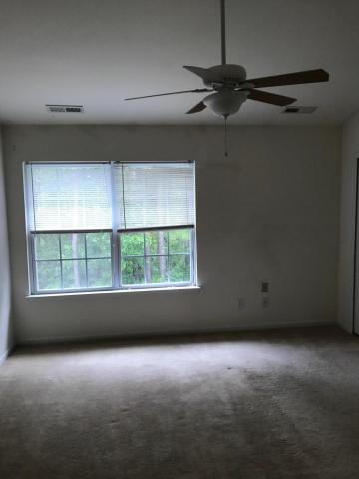
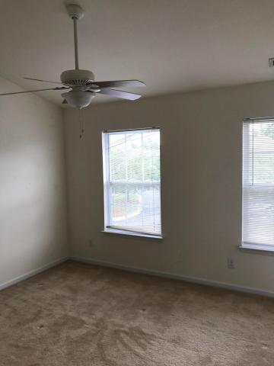
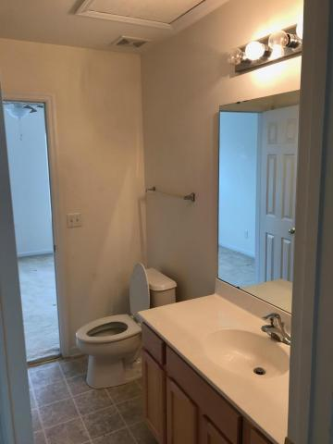
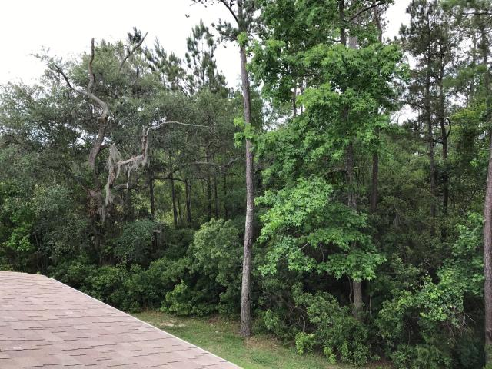
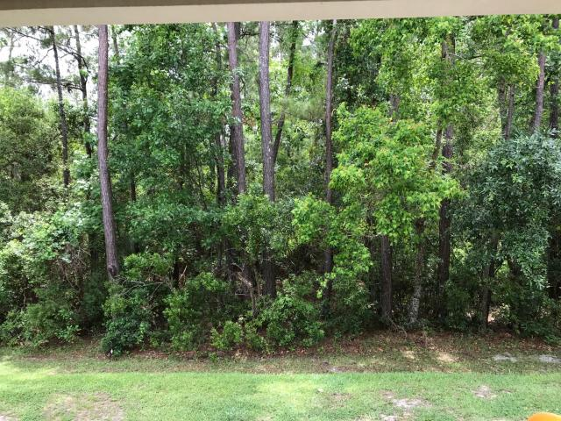

369 Kelsey Boulevard
Beresford Commons ~ Wando
MLS# 17011667 ~ $139,900
Great opportunity to own a marsh view town home! Unique location in the back of the community near the water with a Private & Peaceful view of the marsh, water & horse pastures from your master bedroom, kitchen & covered deck.
Regime Fee includes Hazard Insurance, Lawn & landscape Maintenance, Use & Maintenance of Pool, Water & Sewer, Termite Bond & Annual Renewal, Ext Building Maintenance.
YOU MUST SEE THIS LOCATION TO APPRECIATE!
Jonathan Vroon
(843) 514-3114
jvroon@southernlivingre.com
www.southernlivingre.com
Southern Living Real Estate 2249 Salt Wind Way, Mt. Pleasant, SC 29466

