Slide 1
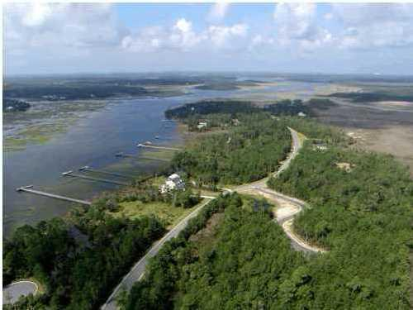
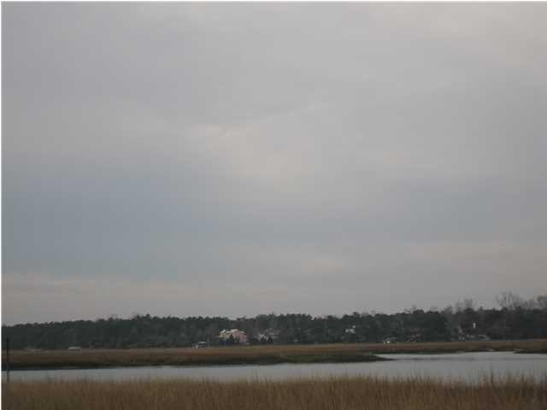
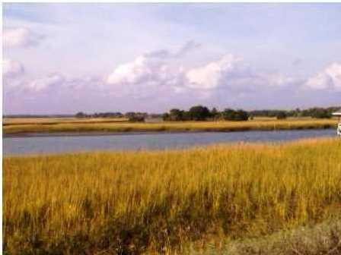
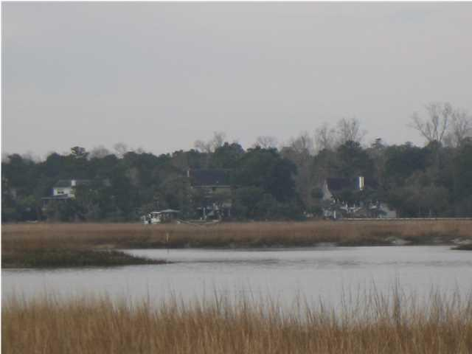


36 Cape Island Drive
Awendaw ~ MLS# 1403651 ~ $199,000
By Far The Lowest Priced Deep Water Lot
In Paradise Island With Dock Permit In Hand!
Check the comps. This is a great buy! This beautiful deep water lot is located on the Wando River, in the picturesque and tranquil neighborhood of Paradise Island. There are lots of nice trees on the lot to accentuate a house that someone would build, and the views are stunning. Just imagine the beautiful sunsets over the water, watching the local wildlife, and enjoying having a dock right out front. The lot is located between two very nice homes. This lot is also a shorter length for a dock that many of the lots. Another nice feature is the way the lot cuts in on one side, you can actually crab and fish right off your property at high tide. Paradise Island is a 340 acre community designed to give you the feeling of being away from it all, yet still just a short drive to Mt. Pleasant and nearby shopping. There is a community boat dock and boat ramp in the neighborhood. The lot is located between the homes at 4638 and 4630 Cape Island Dr.
Bill Smith
843-442-5906 M
bsmith@carolinaone.com
www. carolinaone.com

