Slide 1
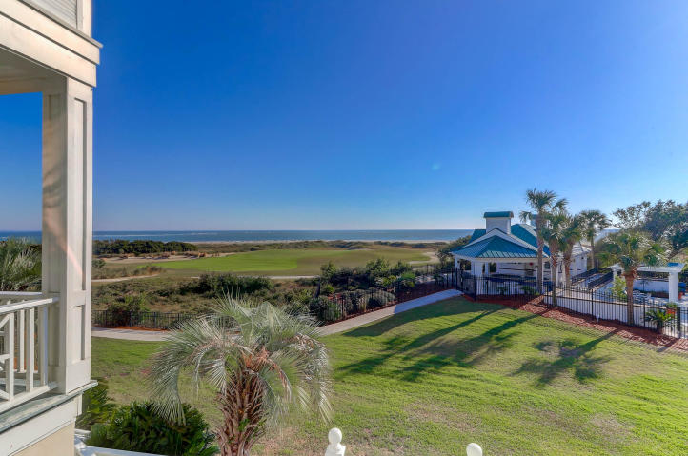
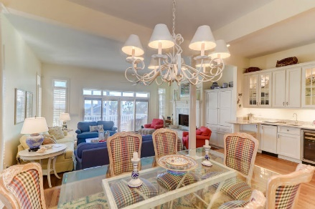
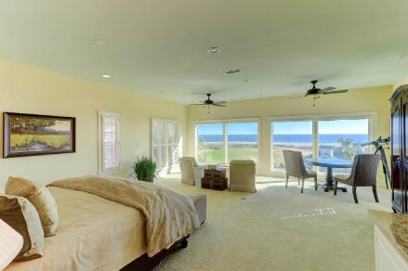
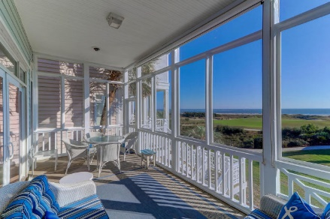
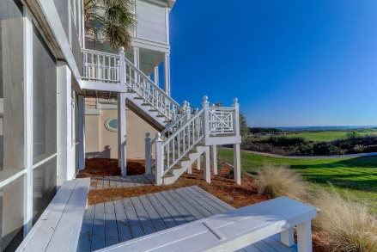


36 Ocean Point Drive Wild Dunes | Isle of Palms, SC 29451 | MLS# 19032736 | $1,699,000 EASY TO SHOW!
Spectacular Wild Dunes Home
Oceanfront... Views... Oh My!!
OWNER MOTIVATED
Oceanfront ... 36 Ocean Point within Wild Dunes is a privately Gated community and Oceanfront. This 'furnished' home is truly spectacular! From the magnificent ocean views, stunning living space, gourmet kitchen, plantation shutters, double screen porches and an unbelievable master suite with huge Ocean Views and private wet bar--you won't want to leave! Every detail was thoughtfully planned and executed to make this Oceanfront home the amazing home that it is.
Darlene Smith Office - (843) 886-8110
Mobile - (843) 696-7824
darlenesmith@carolinaone.com
DarleneSmithTeam.com
Carolina One Real Estate
1503 Palm Blvd Ste
Isle of Palms, SC 29451

