Slide 1
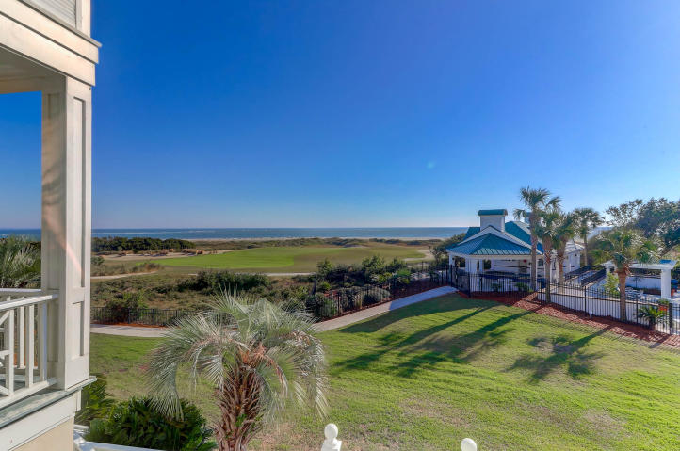
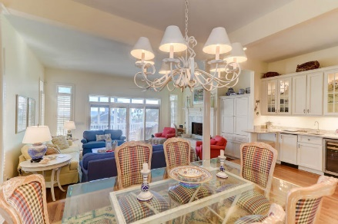
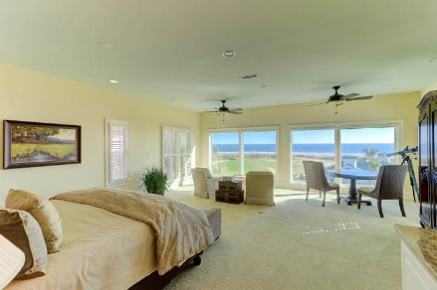
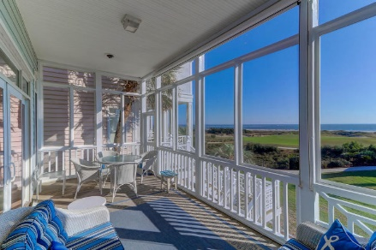
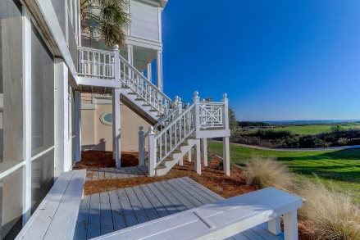


36 Ocean Point Drive
Wild Dunes | Isle of Palms, SC 29451 | MLS# 19032736 | $1,949,000
Spectacular Oceanfront
Views and Interior
OWNER MOTIVATED
Oceanfront ... 36 Ocean Point within Wild Dunes is a privately Gated community and Ocean Front. This home is truly spectacular! From the magnificent ocean views, stunning living space, gourmet kitchen, plantation shutters, double screen porches and unbelievable master suite with huge Ocean Views and private wet bar--you won't want to leave! Every detail was thoughtfully planned and executed to make this Oceanfront home the amazing home that it is.
Darlene Smith
Office - (843) 886-8110
Mobile - (843) 696-7824
darlenesmith@carolinaone.com
DarleneSmithTeam.com
Carolina One Real Estate
1503 Palm Blvd Ste
Isle of Palms, SC 29451

