Slide 1
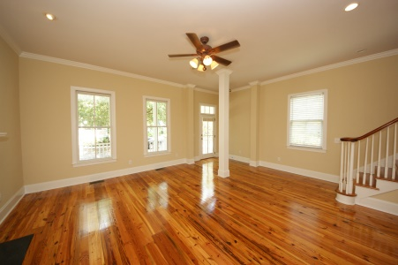
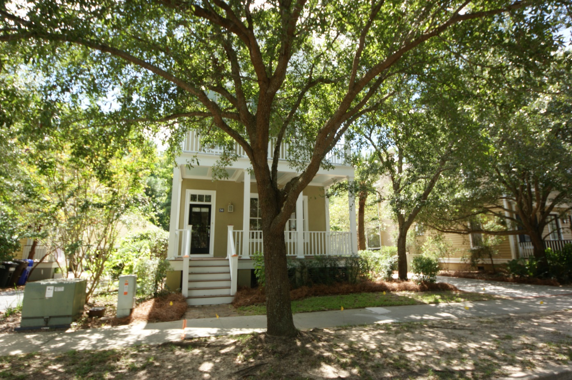
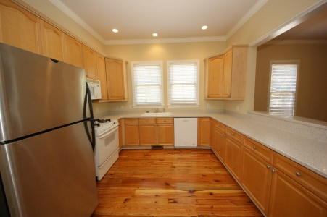
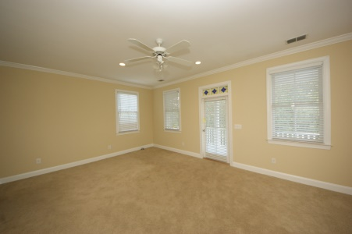
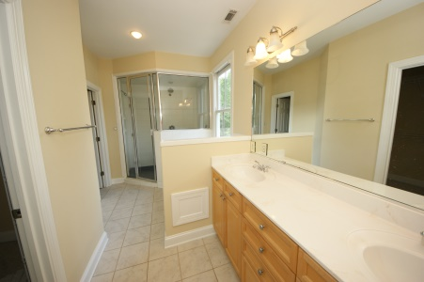
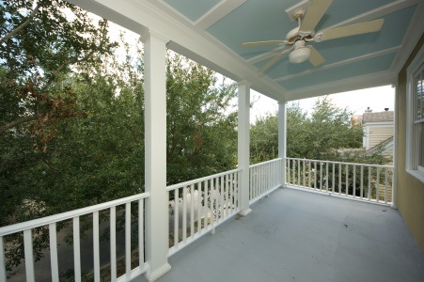
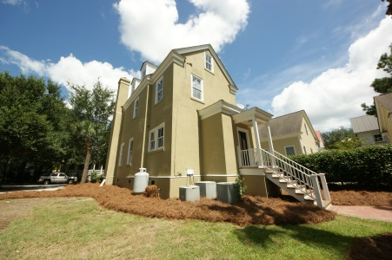
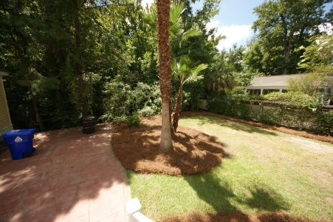
I'ON OPEN HOUSE Wednesday, September 17 11:30-1:30 and 4-6 at Sunset
36 Sowell St
MLS# 1423635 ~ $700,000
Home is in mint condition, repainted inside and outside, plus hardwood floors and landings have been resanded and coated. Has pre-approved one car garage with carport conveys with purchase of property. Possibility of getting ION approval for a 2-car garage. Note: Lot backs up to Rookery, a bird sanctuary.
Bobby Crouch
Cell (843) 224-0644
bobbycrouch@gmail.com
C A PROPERTIES, INC.
871 LOWCOUNTRY BLVD STE B-1
MT PLEASANT, SC 29464

