Slide 1

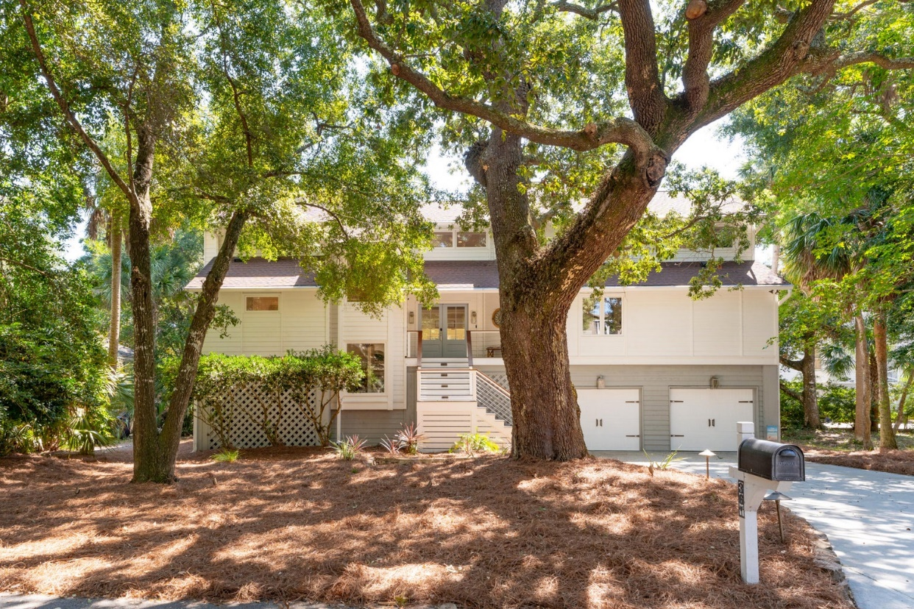
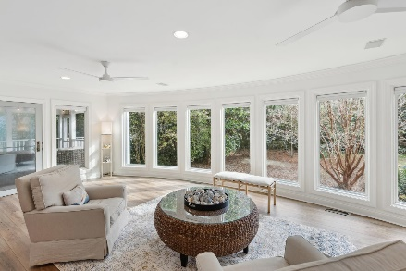
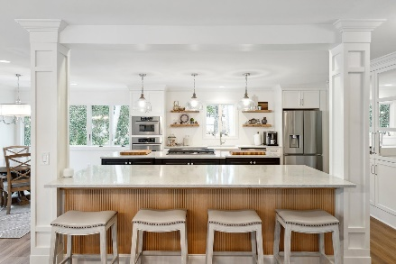
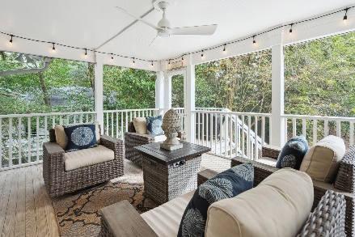
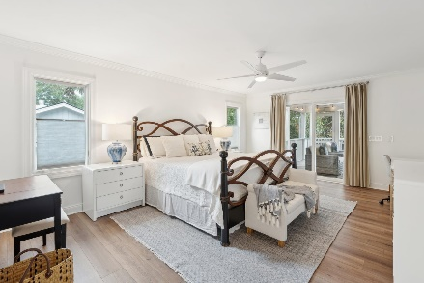
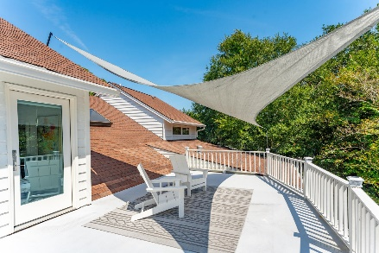
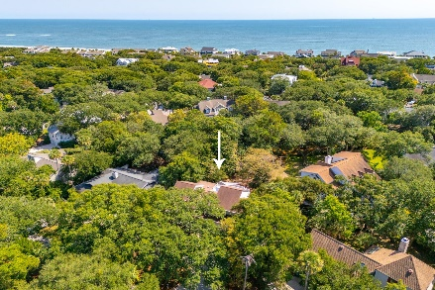


36 Fairway Oaks Lane
Wild Dunes | Isle of Palms, SC 29451 | MLS# 24024713 | $2,625,000
Gorgeous Five Bedroom Home
This beautifully renovated and exquisitely furnished five bedroom home offers island living at its finest AND the owners have just added beautiful luxury vinyl tile to the entire first floor for a stunning new look! Fairway Oaks is one of the most coveted streets in the Resort, lined with gracious live oaks to shade your short walk to the beach. The open kitchen-dining-family room layout and design provides a sense of both spaciousness and warmth, whether you're gathered around the fireplace on a cold winter night or enjoying a large gathering with family and friends. With high-end tasteful finishes throughout, there is very little you need to do to make this house your home. As a primary residence, you can enjoy the privacy of this location while remaining within easy walking distance to the tennis courts, golf course and hotel amenities. If you're looking for a second home with rental potential, you will not be disappointed--please see the rental projections attached in the documents.
The master bedroom is on the first floor with immediate access to the screened porch and the remaining bedrooms are on the second floor with two ensuite bedrooms and a large rooftop deck. The house sleeps 15 people comfortably. Special features include a temperature-controlled wine cellar, a new outdoor shower, and a very large garage for storage. Three new HVAC units were recently installed and are under warranty. Although it would require WDCA approval of submitted plans, the property has plenty of room for the addition of a pool (see attached survey). Wild Dunes Resort offers two Tom Fazio-designed golf courses, 12 hartrue tennis courts, five pickle ball courts, countless pools, a fitness center and world class spa, and miles of walking and biking paths.
Come take a peek--you will not be disappointed!
Fantastic Rental Property
Ann Cortes
Office - (843) 886-8110
Mobile - (843) 324-6808
ann.cortes@carolinaone.com
Carolina One Real Estate | 1503 Palm Blvd | Isle of Palms, SC 29451-2280

