Slide 1
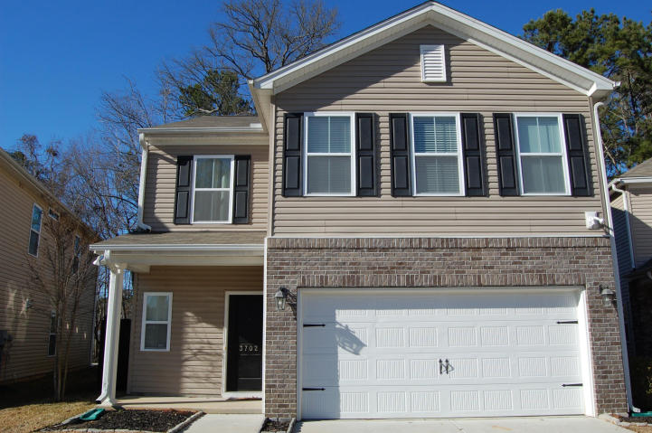
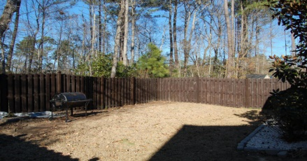
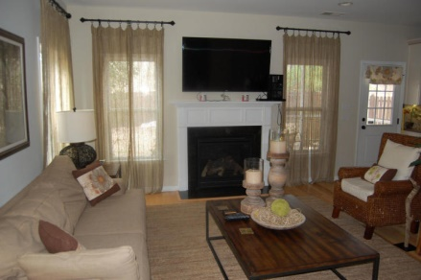
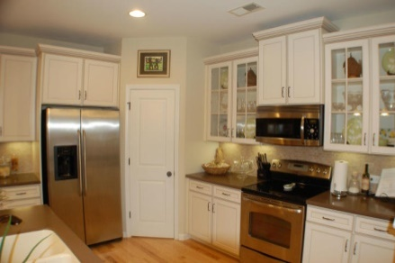
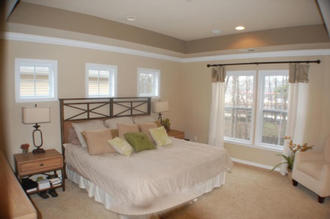
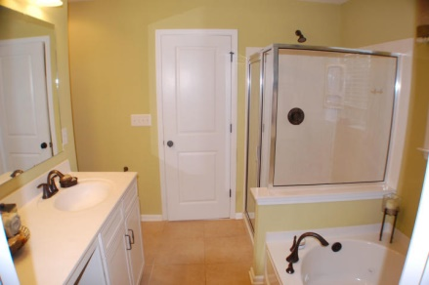
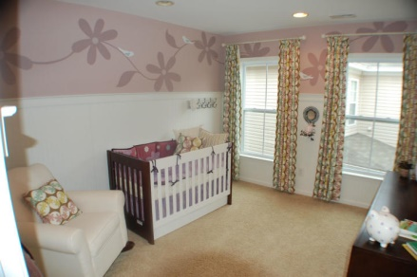
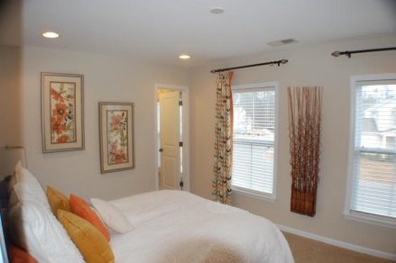
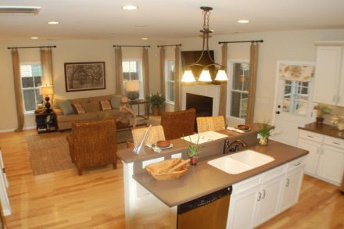
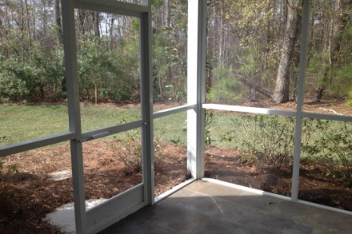


MODEL HOME with $70,267 of Upgrades!
3702 Crescent Way
Wellborn Village
Ladson, SC 29456
MLS #15004572
$225,000
3 Beds | 2½ Baths
2,340 Square Feet
Fabulous kitchen with designer 42 inch cabinets, Stainless appliances OPEN floor plan. Upstairs has a LOFT and a DREAM Master with trey ceilings large jetted soaking tub, separate glass shower and HUGE walk in closet. Wired for sound, huge lighting package, Fireplace, Hardwood floors, extra crown molding and wainscoting, window casing and Screened Porch w slate floor and irrigation system just to name a few!!! Radiant barrier sheathing in roof. If schools and square footage is important, research and measure.
Di Johnson
843-270-6448
dijohnsonsc@gmail.com
www.agentownedrealty.com
AgentOwned Premiere Group
100 Crowfield Blvd
Goose Creek, SC 29445

