Slide 1

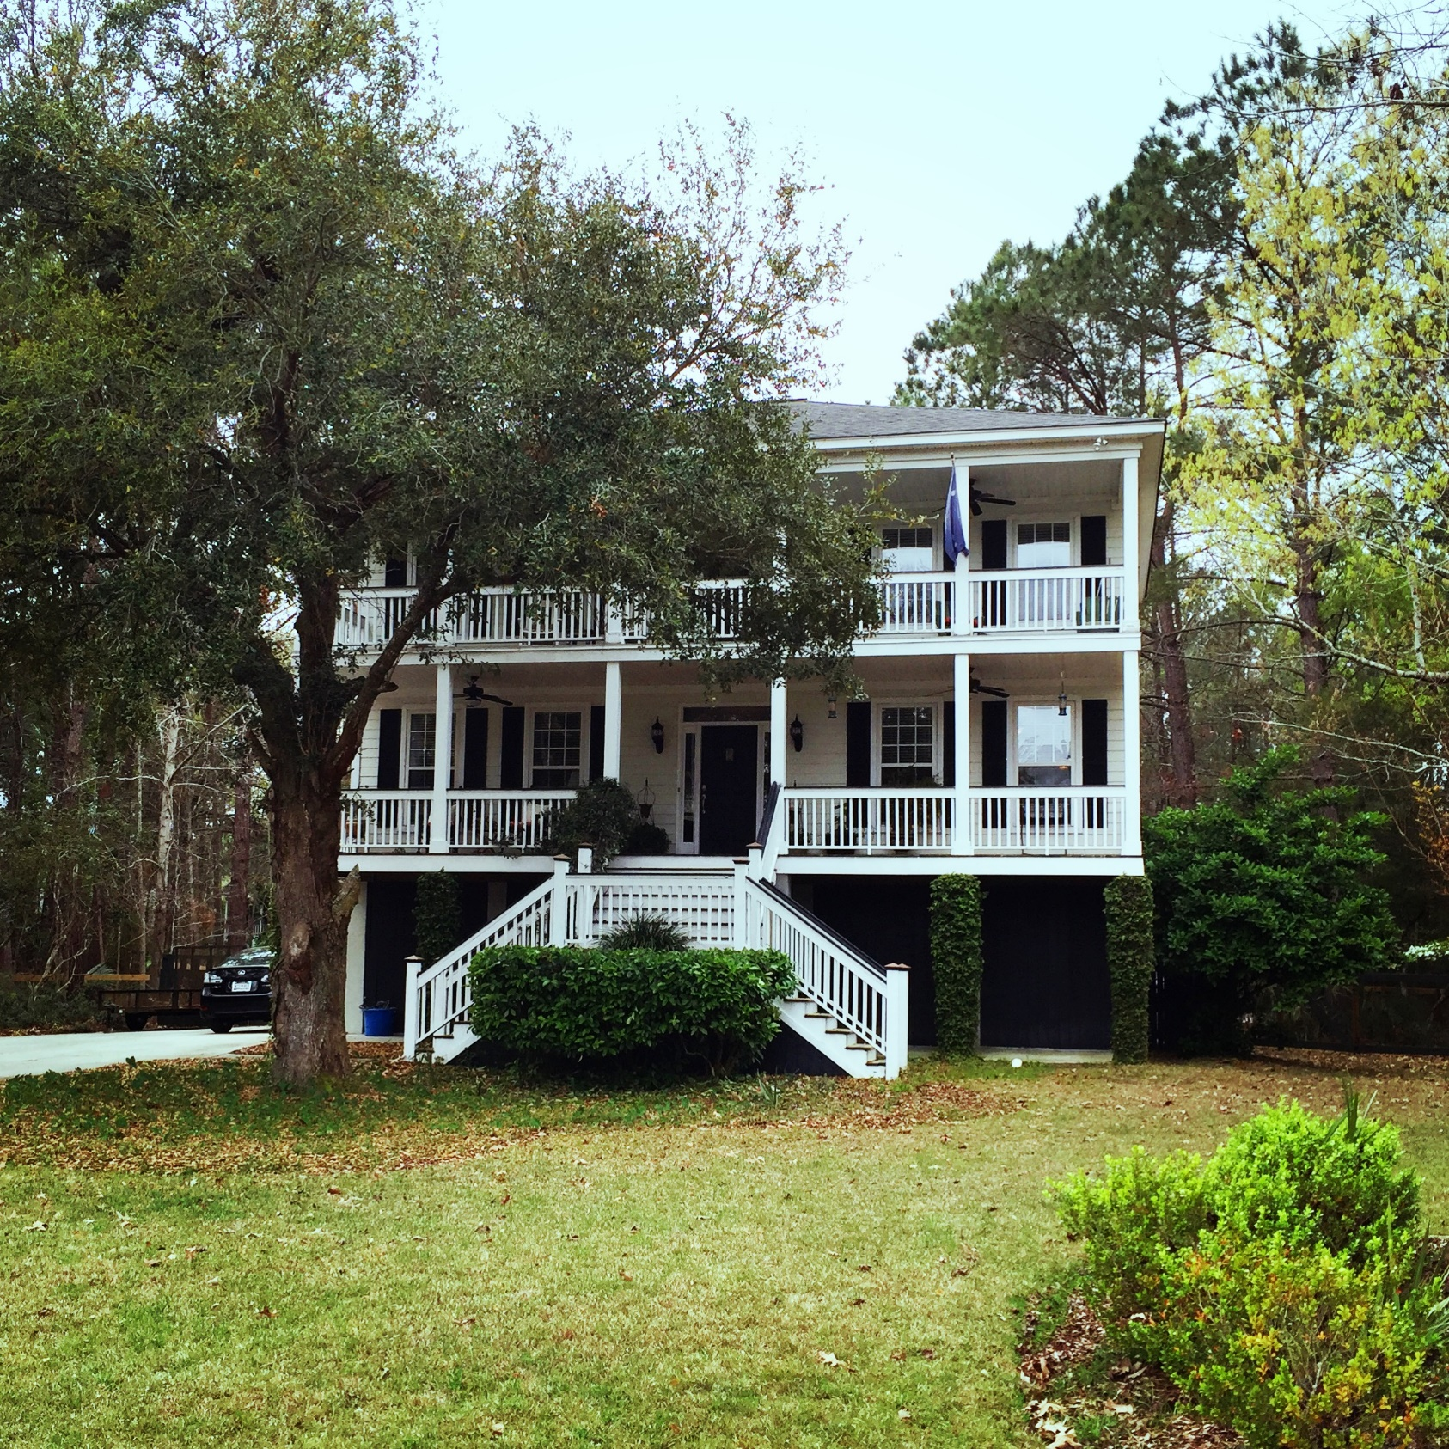

Coming To Market Soon…Take A Sneak Peek!
3703 Hidden Marsh Road
Darrell Creek ~ Mount Pleasant, SC 29466
4BR, 4.5 BA, home with updated kitchen, 2,840 SQ FT
and situated on a quiet lot of almost .60 acres.
Call Erin with Radekopf & Associates for more details or to schedule your showing today!
Andrew Tackitt
(843) 437-8726
andrew@radekopf.com
1205 Two Island Court, Suite 201
Mount Pleasant, SC 29466
Phone: (843) 579.2217
Fax: (843) 971-0281
Erin Quinn Hanhauser
(843) 743-8204
erin@radekopf.com

