Slide 1

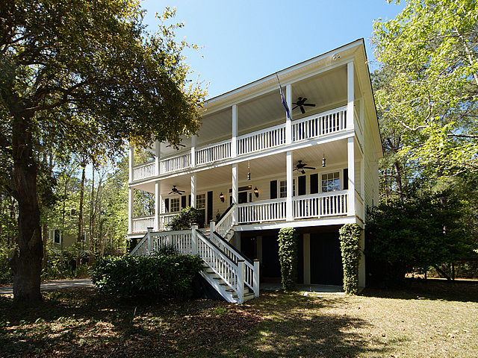
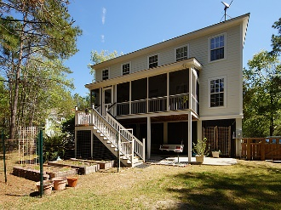
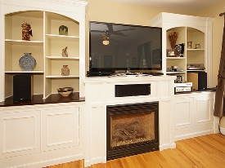
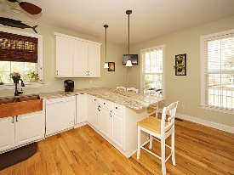
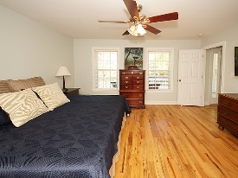
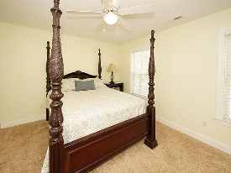
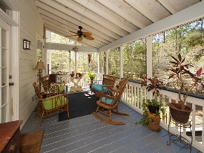
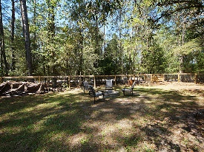

Price Reduced to $559,900! Easy to Show!!
3703 Hidden Marsh Road
Darrell Creek ~ Mount Pleasant, SC 29466 ~ MLS# 17008608
* REDUCED* Custom built, southern-style home sits on a quiet lot of almost .60 acres in Darrell Creek. A healthy and grand Live Oak tree welcomes guests upon arrival. Enjoy rocking chairs in the mornings on the full front porch or, entertain family and friends in your large, fully fenced back yard equipped with a fire pit and screened in porch off the back of the house. UPDATED LARGE KITCHEN with NEW GRANITE COUNTERTOPS, NEW COPPER FARM SINK & NEW APPLIANCES! Gorgeous red oak hardwood floors throughout, 3 bedrooms upstairs, each with their own full bathroom and a mother-in-law suite downstairs w/ on suite full bathroom. There is a laundry room located off the mother-in-law suite & an additional laundry room up on the 3rd floor which is convenient to the master.
Andrew Tackitt
(843) 437-8726
andrew@radekopf.com
1205 Two Island Court, Suite 201
Mount Pleasant, SC 29466
Phone: (843) 579.2217
Fax: (843) 971-0281
Erin Quinn Hanhauser
(843) 743-8204
erin@radekopf.com

