Slide 1
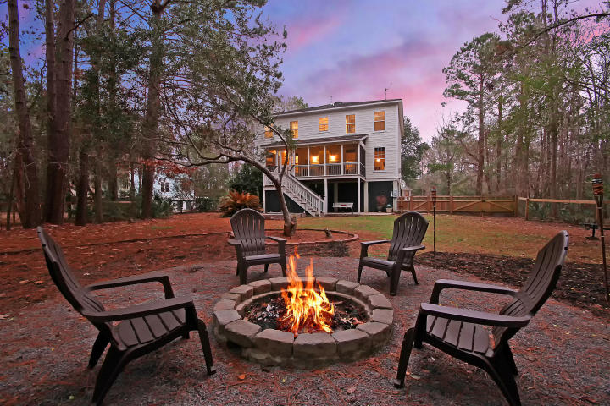

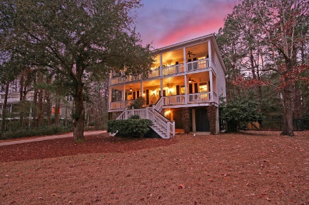
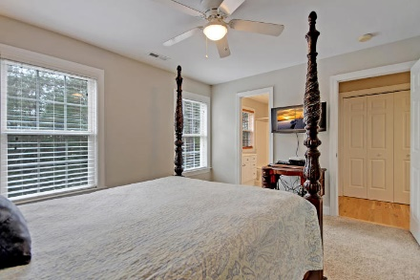
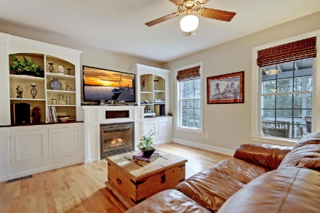
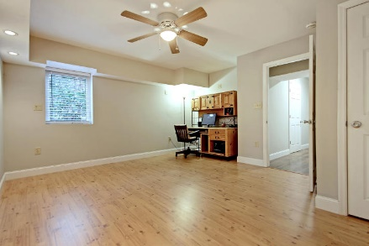
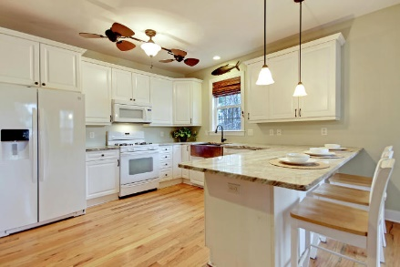
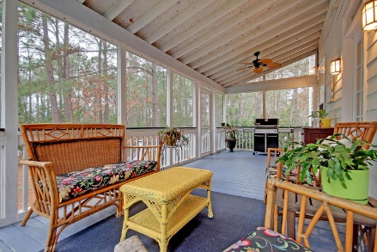
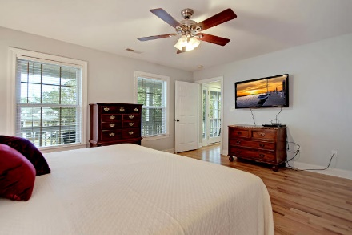
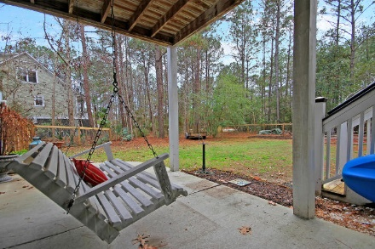
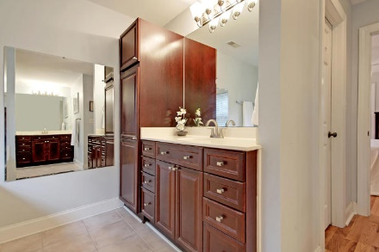
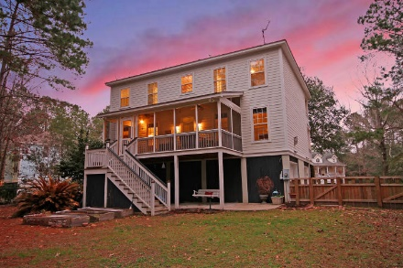

Parkshore Marshfront
Price Reduced in Darrel Creek
Seller Is Offering $10,000 Upgrade Concession To Be Paid To Buyer At Closing!
3703 Hidden Marsh Road
Mount Pleasant, SC 29466 ~ MLS# 18004442 ~ $565,000
Sellers are excited to move forward to the next phase of their life, so please bring all offers! Privately situated on a cul-de-sac in Darrell Creek with over a half acre, this custom built, three-story home with a traditional layout is one that you must see! A stunning Live Oak in the front yard creates a canopy of shade over this amazing home & creates a peaceful view to enjoy from the full front porch & full-length balcony on the third level. A screened-in porch overlooks the fenced-in backyard for yet another great outdoor living space. A gate in the rear of the fence allows room for you to swing your boat in & a beautiful fire pit is the perfect centerpiece to create lasting memories every night.
Additional features include:
Hardwood floors, a fireplace w/built-ins in the family room & a copper farm sink in the granite kitchen are just some touches that make this home so skillfully crafted
Kitchen has a breakfast bar, granite counters and a copper farm sink
The ground level features its own suite with a bedroom, en-suite bath and a huge laundry room with sink and built-in table
Master bedroom has two walk-in closets and en-suite bath with dual vanities, walk-in shower and oversized soaking tub
The downstairs section includes a large full room with a closet and a full bathroom. This space can be used as a bedroom, bonus room, office, or flex space.
Two laundry rooms
Lots of storage space
Backyard garden
Enjoy beautiful wildlife including hawks and deer
Book your showing today!
Sam Stith Sam@MattOneillTeam.com (843) 452-5271

