Slide 1
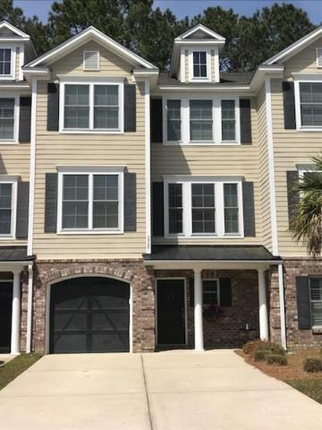
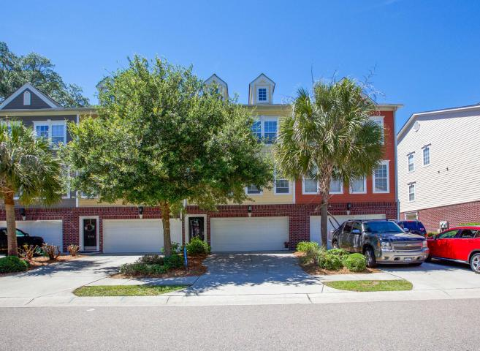
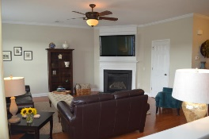
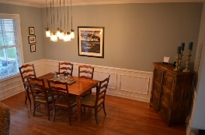
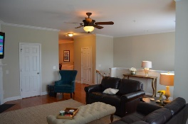
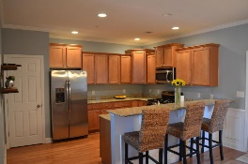
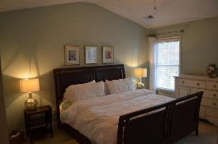
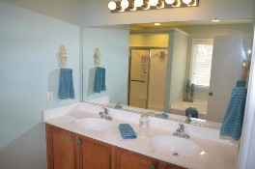
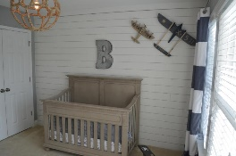
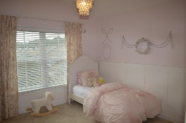
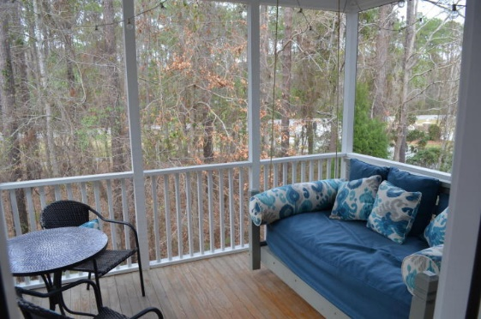

$1,500 Agent Bonus With Contract Ratified By 4/30/18!!
3708 Bagley Drive
Park West ~ Mount Pleasant, SC 29466
MLS# 18004556 ~ $359,900
Welcome home to this beautiful townhome located inside one of Mt. Pleasant's premier neighborhoods, Park West. This lovely 3 bedroom, 2 1/2 bath townhome was the last of the three story units built for the Preston section. From the moment you enter the front door, you will notice the upgrades throughout the home, some which include board and batten, ceramic tile and hardwood floors, just to name a few. The first floor consists of three large closets and a very large garage with additional flex space, which could be a playroom, teen retreat, or space for a 4th bedroom. As you walk up the stairs, you will find the wonderful open floor plan to the living room, kitchen and dining room. The dual porches are located just off of the kitchen, making it convenient to step outside and enjoy the beautiful woods and wildlife. The gourmet kitchen has varying height 36" Cherry Paprika cabinets with crown molding and lots of drawer space. Beautiful granite countertops and all appliances are GE stainless steel which includes a beautiful gas range, dishwasher and micro hood. The large dining area is perfect for any family or friend gathering as it is open to the large living room area. The gas log fireplace is perfect for those cooler mornings and nights. You will also find a half bath on this level as well for your convenience.
As you venture up to the third floor, the private Owner's Suite awaits you, complete with large master bath. Here you will find a deep soaking tub, separate shower, dual sinks, and private water closet. The 2nd and 3rd bedrooms are oversized and have been upgraded with shiplap walls and board and batten. There is also a large, full bathroom located on this level, as well as the laundry area and even more closet space.
This home comes with an elevator shaft (should you want to take that route), TANKLESS GAS water heater, and a 2 car tandem garage with storage area. The original builders warranty still exists on this home and is good through October 2020!!
The Preston subsection offers a low maintenance style living and is located next to the amenities center with clubhouse, 2 pools, 6 lighted tennis courts, summer kitchen, play ground and beach volleyball. Appx. 6 miles of walking/jogging/biking trails a few steps away. Park West is a master planned community featuring shopping, dining, schools, doctors, services and a 50 acre Mt. Pleasant Rec Facility featuring a track, indoor pool, activities, dog park and ball fields! Be sure to schedule your appointment today to view this lovely gem!
Deborah Meuli
(843) 822-0133
dmeuli@comcast.net
Wendy Deitsch
(843) 270-0433
wendy@lifetreeliving.com
LifeTree Real Estate, LLC | 3094 Hwy 17 North | Mt. Pleasant, SC 29466 | www.lifetreerealestate.com

