Slide 1
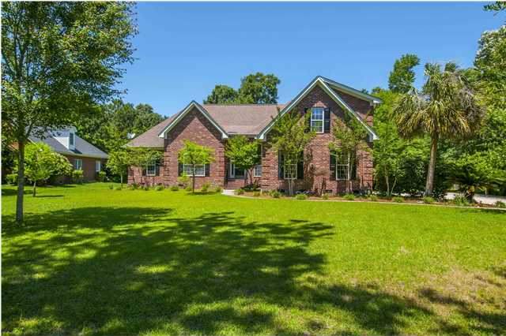
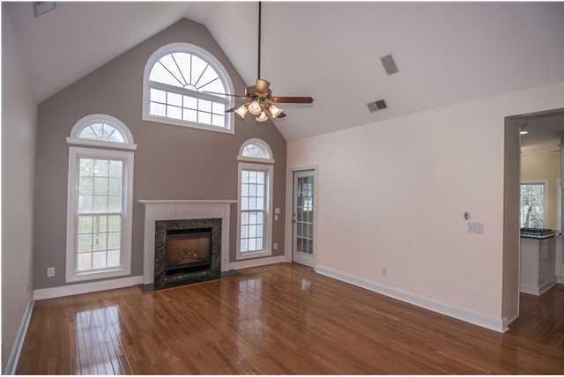
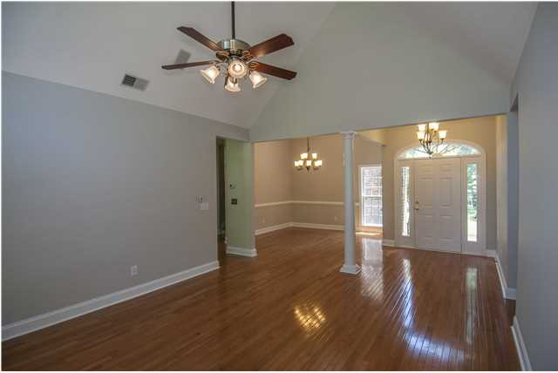
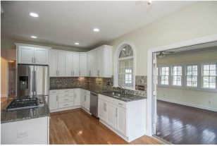
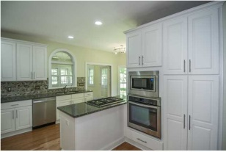
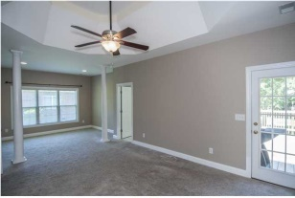
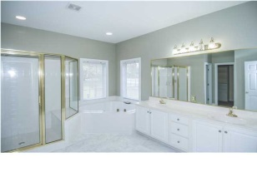
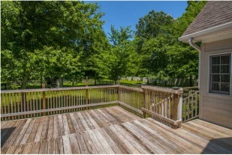
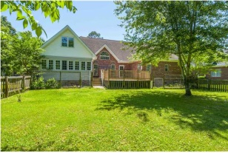


3708 Colonel Vanderhorst Cir Dunes West ~ Mount Pleasant MLS# 1408467 ~ $535,000
Estate-sized Lot in Gated Golf Community
This home invites the executive home owner looking for that estate-sized lot and special setting in a gated golf course community, as easily as it beckons the active family with children. A 1.05 acre lot, golf course and wooded back setting, large fenced back yard space, your own storage shed, and more are all good reasons to own this home. Stately curb appeal and very livable interior spaces make this a home that fills many needs and desires. The professionally remodeled kitchen space ( October 2012) is fine for the active family or the true gourmand, with gas cooktop, great appliances, pull-out kitchen cabinet shelves, granite counters and more. The spacious master bedroom (MBR) with tray ceiling includes a large separate sitting area (current owner used as a nursery) as well as walk-out deck access. The MBR bathroom has a jetted garden tub, separate shower, double-sink vanity and large walk-in closet. All the bedrooms are generously sized and have good closet space. Previous owners expanded useful living space approximately three years ago by adding a comfortable, casual sun room off the kitchen and living room at main floor level. That created a second story bonus space of considerable size off the upper media room; enjoy in any one of several ways – office, bedroom suite, crafts space, or as you wish…a very nice flex space. Outside, the oversized back deck overlooks a very spacious fenced back yard replete with a great children’s play set beneath mature trees. Beyond, you have the tree buffer and golf course setting, just past your own 10x12 storage shed. System upgrades of note include partial replacement of the heating and air conditioning systems in 2011 a tankless water heating system, and an economic separate water meter for the lawn irrigation system. Propane gas fuels the gas cooktop as well as the fireplace gas logs. Oversized two car garage with walk-out door has room for extra storage and a bank of cabinets is already in place. A clever high privacy fence designed by previous owner would benefit on-premises storage of a boat by the new owner should that be desired. Dunes West offers extensive amenities and options, including boat storage/ramp, exercise/pool/water park complex, a large tennis facility and two club houses. Welcome home!
Steve Rowe M – (843) 303-7438
srowe@carolinaone.com

