Slide 1
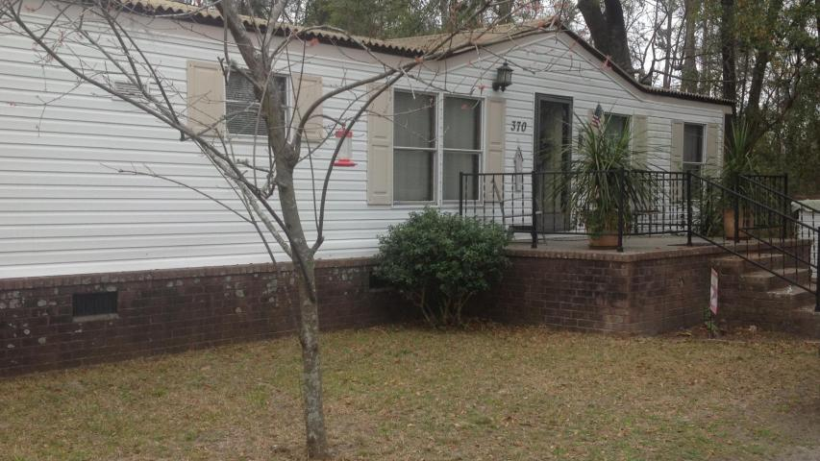
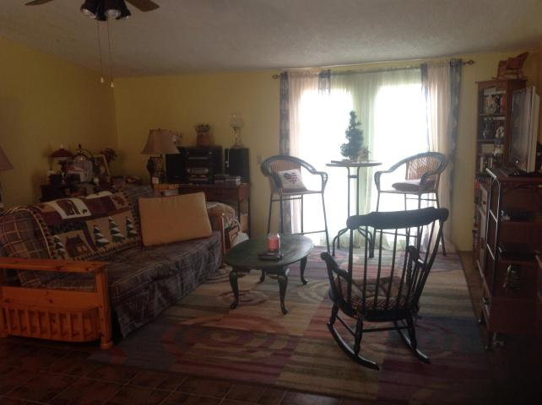
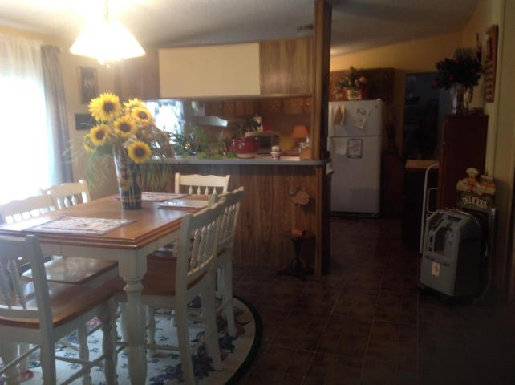
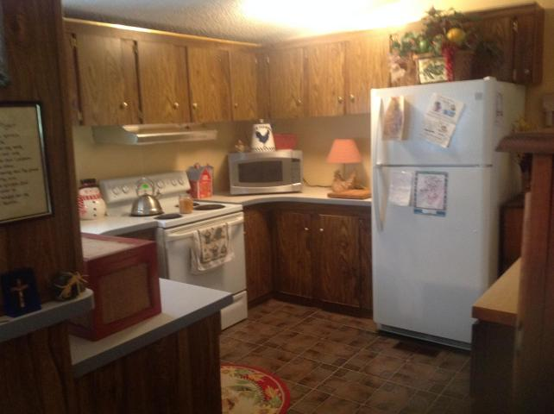
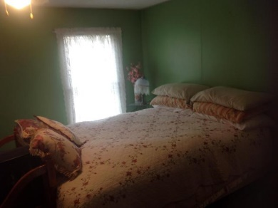
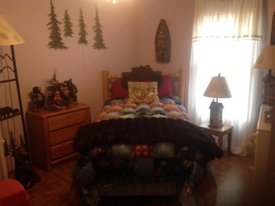
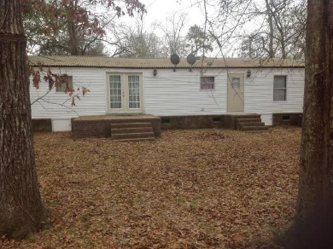
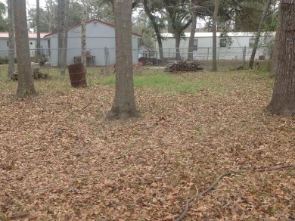

Just Minutes Away From Lake Marion
And Public Boat Landings!
370 Sinkler Avenue
Eutawville, SC 29048 | MLS# 17005809 | $69,900
3 Beds | 2 Baths | 1,248 Square Feet
Three bedroom, two bathroom mobile close to Little Cathead Boat Landing!
Property has nice sized lot with fenced-in backyard, with a large kitchen and dining room combo!
Call today to make your appointment!
Carla C Davis
Mobile - (843) 437-4873
gaweber@tds.net
AgentOwned Premiere Group
141 A N. Main Street
Summerville, SC 29483

