Slide 1
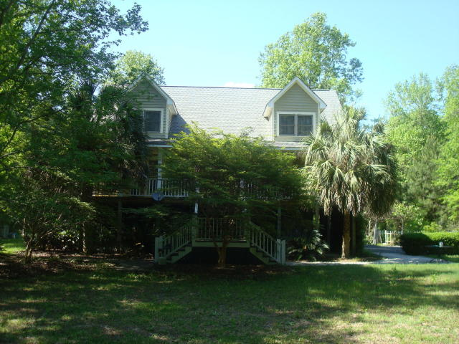
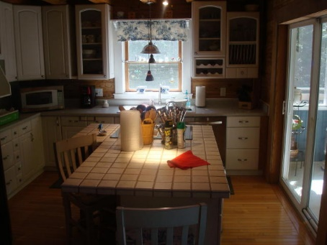
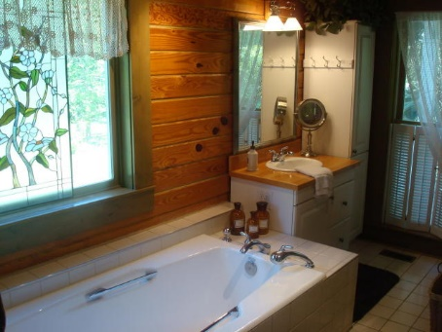
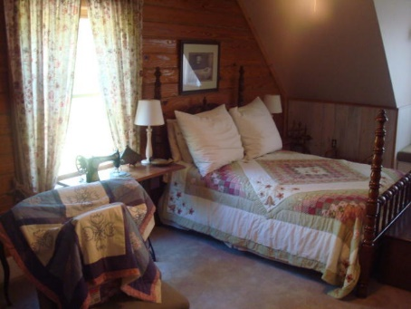
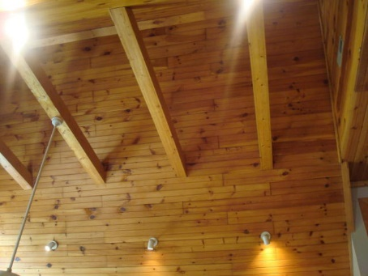
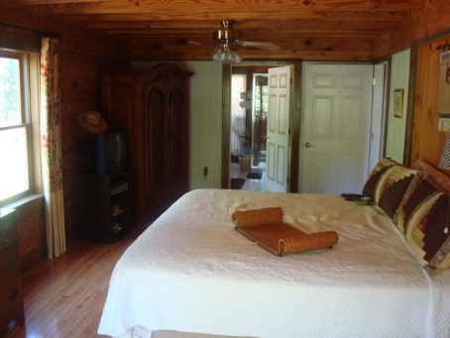
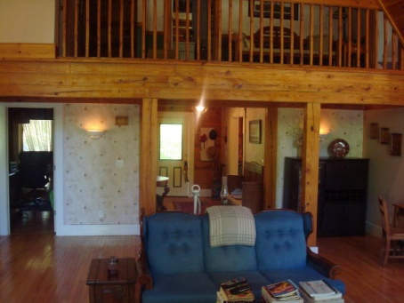
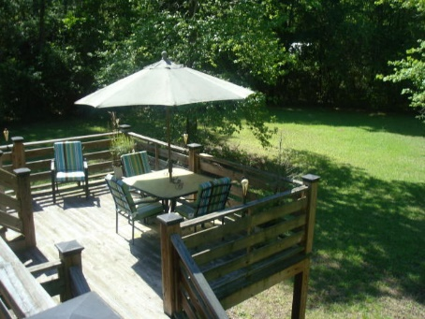
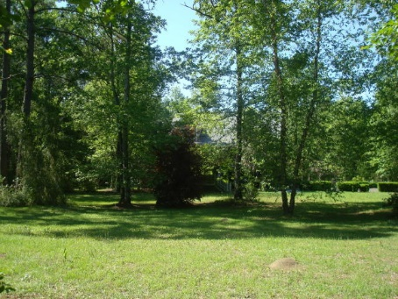
~ Lots of Privacy ~
1.5 Acres include 2 buildable lots
370 Society Road
McClellanville, SC 29458 | MLS# 15011108 | $380,000
Lots of privacy! The home sits off the road and is surrounded by trees. As you enter the home you immediately notice the warmth of all the wood...Oak floors and pine beams and ceiling. The wide entrance foyer opens into a large living/family room that has a cathedral ceiling that’s 30ft high with wood and glass. To the left as you enter is a very large dining room that overlooks the front porch with 6ft tall windows. Between the dining room and kitchen is a pantry with a stackable washer and dryer. The kitchen has a stainless steel refrigerator and dishwasher, plus a cooking island with flat top range, breakfast bar, and cabinets underneath. Adjoining the kitchen is a glass slider that enters onto a second rear patio which connects to a multi-tiered deck which overlooks the rear yard. Also, on the first floor is the large master bedroom with oak flooring...Beamed ceiling and lots of light...You can also access the rear deck from the glass sliding door. The master bathroom is bright and has lots of natural light plus a huge tub and glass enclosed shower. Adjoining the master bedroom is and area currently being used as an office that was designed to be the walk-in closet. Upstairs are 2 large bedrooms and full bath. On the homes exterior there is a covered front porch plenty wide for your rocking chairs and swing. The front porch also has an elevator so you can get from the parking area under the home to the first level without going up any stairs! The garage has plenty of room for 3 autos plus lawn equipment and workshop. Home has an elevator, the master bedroom is on the main floor, large rooms upstairs, garden outside with a picket fence and mature blueberry bushes and an arbor with mature kiwi fruit. Over an acre of land.
Rick Willis
843-327-3017
rwillisteam@gmail.com
The Group, LLC

