Slide 1

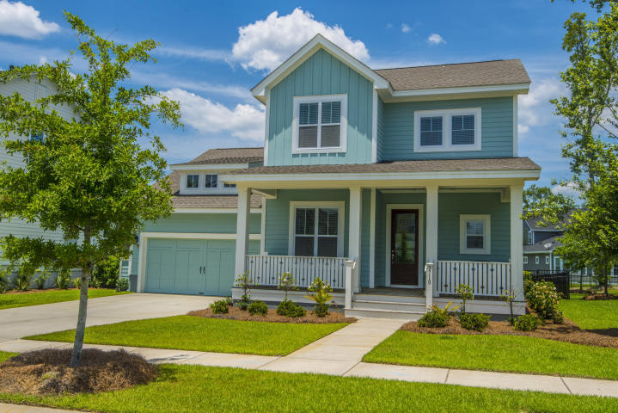
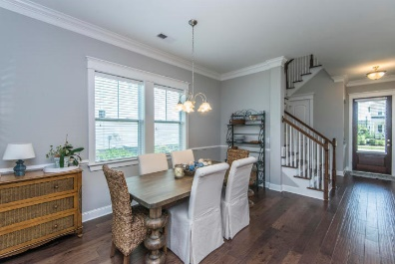
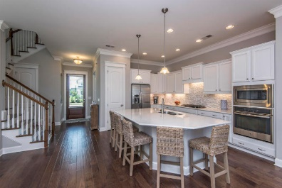
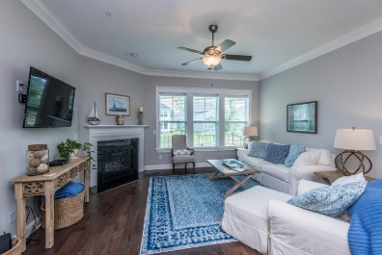
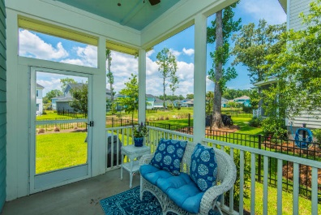
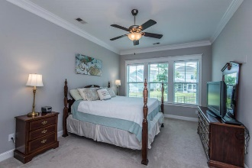
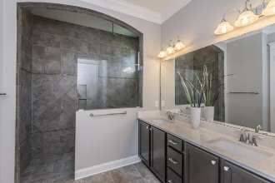
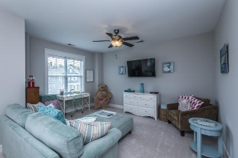
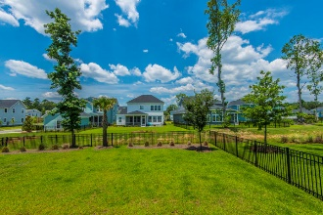
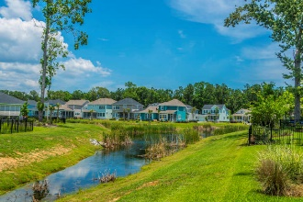
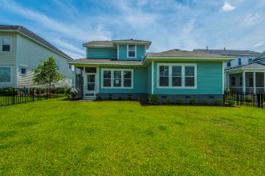


3710 Gambrill Lane ~ Carolina Park ~ Mount Pleasant
Shows Like A Model Home
Coastal cottage styling, from the serene colors, to the vertical hardi-plank siding, this charmer will have you sitting on your front porch dreaming of the shoreline! Step inside and notice the coastal inspired details that continue throughout the home. Dark hardwood floors provide an anchor for the light and airy feel of this home and custom details, such as the art niche in the foyer, speak to the thoughtful finishes throughout. Just off of the foyer is a flexible space with glass paned French doors, perfect as a home office or study. The rear of the home expands into a wide open floor plan that is as ideal for entertaining as it is for everyday family life. The gorgeous chef's kitchen features white shaker style, staggered top custom cabinets with beautiful Cambria quartz countertops, gas cooktop, wall oven with microwave and a huge center island. The island is the heart of the kitchen and offers more than enough space for friends to gather around or children tocomplete homework while you prep the evening's dinner. The kitchen flows seamlessly into the dining area, large enough to accommodate a table big enough for holiday celebrations, yet cozy enough for everyday dining. The family room features a focal-point fireplace and the entire space is filled with natural light and accented with multi-piece crown moulding. The master retreat is conveniently located downstairs and offers a gorgeous en-suite bathroom and walk-in closet. You'll love the luxury hotel-styled bathroom features such as the walk-in, oversized shower complete with both rain head and traditional shower heads The spa-like bath also features a beautiful dual vanity and private water closet. Upstairs, you'll love the flexibility of the loft area, ideal as a playroom, game room, secondary family room, man-cave... the possibilities are endless! Two additional bedrooms share a full bathroom. The backyard is fully fenced and an ideal spot for kids and pets to frolic while you watch from the shade of the screened-in porch! Enjoy watching the egrets fish for supper in the pond located just beyond the fence. Located in desirable Carolina Park, you'll have access to luxury amenities such as a resort style swimming pool, tennis courts, children's play park, dog park, miles of walking/jogging trails, and a 20 acre lake with boardwalk and kayak launch. The new Carolina Park Elementary opened this year to join Wando High School, Wando Center for Advanced Studies, Oceanside Academy and the Pre-K Children's Center. In addition, a brand new public library is slated to open later this year.
Asking $516,500
MLS# 18016303
2,372 SqFt
3 Bed/2½ Baths
Close to beaches, dining, shopping and historic downtown Charleston
Don Dawson 843-514-0452 ddawson@carolinaone.com Carolina One Real Estate • 2713 Highway 17 North • Mount Pleasant, SC 29466
www.TeamDawsonSC.com

