Slide 1
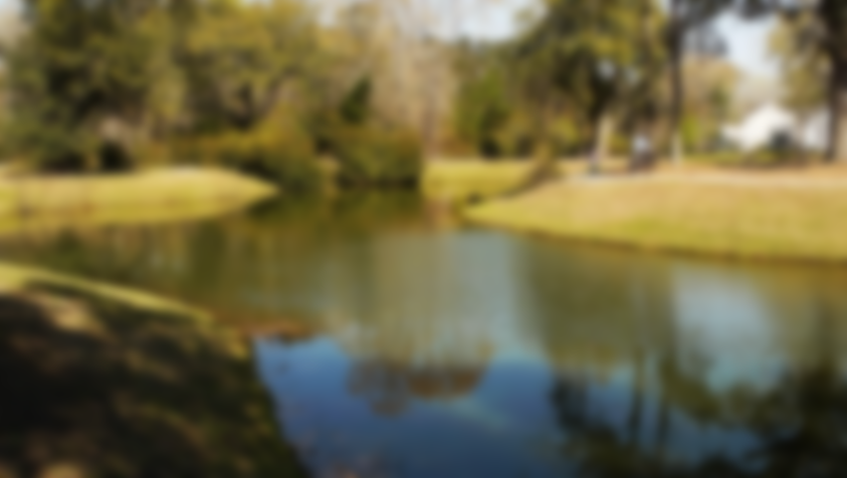
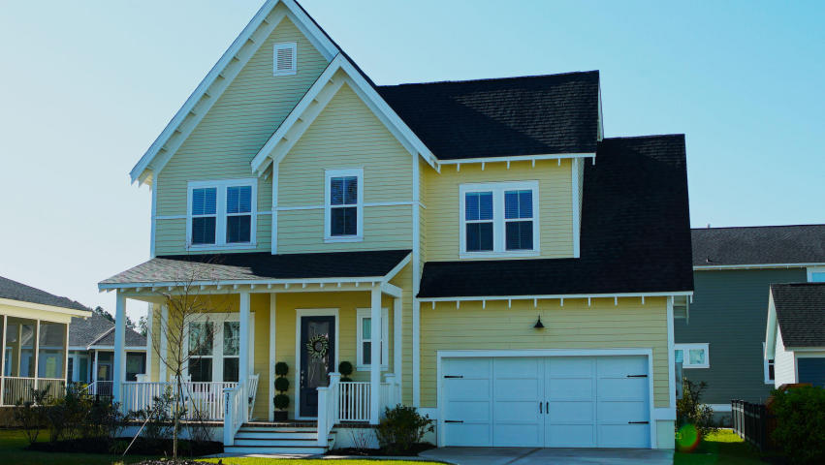
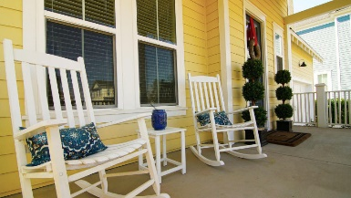
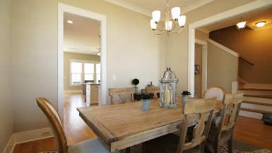
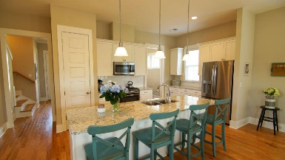
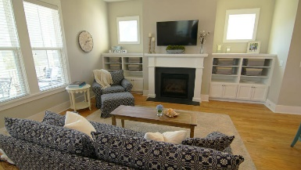
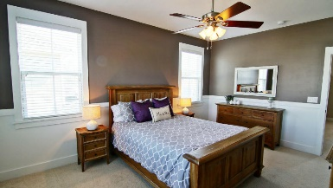
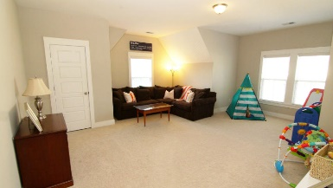
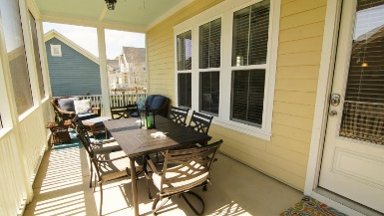
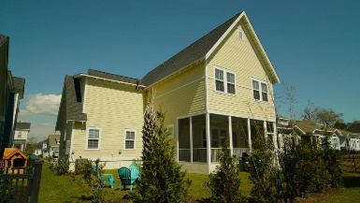


New Price in Carolina Park
3711 Gambrill Lane Mount Pleasant, SC 29466 ~ MLS# 18006885 ~ $534,900
Situated in a picturesque setting on a tree lined street in Carolina Park is 3711 Gambrill Lane. This impressive Saussy Burbank home boasts superior craftsmanship and wonderful architectural detail. Built in the popular Farmhouse style this home features 4 bedrooms and 2.5 baths and gleaming hardwood floors throughout the first floor. The front porch is charming and welcoming and leads to an inviting entryway flanked by the formal dining room or den/office space. Straight back you will find the open concept kitchen and family room area. The kitchen is a chefs dream with shiny subways tiles, granite countertops and upgraded cabinetry. The family room is bright and open with lots of windows and natural light. The center piece is a gas fireplace with a large mantle and built in bookshelves.
The large master bedroom and bath features dual vanities, a separate garden tub and shower, as well as a spacious walk in closet. Three additional bedrooms, a large loft area, and laundry room complete the upstairs.
This home has tons of storage and the owners have built additional elevated storage in the garage. The screened porch is framed with Bahama shutter and is perfect for family dinners or just relaxing with a glass of sweet tea. This home sits on a large lot with trees and updated landscaping for added privacy. Carolina Park is a family oriented community with miles of walking trails, an Olympic sized pool, community pavilion, dog park, and soon to be completed Bolden Lake recreational area. Live just minutes from the beach and Charleston; voted as the BEST city in the world for three years in a row!
Jimmie Johnson (843) 469-7307
jimmie.johnson@agentownedrealty.com
jimmiesellscharleston.com
AgentOwned Preferred Group
824 Johnnie Dodds Blvd | Mt Pleasant, SC 29464

