Slide 1
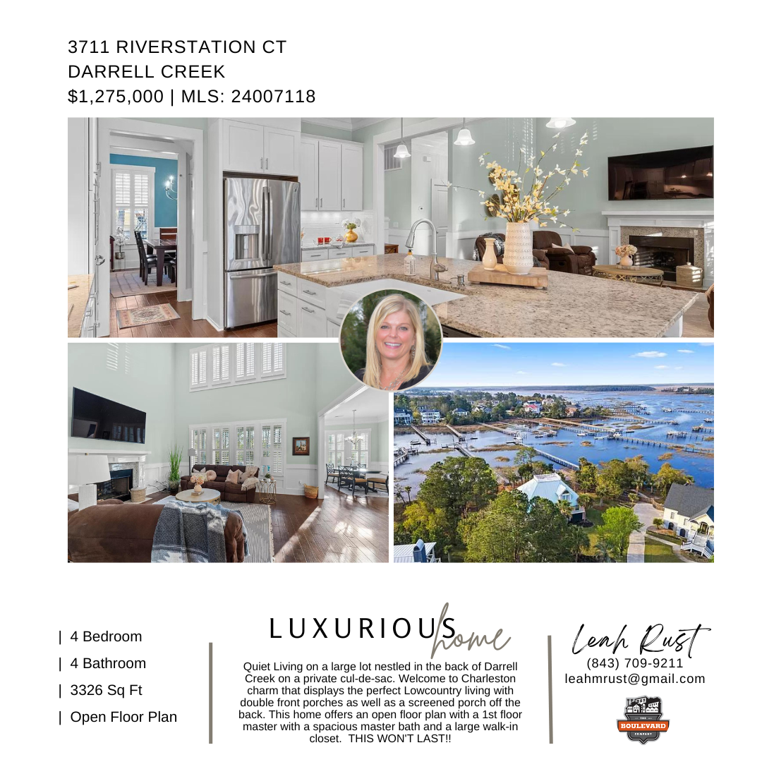
Private lot on Cul-de-sac

