Slide 1
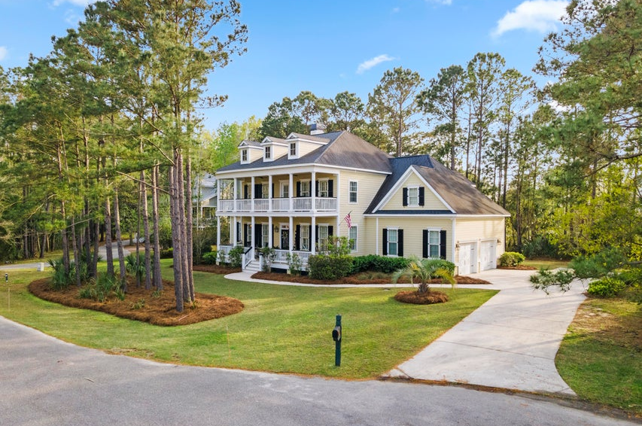
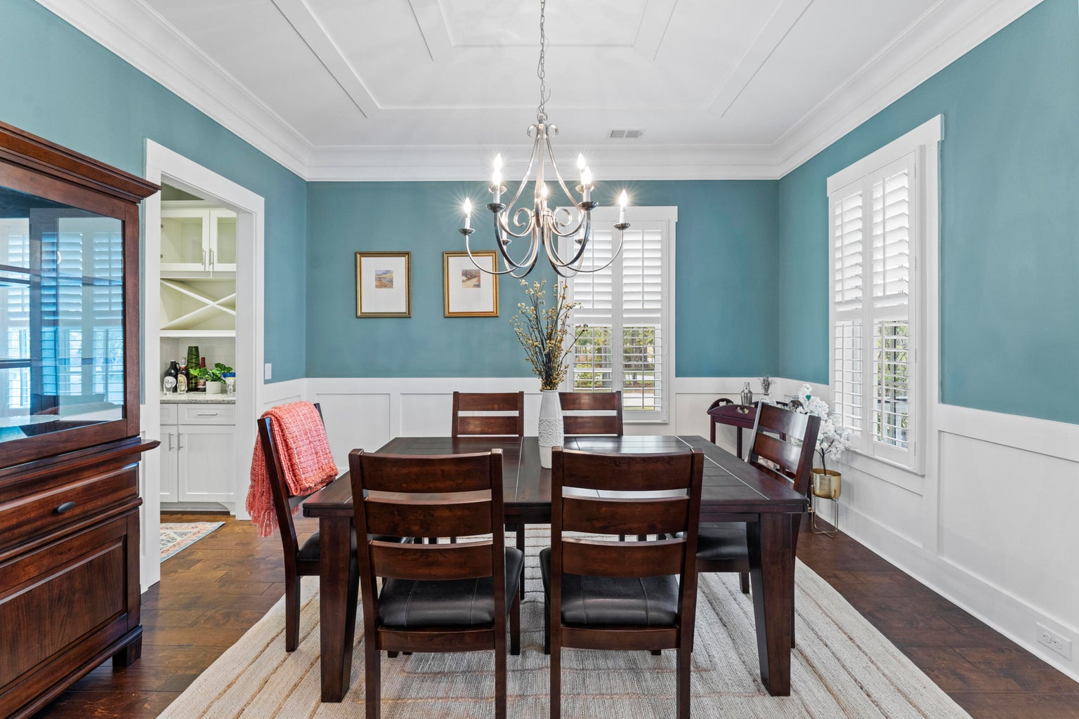
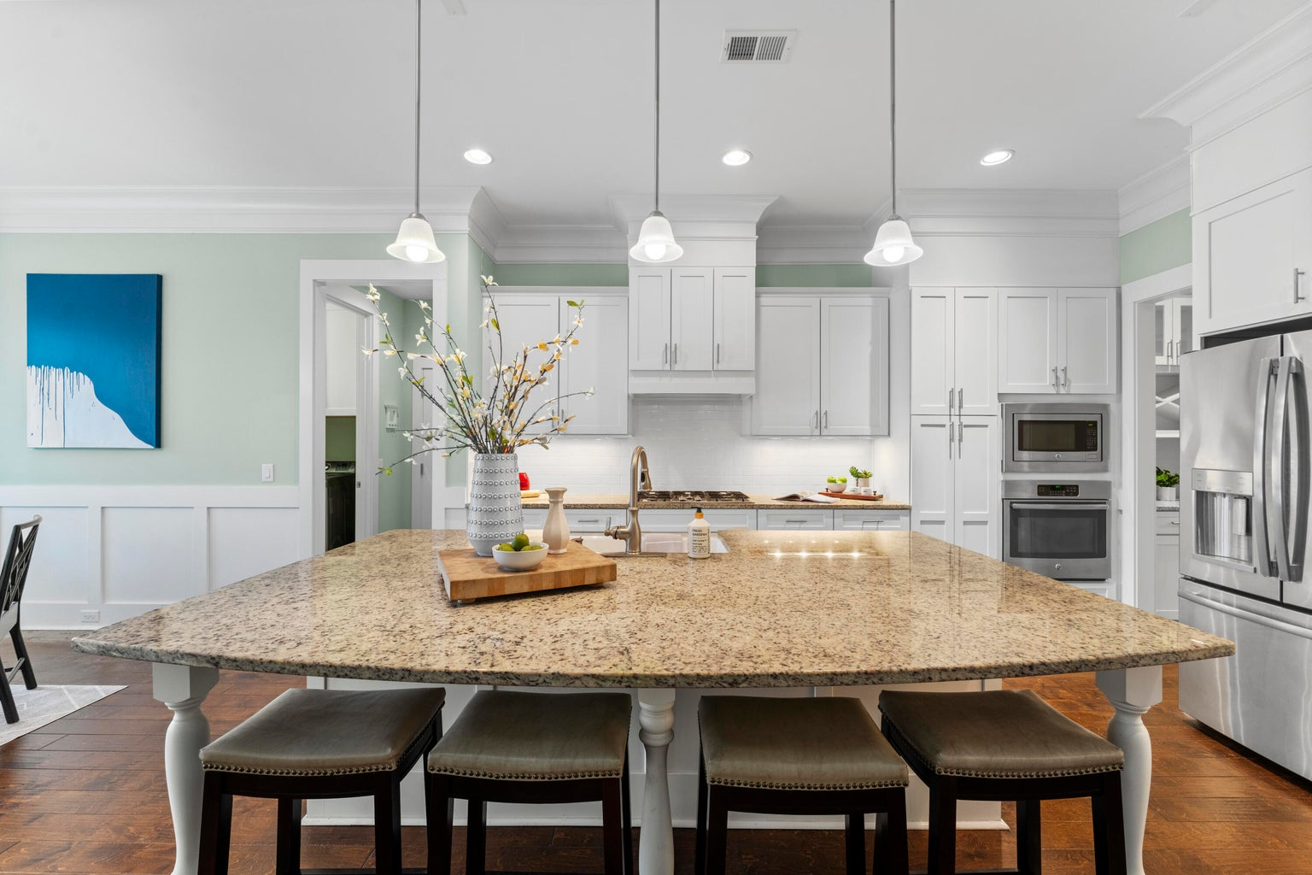
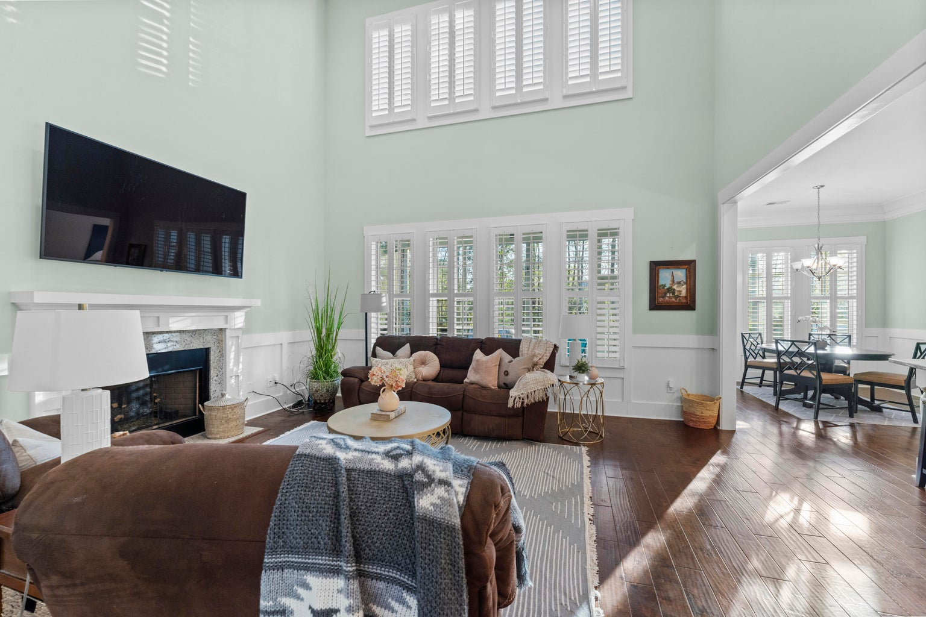
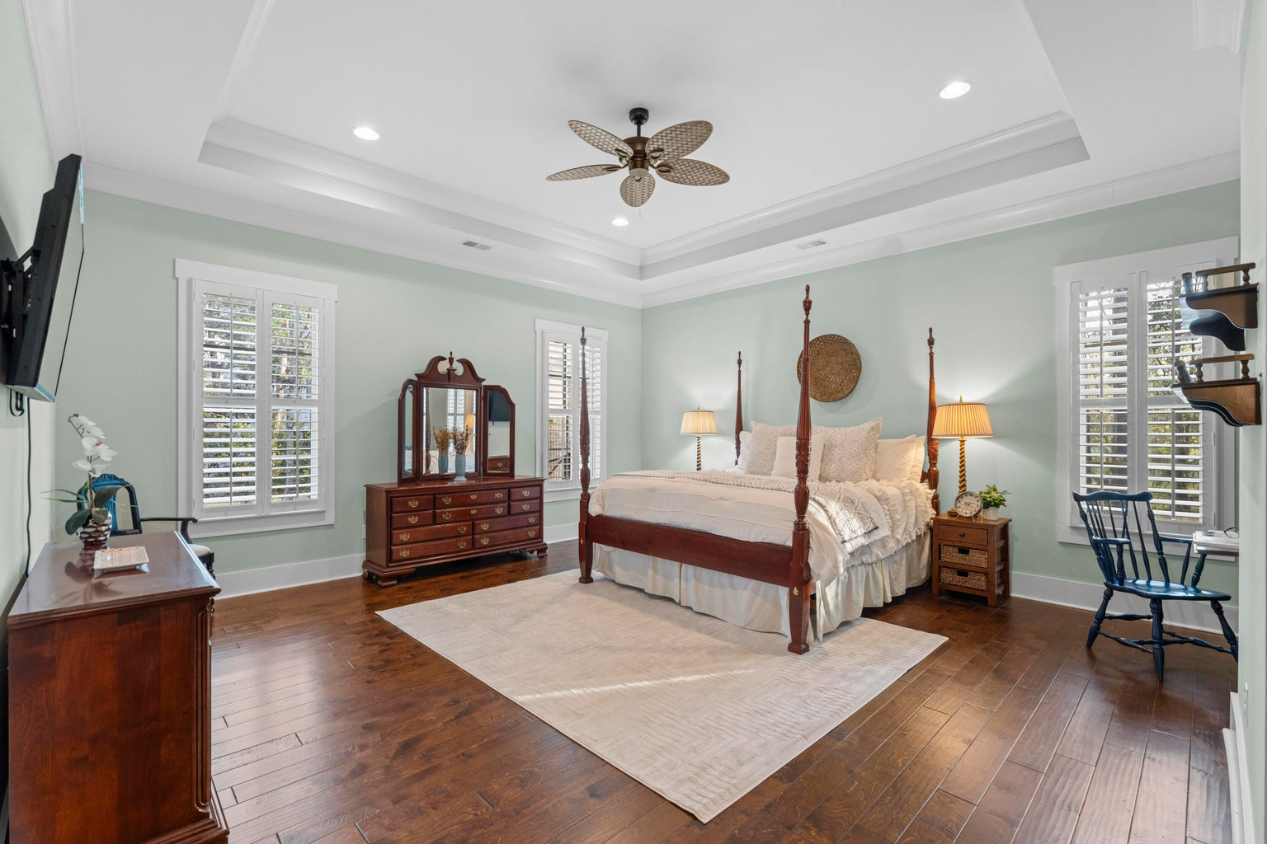
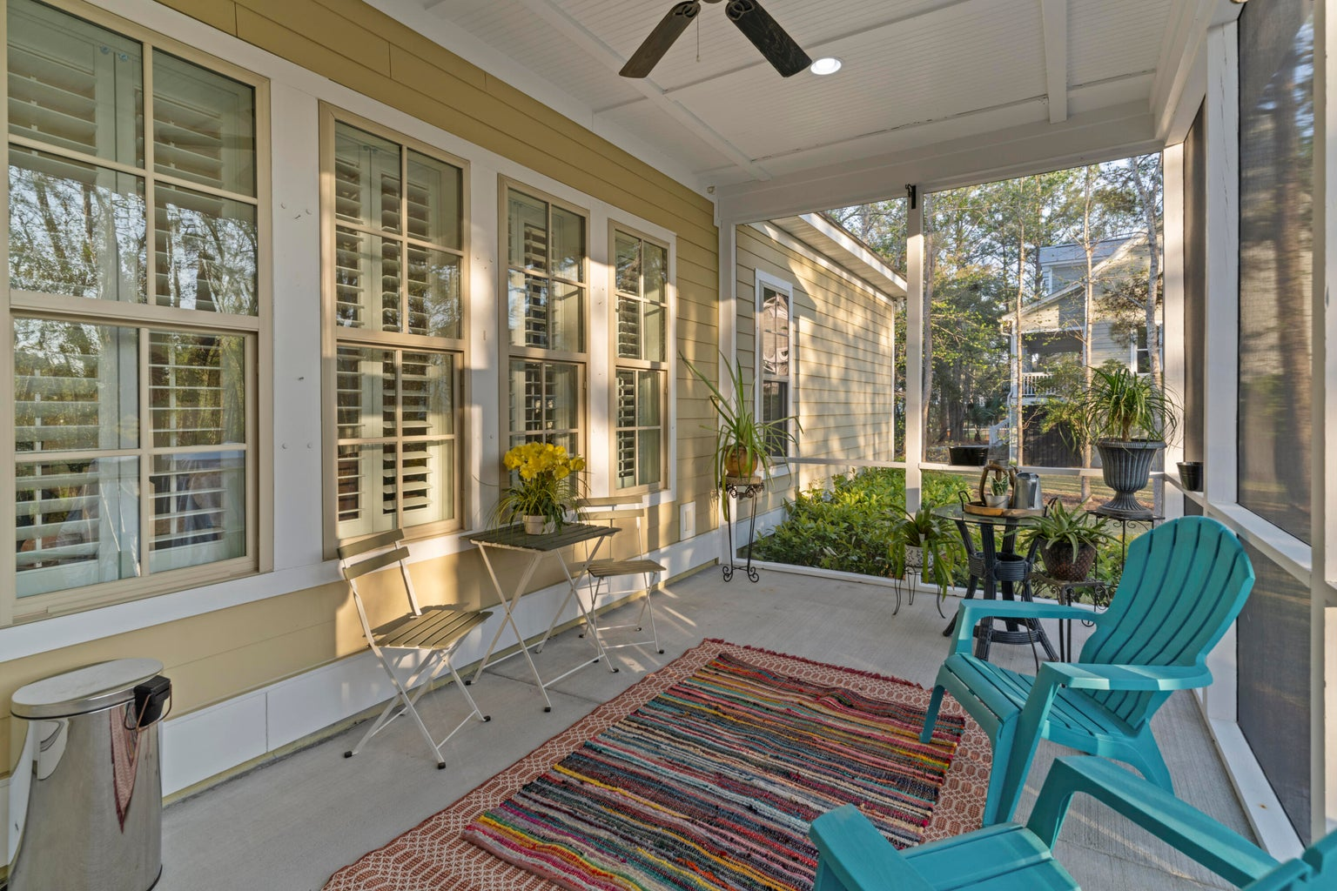
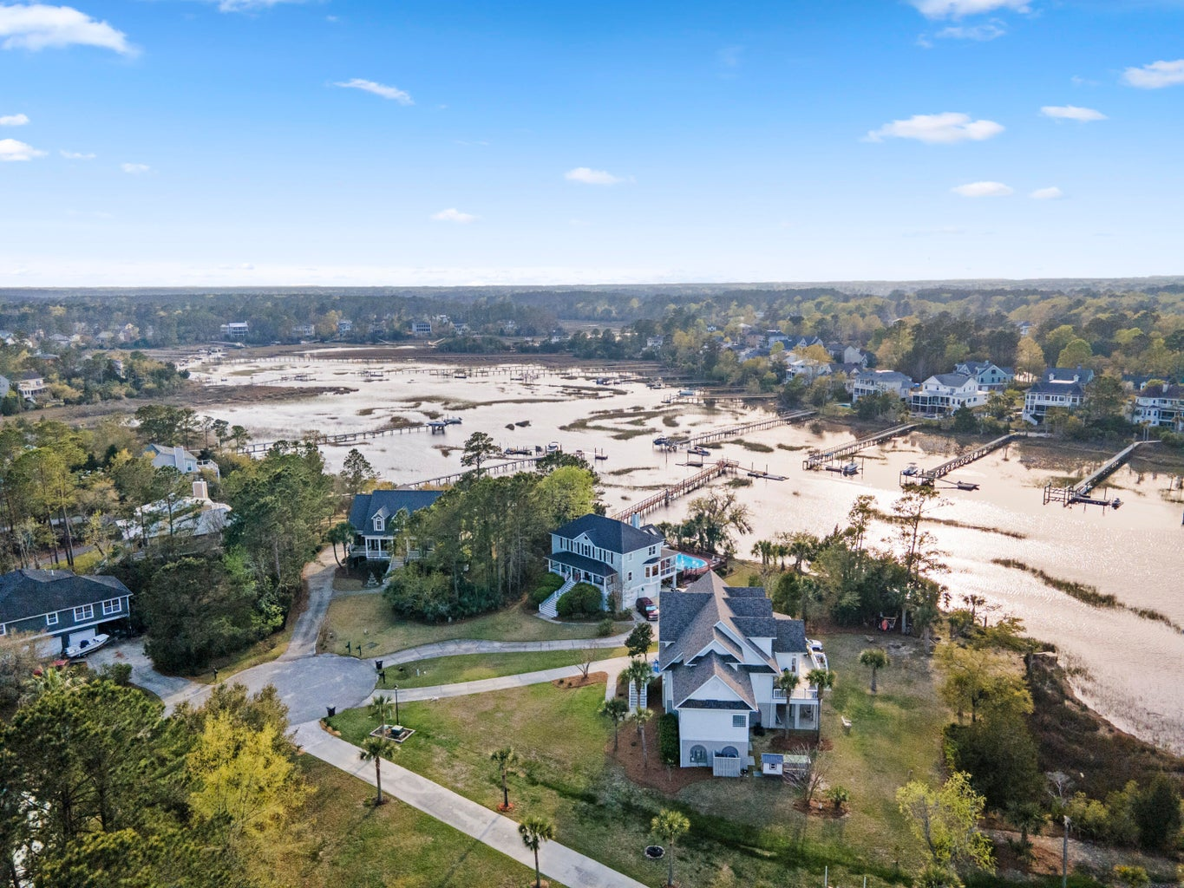
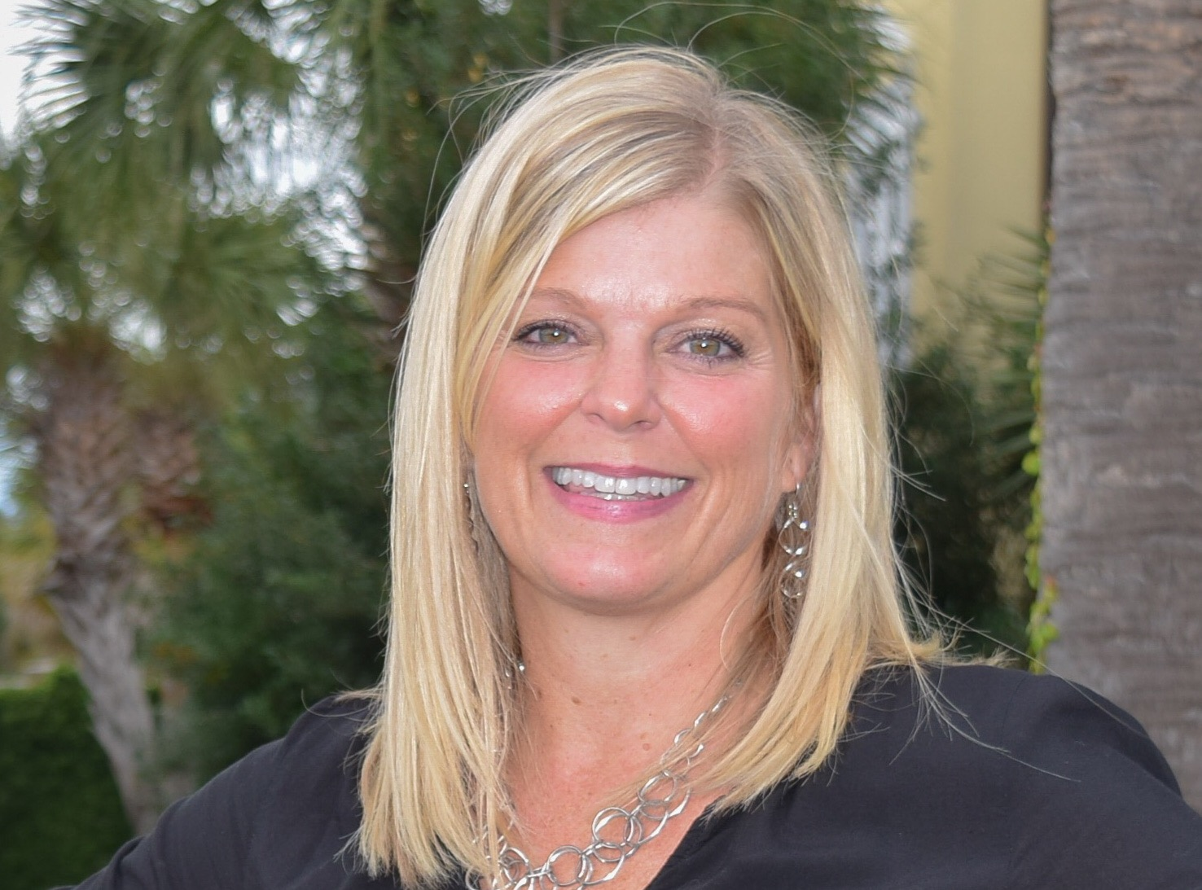

Move in Ready, Quick Close!
Quiet Living on a lot nestled in the back of Darrell Creek on a private cul-de-sac.
3711 Riverstation Ct
Darrell Creek
Mount Pleasant, SC 29466
MLS# 24007118 | $1,264,000
4 Bed | 3½ Bath | 3,326 SF
Welcome to Charleston charm that displays the perfect Lowcountry living with double front porches as well as a screened porch off the back. This home offers an open floor plan with a 1st floor master with a spacious master bath and a large walk-in closet. Upon entering the home you will notice the precious hardwood floors, classic wainscoting with a formal dining room off to your right that leads to a butlers pantry and walk in pantry. The modern kitchen offers white cabinets, gas stove, stainless appliances and a large island with bar stool seating. Head upstairs and you will have 3 additional bedrooms ( one could be considered a 2nd master),a loft and Plantation Shutters. Perfect location for a family with children wanting to be close to Wando High School as well as the schools in Carolina park, just a short 3-5 minute drive. Come Check out this beautiful, well maintained home on a larger more private lot than most of the newer neighborhoods. At night relax on the front porch and watch the sunsets of Darrell Creek.
Leah Rust
The Boulevard Company
806 Johnnie Dodds Blvd.
Mount Pleasant, SC
leahmrust@gmail.com
843-709-9211

