Slide 1
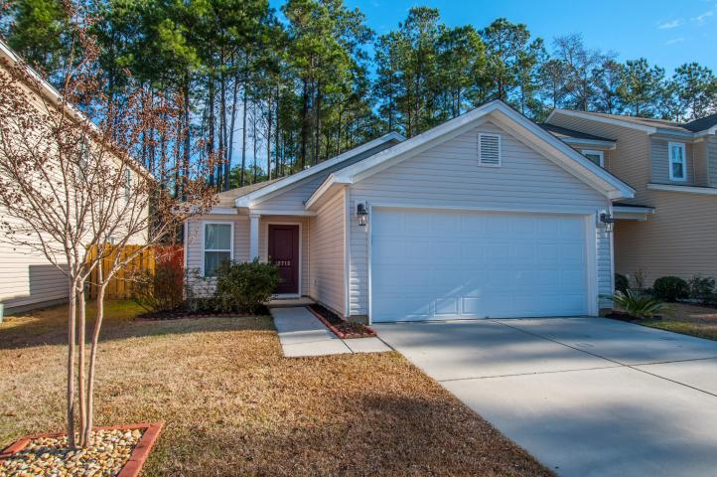
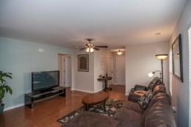
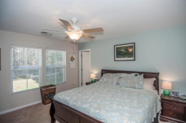
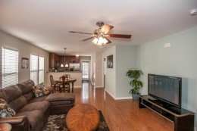
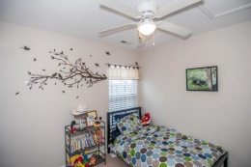
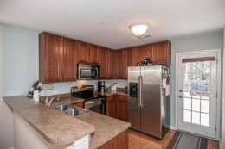
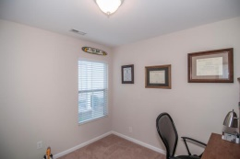
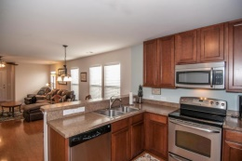
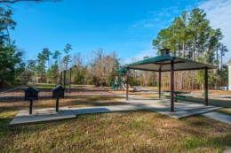


1 Story Jewel!
Excellent location!
3712 Crescent Way
Wellborn Village
Ladson
MLS# 15000720
$145,000
Such a pretty entryway into this very open one story 3 bedroom 2 bath home. The large master suite offers a walk in closet, a garden tub/ shower combination, and double bowl vanities for your convenience. Enjoy entertaining outdoors on the patio & great back yard complete with raised planting garden for homegrown veggies or flowers. Some of the other features included in this home are upgraded cabinets, beautiful floors, and stainless steel appliances. Large laundry room w/custom installed cabinetry storage. 3rd bedroom can be office or study. Neighborhood has wonderful outdoor space for family play, powerwalks or strolls. Location is close to Boeing, shopping & historic plantations & gardens. Ask your agent to put this home on your ''must see'' list today!
Sheila Romanosky
(843) 224-0242
sromanosky@carolinaone.com

