Slide 1
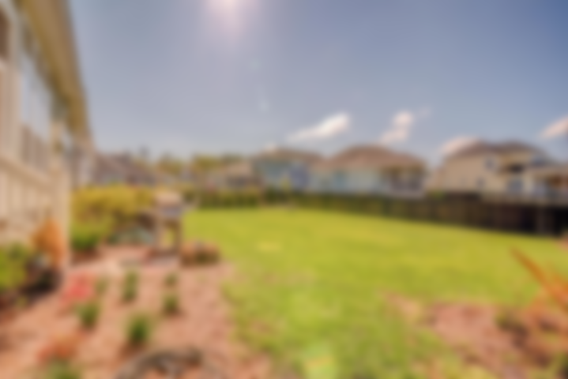
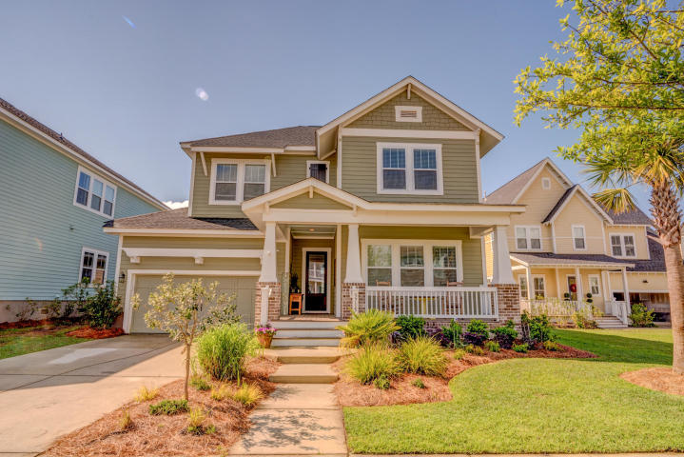

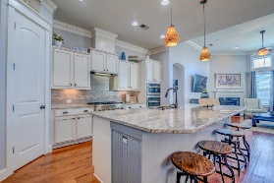
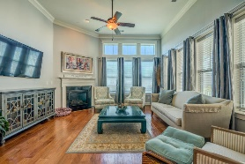
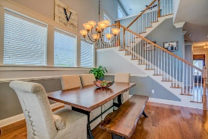
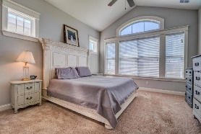
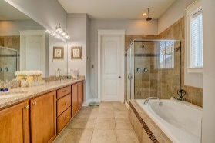
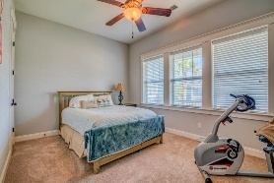
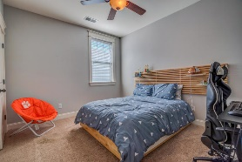
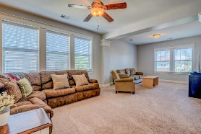
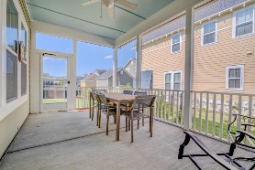
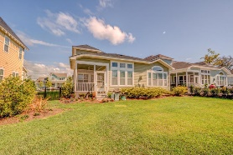


Open House April 20th 12-2p
3715 Gambrill Lane
Carolina Park | Mount Pleasant | MLS# 19010590 | $619,000
Highly sought after Whitham plan in the Village of Carolina Park offers 4 bedrooms, 4 bathrooms, downstairs owners suite with downstairs guest room and full bath. The open floor plan allows for plenty of natural light with tall ceilings and lots of windows. The upgraded kitchen features large center island, granite countertops, tiled backsplash, walk-in pantry, stainless appliances with upgraded professional cooktop & range, & soft close drawers. The family room has fireplace with gas logs and overlooks spacious fenced backyard. A home office with glass French doors is on main floor as is laundry/mud room. Downstairs owners suite overlooking backyard is spacious with huge walk-in closet and lots of storage.Large master bath offers dual vanities, garden tub, & separate water closet.
Rounding out downstairs is the screened back porch overlooking fenced backyard.
Upstairs, you will find the large loft/media room with large storage closet. There are 2 additional bedrooms and 2 full bathrooms (one is ensuite). Make sure to check out the huge storage spaces under the stairs as well as in the loft area. This home is ready for you to just move in and start enjoying life at 3715 Gambrill Lane. This home also features a tankless hot water system, Energy Star Appliances, and many custom upgrades throughout.
Carolina Park amenities include Junior Olympic size pool, playground, Pavilion with outdoor fireplace, tennis courts, Great Lawn, and dog park. It has sidewalks, bike paths and a trail system and offers over 380 acres of scenic marsh, parks and open space. There will be a future kayak/paddleboard launch at Bolden Lake. Carolina Park is conveniently located to local schools, doctors/hospitals, shopping, new public library, restaurants, beaches, and is just a short drive to Downtown Charleston. Live, work, learn and play in Carolina Park. Welcome home!
Lauren Courcoux
Mobile - (843) 224-8613
lauren.courcoux@carolinaone.com
www.laurendelucacourcoux.com
Carolina One Real Estate | 2713 Highway 17 North | Mt Pleasant, SC 29466

