Slide 1

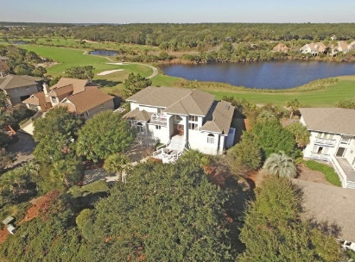
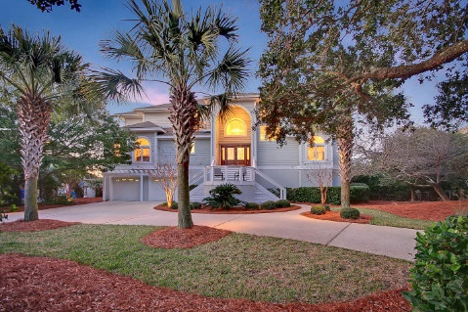
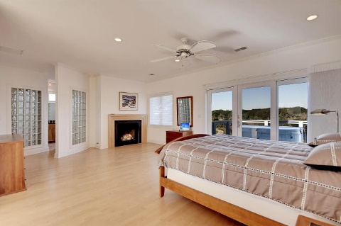
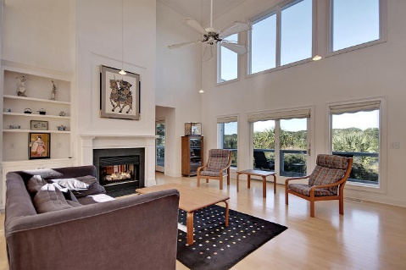
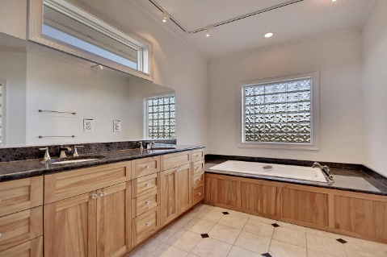
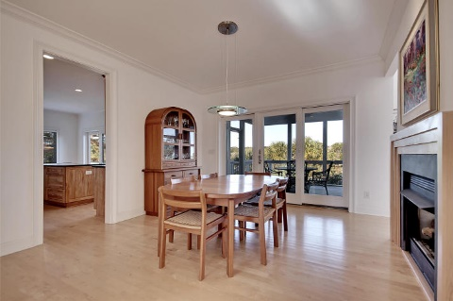
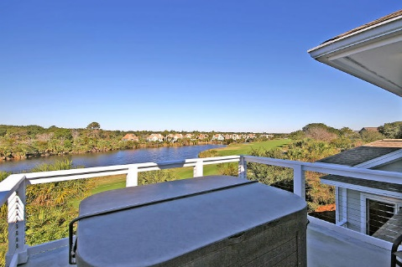
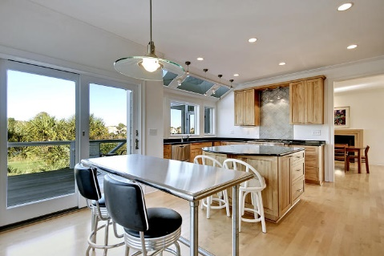
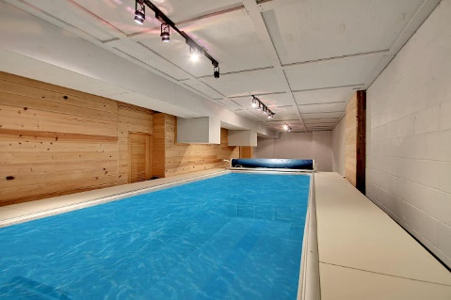
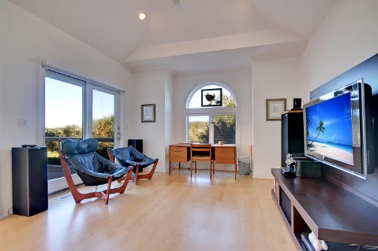
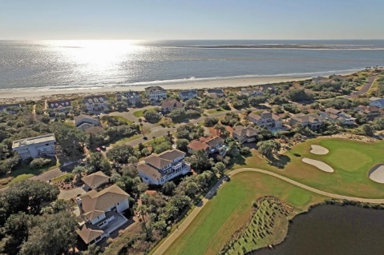

Steps to the Beach
3721 Seabrook Island Road
Seabrook Island, SC 29455 ~ MLS# 16000428 ~ $1,100,000
Step out the front door of this luxurious 3BR, 3.5BA home, cross the street and you’ve entered the direct pathway to one of the most beautiful beaches you’ve ever seen. Situated on one of the finest lots on Seabrook, this home backs to the golf course and lagoon and boasts ocean views from the balcony. The natural sunlight simply pours into this open floor plan which features a two story living room with a double sided fireplace shared with the dining room, hardwood floors, a gourmet kitchen, five separate outdoor living spaces, an infinity lap pool on the first floor as well as a workshop area. You’ll never want to leave this house once you come in, but if you must, the community pool, golf course and Seabrook amenities are very close by. This home in this location can’t be beat!
Additional features include:
Kitchen has Dacor SS appliances, center island, granite counters, built-in desk area
Recessed lighting
Surround sound
Kohler fixtures
Skylights
Built-ins in living room and media room/office
Palladian windows
Gorgeous laundry room with sink and built-ins
Elevator goes from garage to levels 2 and 3
Screened-in porch and 4 other decks make up outdoor living spaces
Professionally landscaped with lighting
Master bedroom has two decks, fireplace and walk-in custom closet
Master bath has dual vanity, glass block, soaking tub and walk-in shower with dual shower heads and body sprays
Book your showing today!
Nate Gainey nate@mattoneillteam.com 843-513-2038

