Slide 1
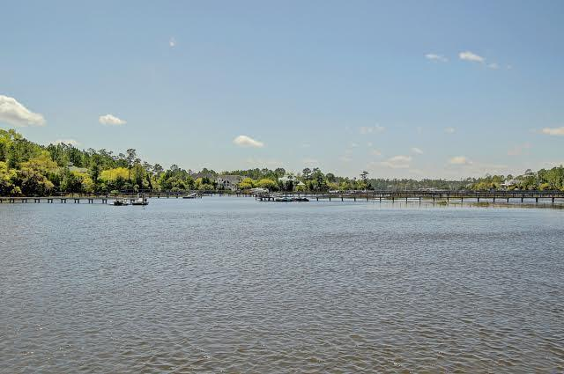
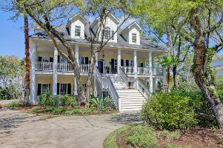
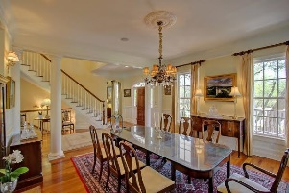




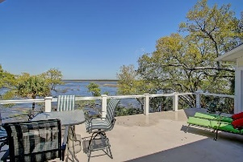
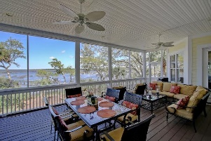
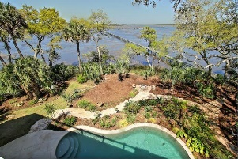
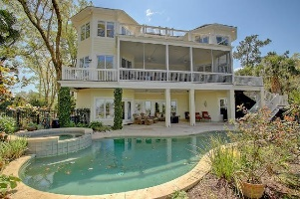


3721 Station Point Court Darrell Creek Mount Pleasant, SC 29466 MLS# 16008292 $1,675,000
Must See!! One in a million!!!
New Price!
Extraordinary home with sweeping views of the Wando River and the National Forest! This home was custom built with many exceptional features. The entry to this home welcomes you with a large front porch, that speaks of southern days sipping mint juleps. It is the ideal Southern property with all the charm and beauty of a Plantation home! The formal entry offers a picturesque view of the wide open waters, that appears to be a painting. The kitchen is open to the Great room with lots of natural light and custom mouldings. Lots of custom cabinetry, gas fireplace in Great room, Large spacious dining room providing lots of room for all those family parties and gatherings. Elevator to all levels, master bedroom on first floor with lots of views, double closets, master bath with large tile shower with whirlpool tub. Office or music room, exceptionally large screened porch that is accessible from the kitchen, Great room, and master bedroom. Beautiful wood floors throughout most of the living area. The downstairs offers a mother in law suite, kitchen, bath and separate bedroom. An additional recreational area is available that provides access to the lovely heated pool and attached jacuzzi. The area from the recreational room leads to a incredible pool side covered flex space that is great for entertaining and relaxing by the pool. This home features a shared dock, with a private floater and boat lift. This home is located on Darrell Creek with close access to the Wando River. 3 Car garage with work space and a full wine cellar for the wine connoisseur. Not to forget two dishwashers, two ovens, two laundry areas in the main house.
Darlene Smith Office - (843) 886-8110
Mobile - (843) 696-7824
darlenesmith@carolinaone.com
DarleneSmithTeam.com
Carolina One Real Estate
1503 Palm Blvd Ste
Isle of Palms, SC 29451

