Slide 1
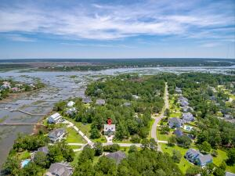
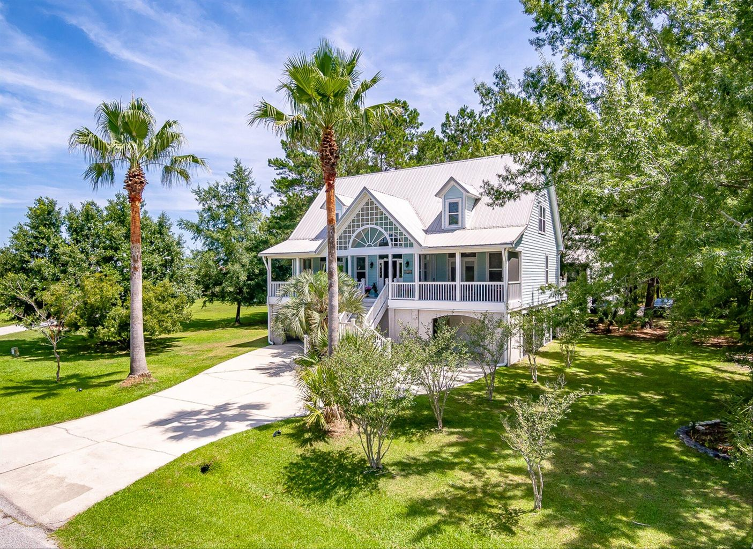
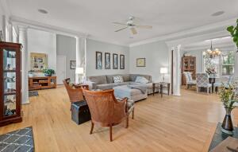
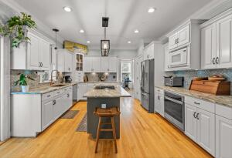
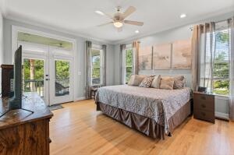
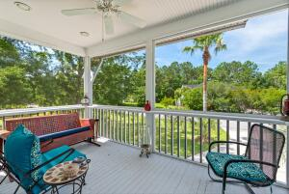
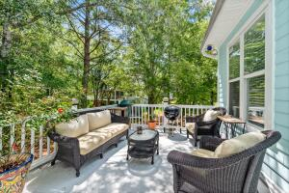
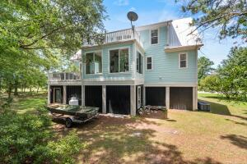


3722 Channel View Court Darrell Creek · Mount Pleasant, SC 29466 MLS# 22016335 · $925,000
NEW ON THE MARKET!
This bright and airy home has it all: 4 very large bedrooms , 3 full baths and a half bath, 2 screened in porches and 2 decks! Plus tons of outdoor living space. The elevated home offers a huge amount of storage underneath with plenty of space to park your vehicles, golf cart or whatever mode of transportation you may have. Freshly painted on the inside and tons of updates have been completed in this home including a new metal roof. The master bathroom has been remodeled and the master closet has been enlarged as well. The kitchen has had a beautiful facelift with new quartz countertops, new appliances, a new copper farmhouse sink and more! The owners have also removed all carpet and so the home has hardwood floors throughout!
Just beyond the family room is a screened in porch which is great for watching sunsets in the evening. The master bedroom is on the main living area and also has its own screened in porch. Upstairs you will find 3 very nicely sized bedrooms (you will be impressed). One of the bedrooms has an en suite bathroom, a huge walk in closet and additional cedar closet. The other two bedrooms share a hallway bathroom. The middle bedroom also has access to a second deck. The yard is a great size and it is considered a double lot. The extra lot sits to the right of the home if you are facing the home from the street. This space has a ton of potential for a pool, outdoor kitchen, etc. The sky's the limit! Darrell Creek is a great neighborhood with nicely spaced out homes with large lots. There is a community pool as well for residents to enjoy! Don't miss out on this opportunity to live in one of Mt. Pleasant's coolest neighborhoods!
Carey Nikonchuk
(843) 276-1701 M
cnikonchuk@gmail.com
www.palmettoproperty.net

